Slide 2
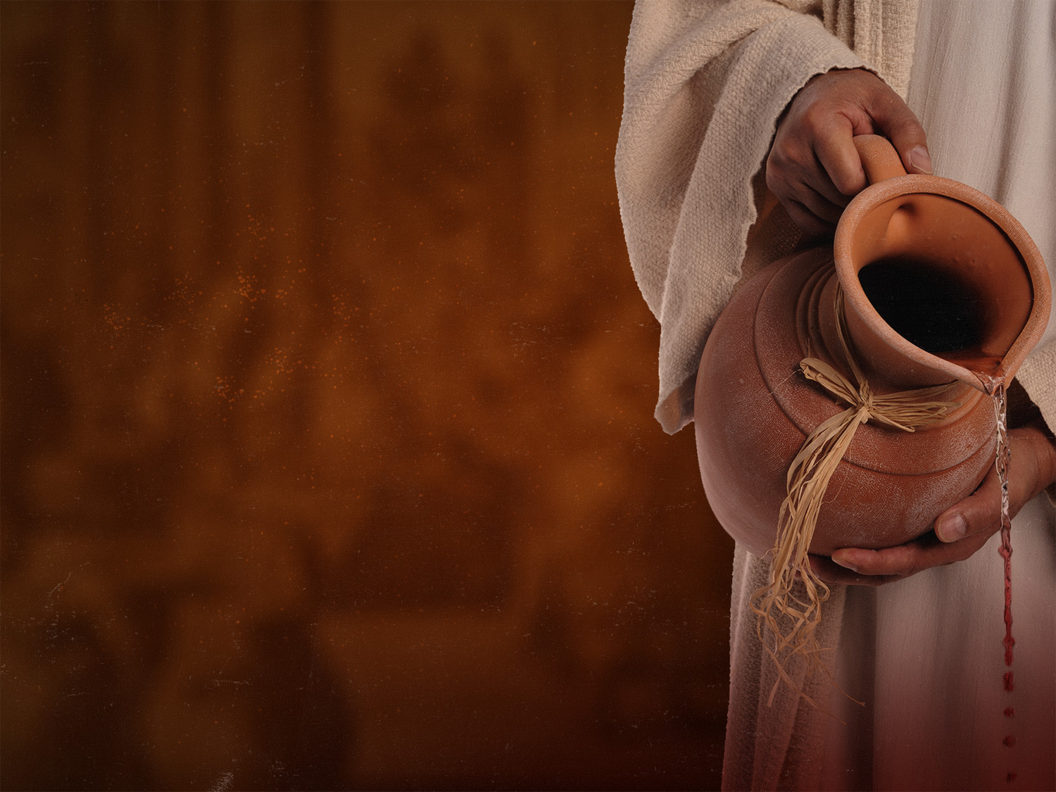
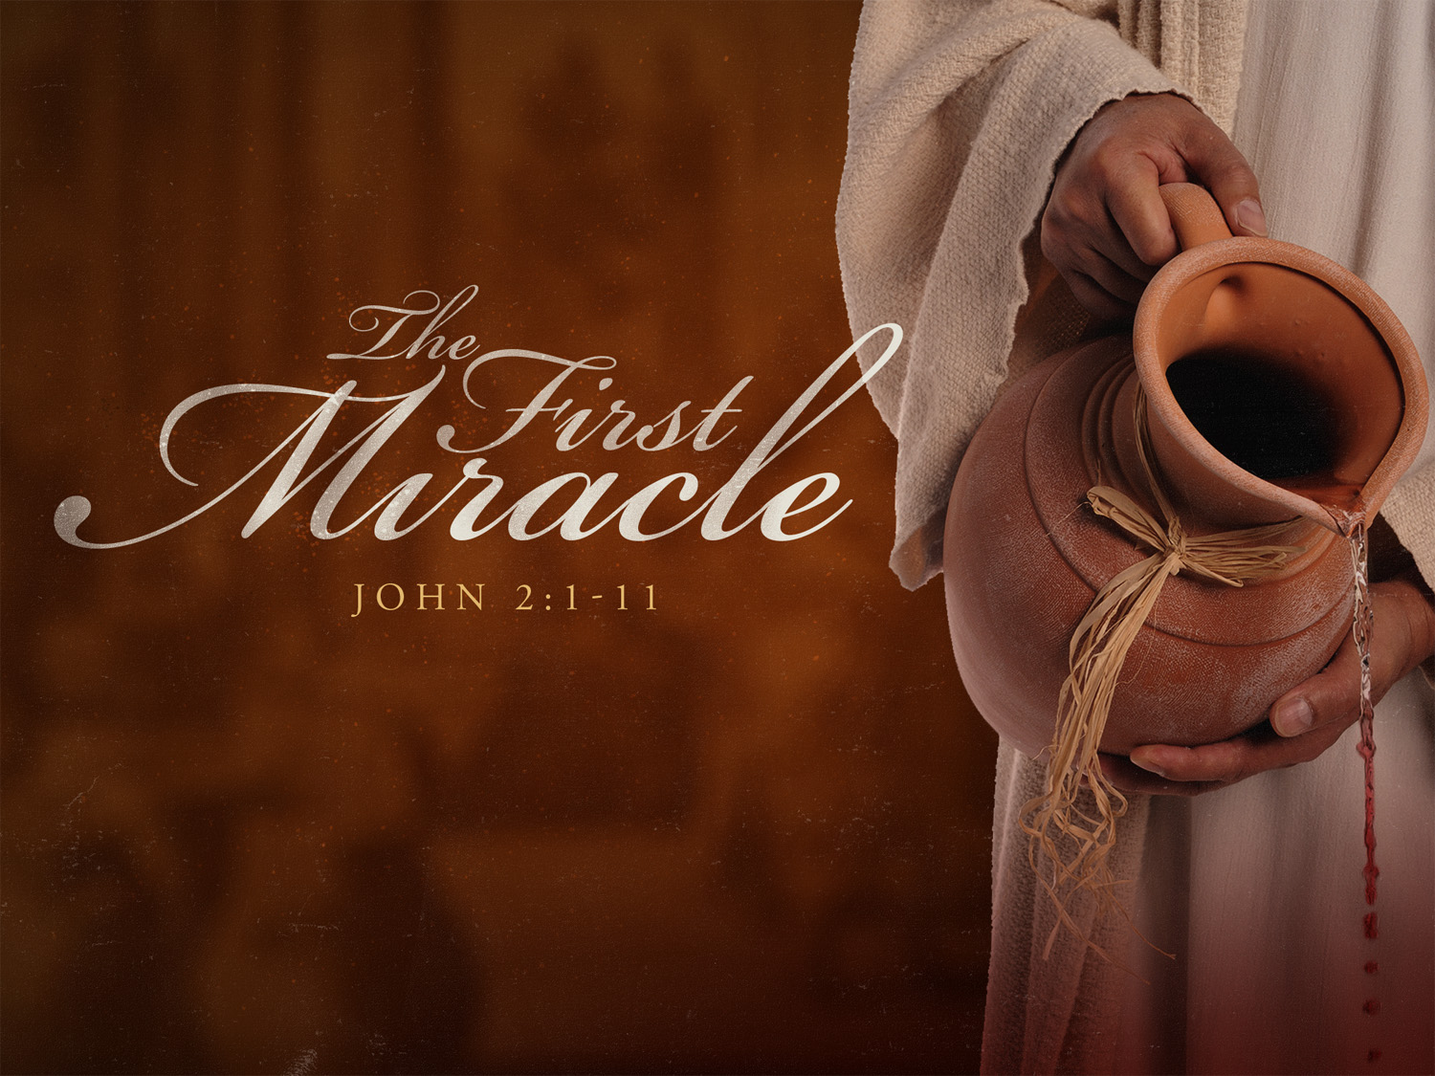

Slide 3
Obedient Son
John 2:1-4
John 5:17-19
John 8:28
Luke 11:27-28
Mark 3:32-34

Slide 4
Obedient Son
Ultimate Purifier
John 7:30
John 8:20
John 12:27
John 12:23-24
1 John 1:7
Matthew 26:27-28
John 6:53-56

Slide 5
Obedient Son
Ultimate Purifier
All-Providing Bridegroom
John 3:29-30
John 2:9-10

