Slide 2
HERO

Slide 3
Heroes Of Faith
“A hero is someone who has given his or her life to something bigger than oneself”
(Joseph Campbell)
Three things define a HERO:
A willingness to take risks;
A willingness to step out of their comfort zone;
A willingness to make a difference in the world

Slide 4
My Heroes Are
Young people who stand in the valley of Elah and fight for the Lord
David 1 Samuel 17
Joseph Genesis 37-50
Maiden 2 Kings 5
Boys from Babylon Daniel
Timothy 2 Timothy 2:22

Slide 5
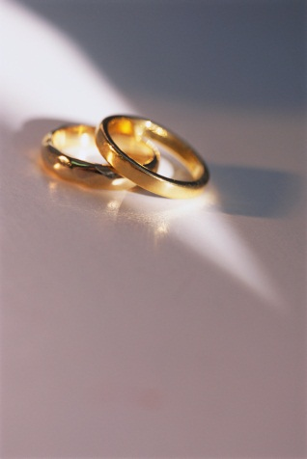
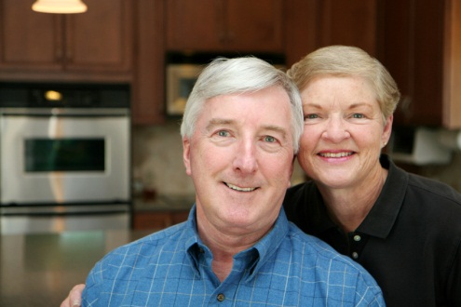
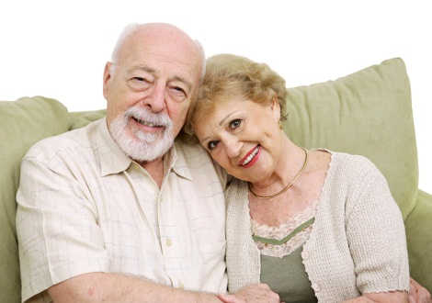
My Heroes Are
Couples who face the ravages of Satan’s onslaught with COURAGE
The successful marriage is not characterized by the absence of problems but the ability to solve those problems.
Hebrews 13:4
Ephesians 5:22-33 ; Colossians 3:18-19

Slide 6
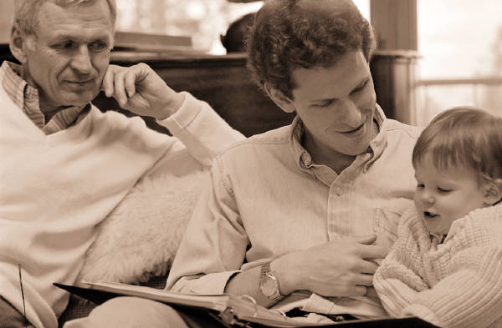
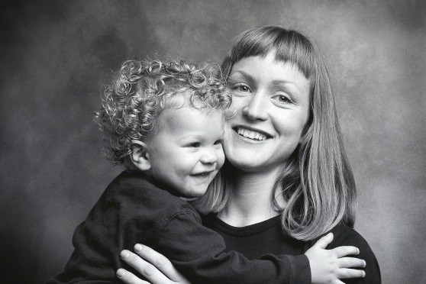
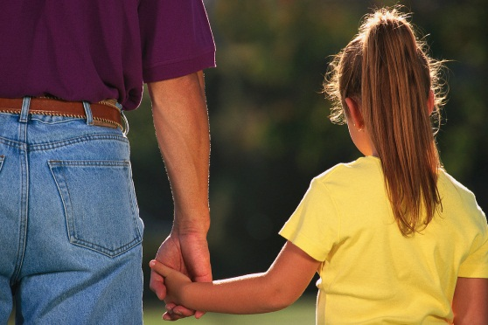
My Heroes Are
Parents who give no quarter to the influence of the world upon their children
Judges 13:8,12 Help …..
Daniel 6:10 Early days
2 Timothy 1:5; 3:15 Genuine faith
Genesis 7:13 No quarter given!

Slide 7
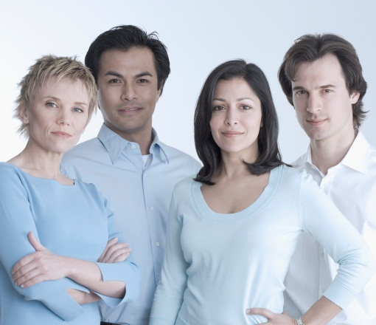
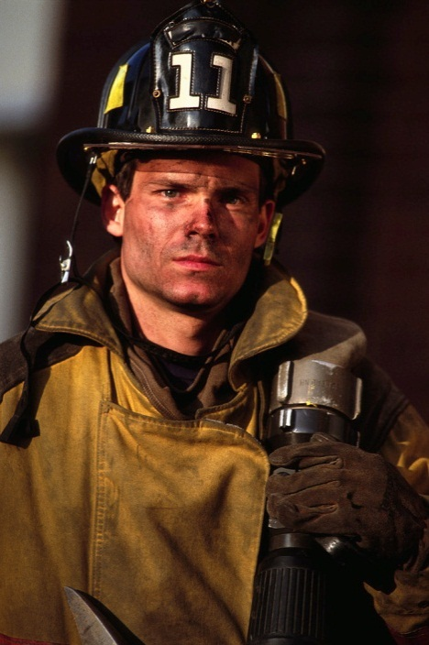
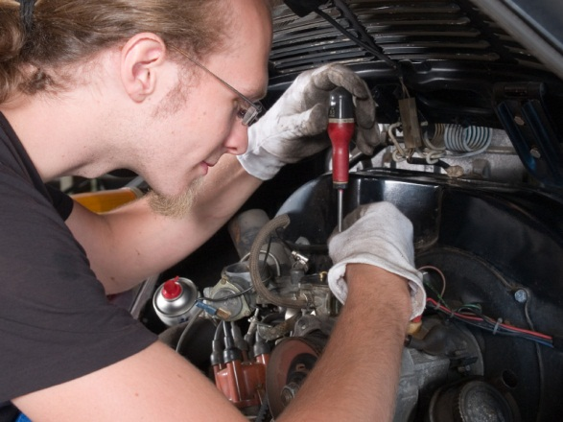
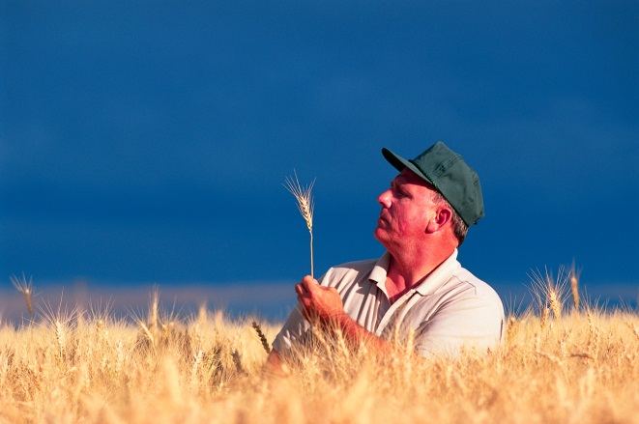
My Heroes Are
Men and women who shine as lights on a hill in the work place
Ephesians 6:5-9; Colossians 3:22-4:1

Slide 8
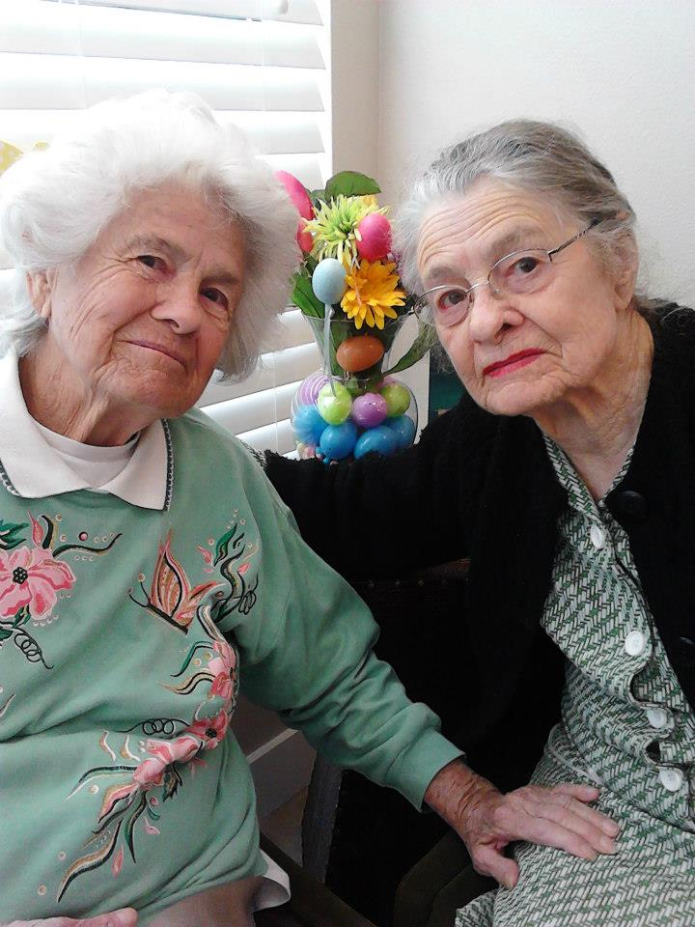
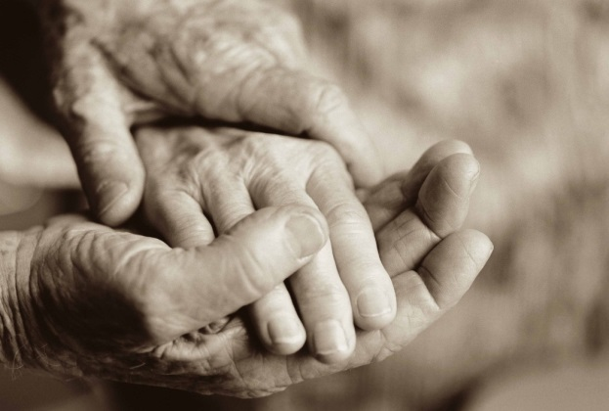
My Heroes Are
Older folk who keep building bridges for the next generation
Luke 1:5-7 Well advanced in age
Titus 2 Older teaching younger

Slide 9
Now also when I am old and gray headed, O God, do not forsake me, until I declare Your strength to this generation, Your power to everyone who is to come.

