Slide 2
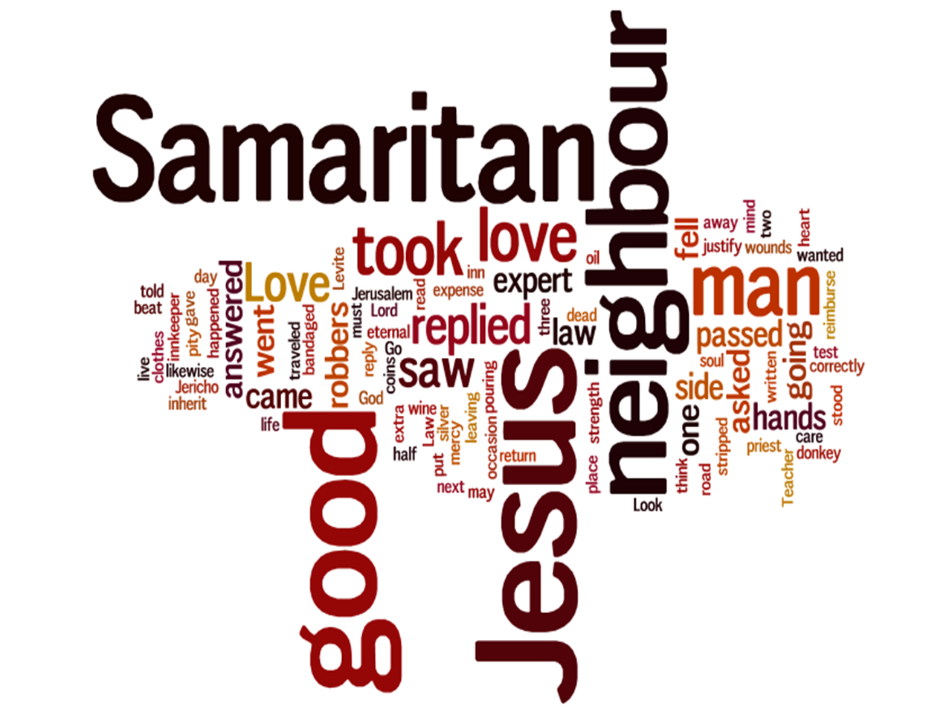

Slide 3
WHO
do you
LOVE?

Slide 4
WHO
do you
LOVE?
Do I have to love… ?
O
X
X
X
X
O
O
X
O
X
X
O
O
X
X
O
O
O
O
X

Slide 5
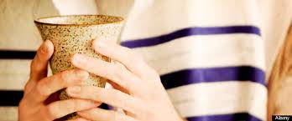
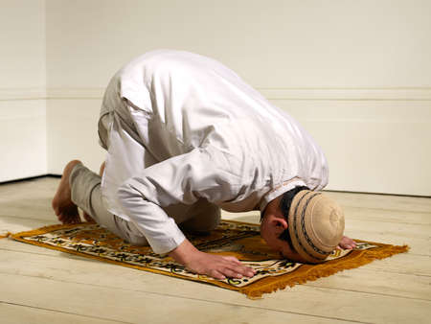
WHO
do you
LOVE?

Slide 6
WHO
do you
LOVE?
“Who is my neighbor?”
—Lawyer
“Who proved to be a neighbor?”
—Jesus

Slide 7
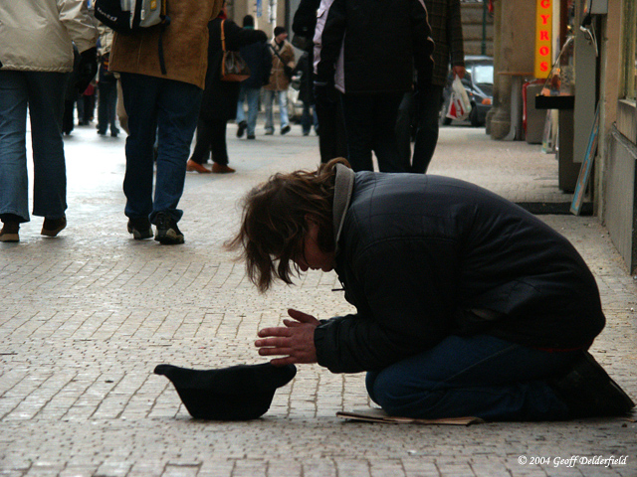
WHO
do you
LOVE?
“So, who is my neighbor?”

Slide 8
WHO
do you
LOVE?

