Slide 1
The Gospel in Atlanta
A look at the work
and the church

Slide 2
The Gospel in Atlanta
The work

Slide 3
Small Group Studies around ATL
4 different studies are currently hosted every week
Held on Mondays, Tuesdays, Thursdays, and Fridays
2 other studies were discontinued after several months of efforts
Visitor amount varies significantly
These studies have produced modest opportunity for personal studies

Slide 4
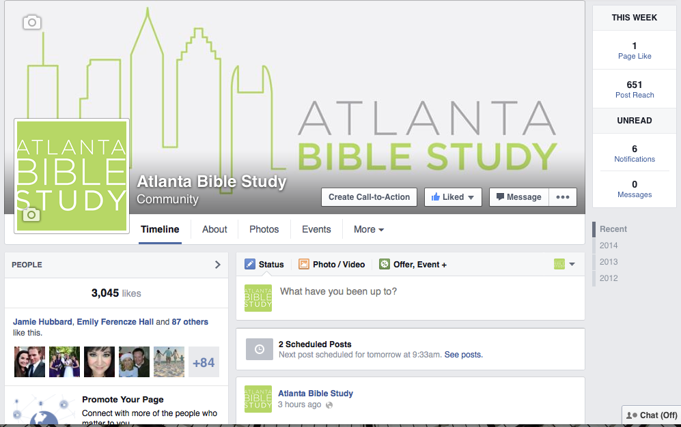
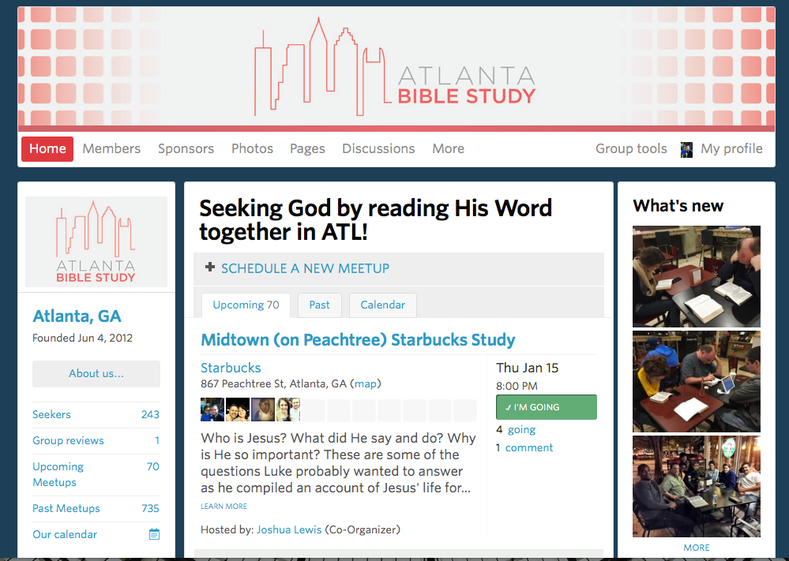
Using Social Media
Meetup: 243 members
Facebook: 3,045 likes
Twitter: 104 followers

Slide 5
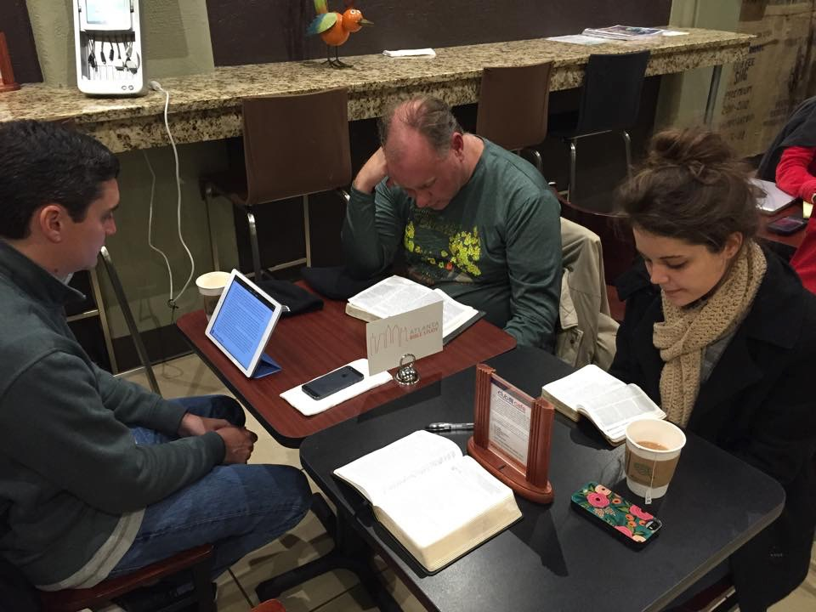
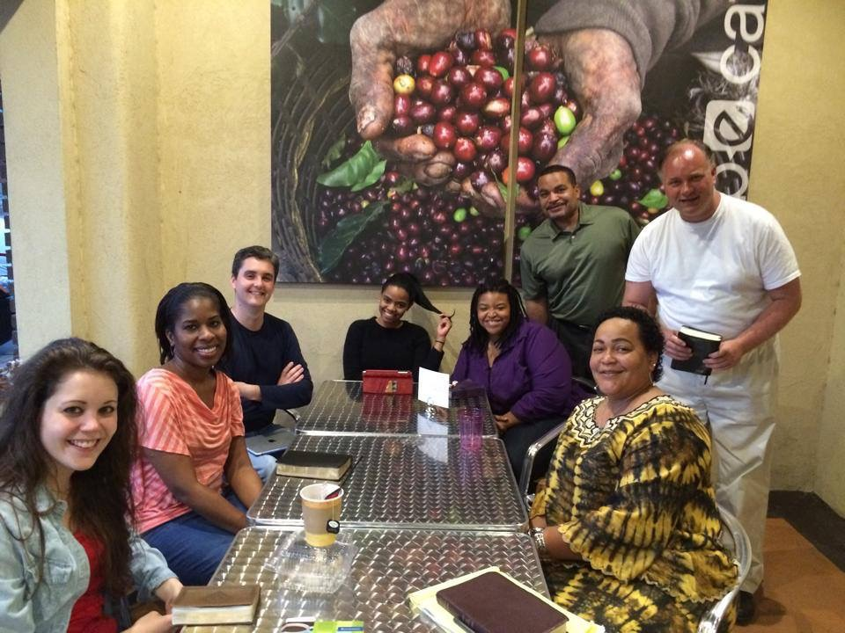
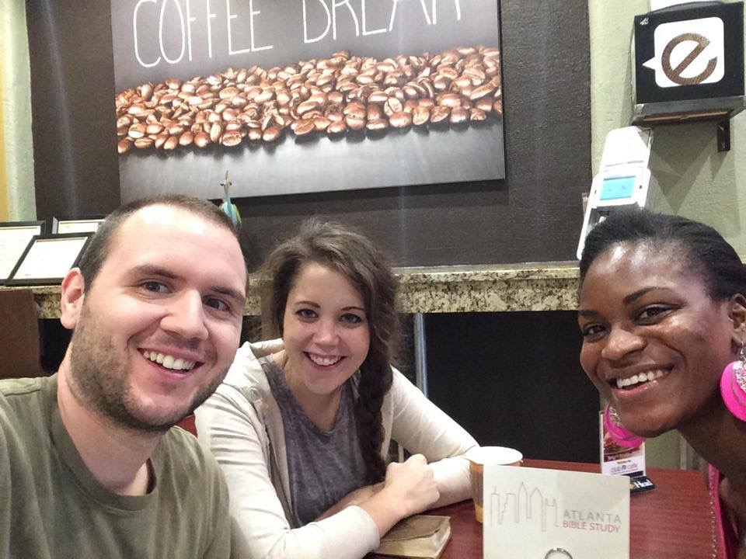
Monday Nights

Slide 6
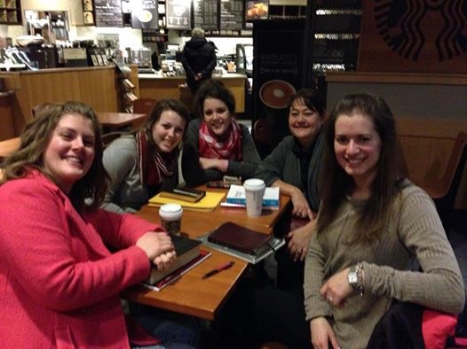
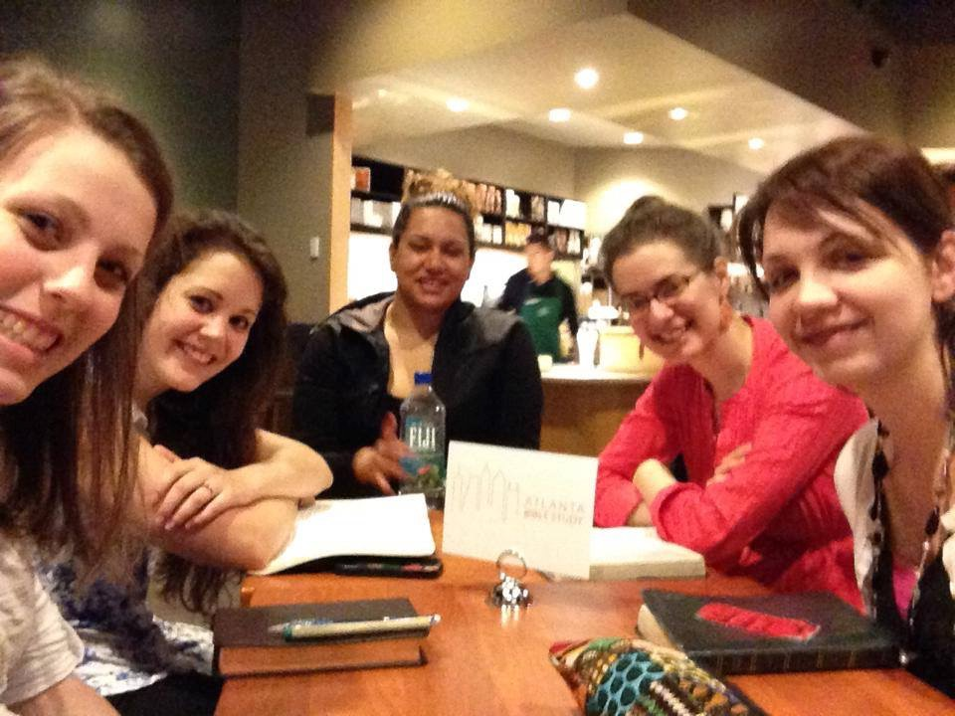
Tuesday Nights

Slide 7
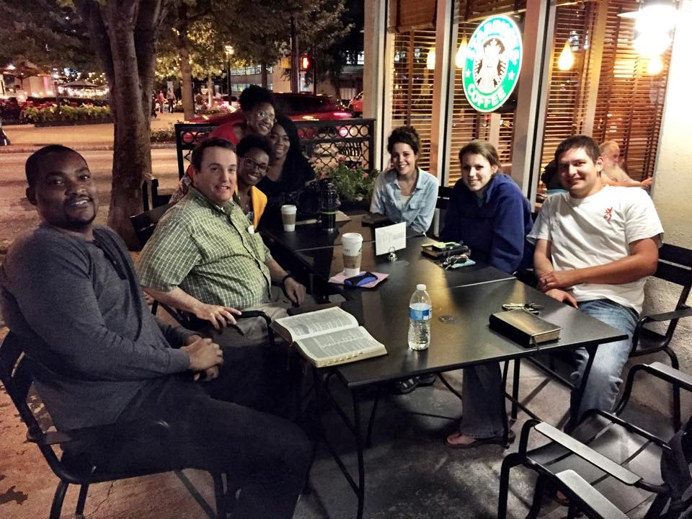
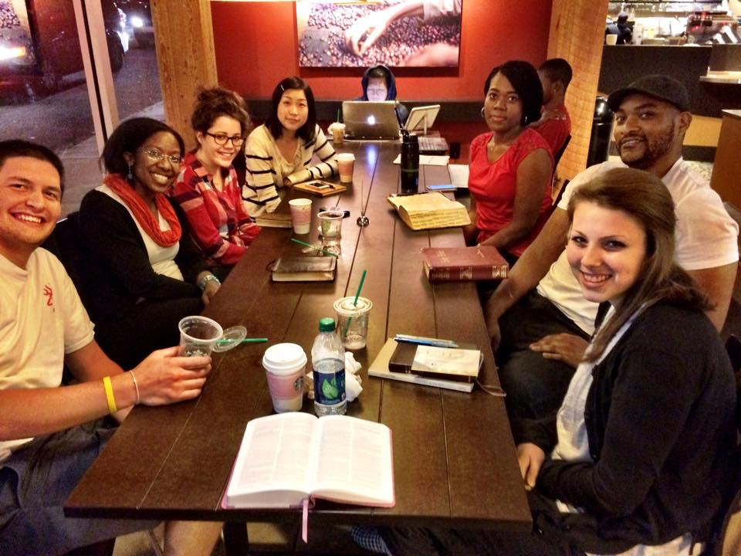
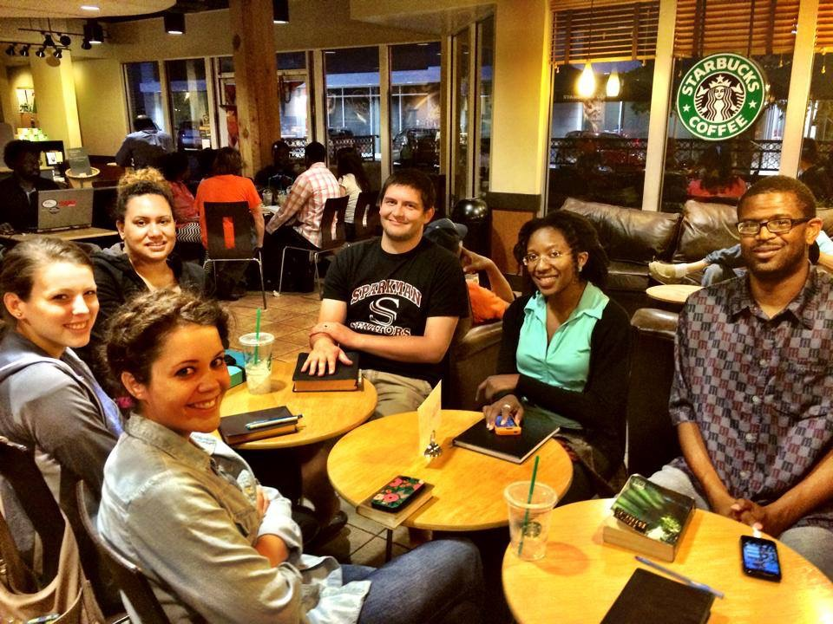
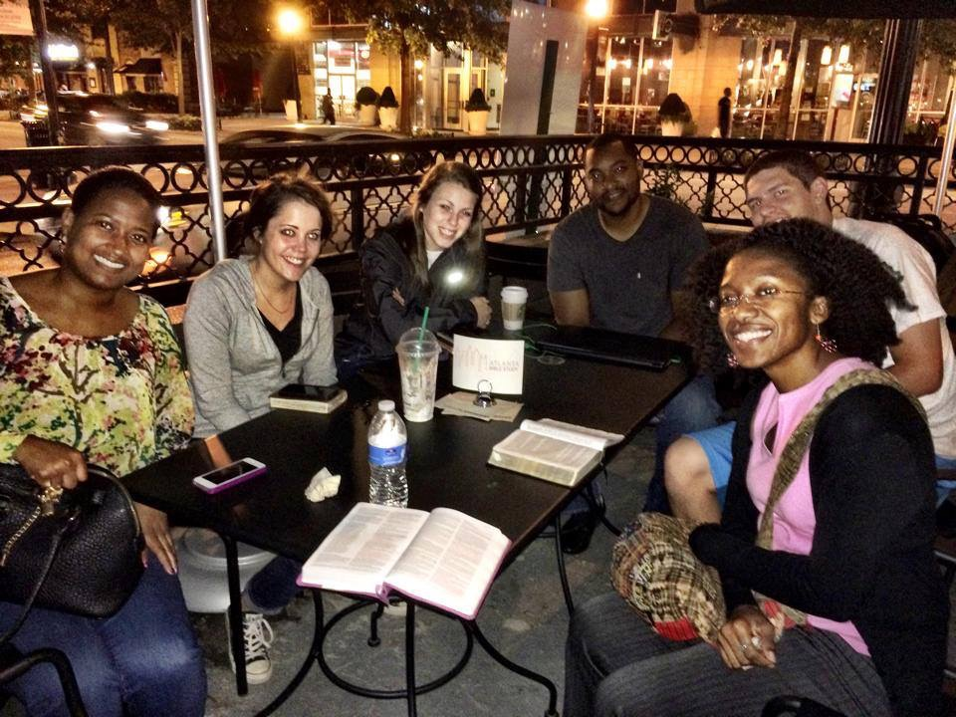
Thursday Nights

Slide 8
The Gospel in Atlanta
The church

Slide 9
Intown Atlanta
Began meeting March 2, 2014
Began with 8 members
Now have 9 members and 4 regularly visiting
Preaching/teaching is shared by the men
Theme/Goals for the year:
Learning goal: to learn about Jesus
Living goal: to teach others about Jesus

Slide 10
Intown Atlanta
Our home with 19 people in it for worship

Slide 11
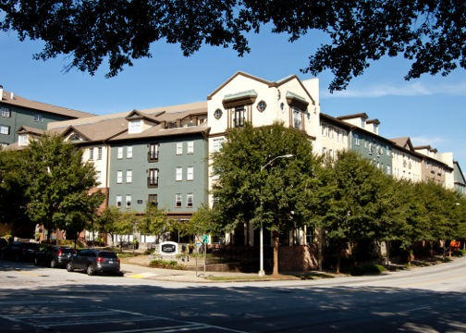
Meeting Place
Our current meeting location

Slide 12
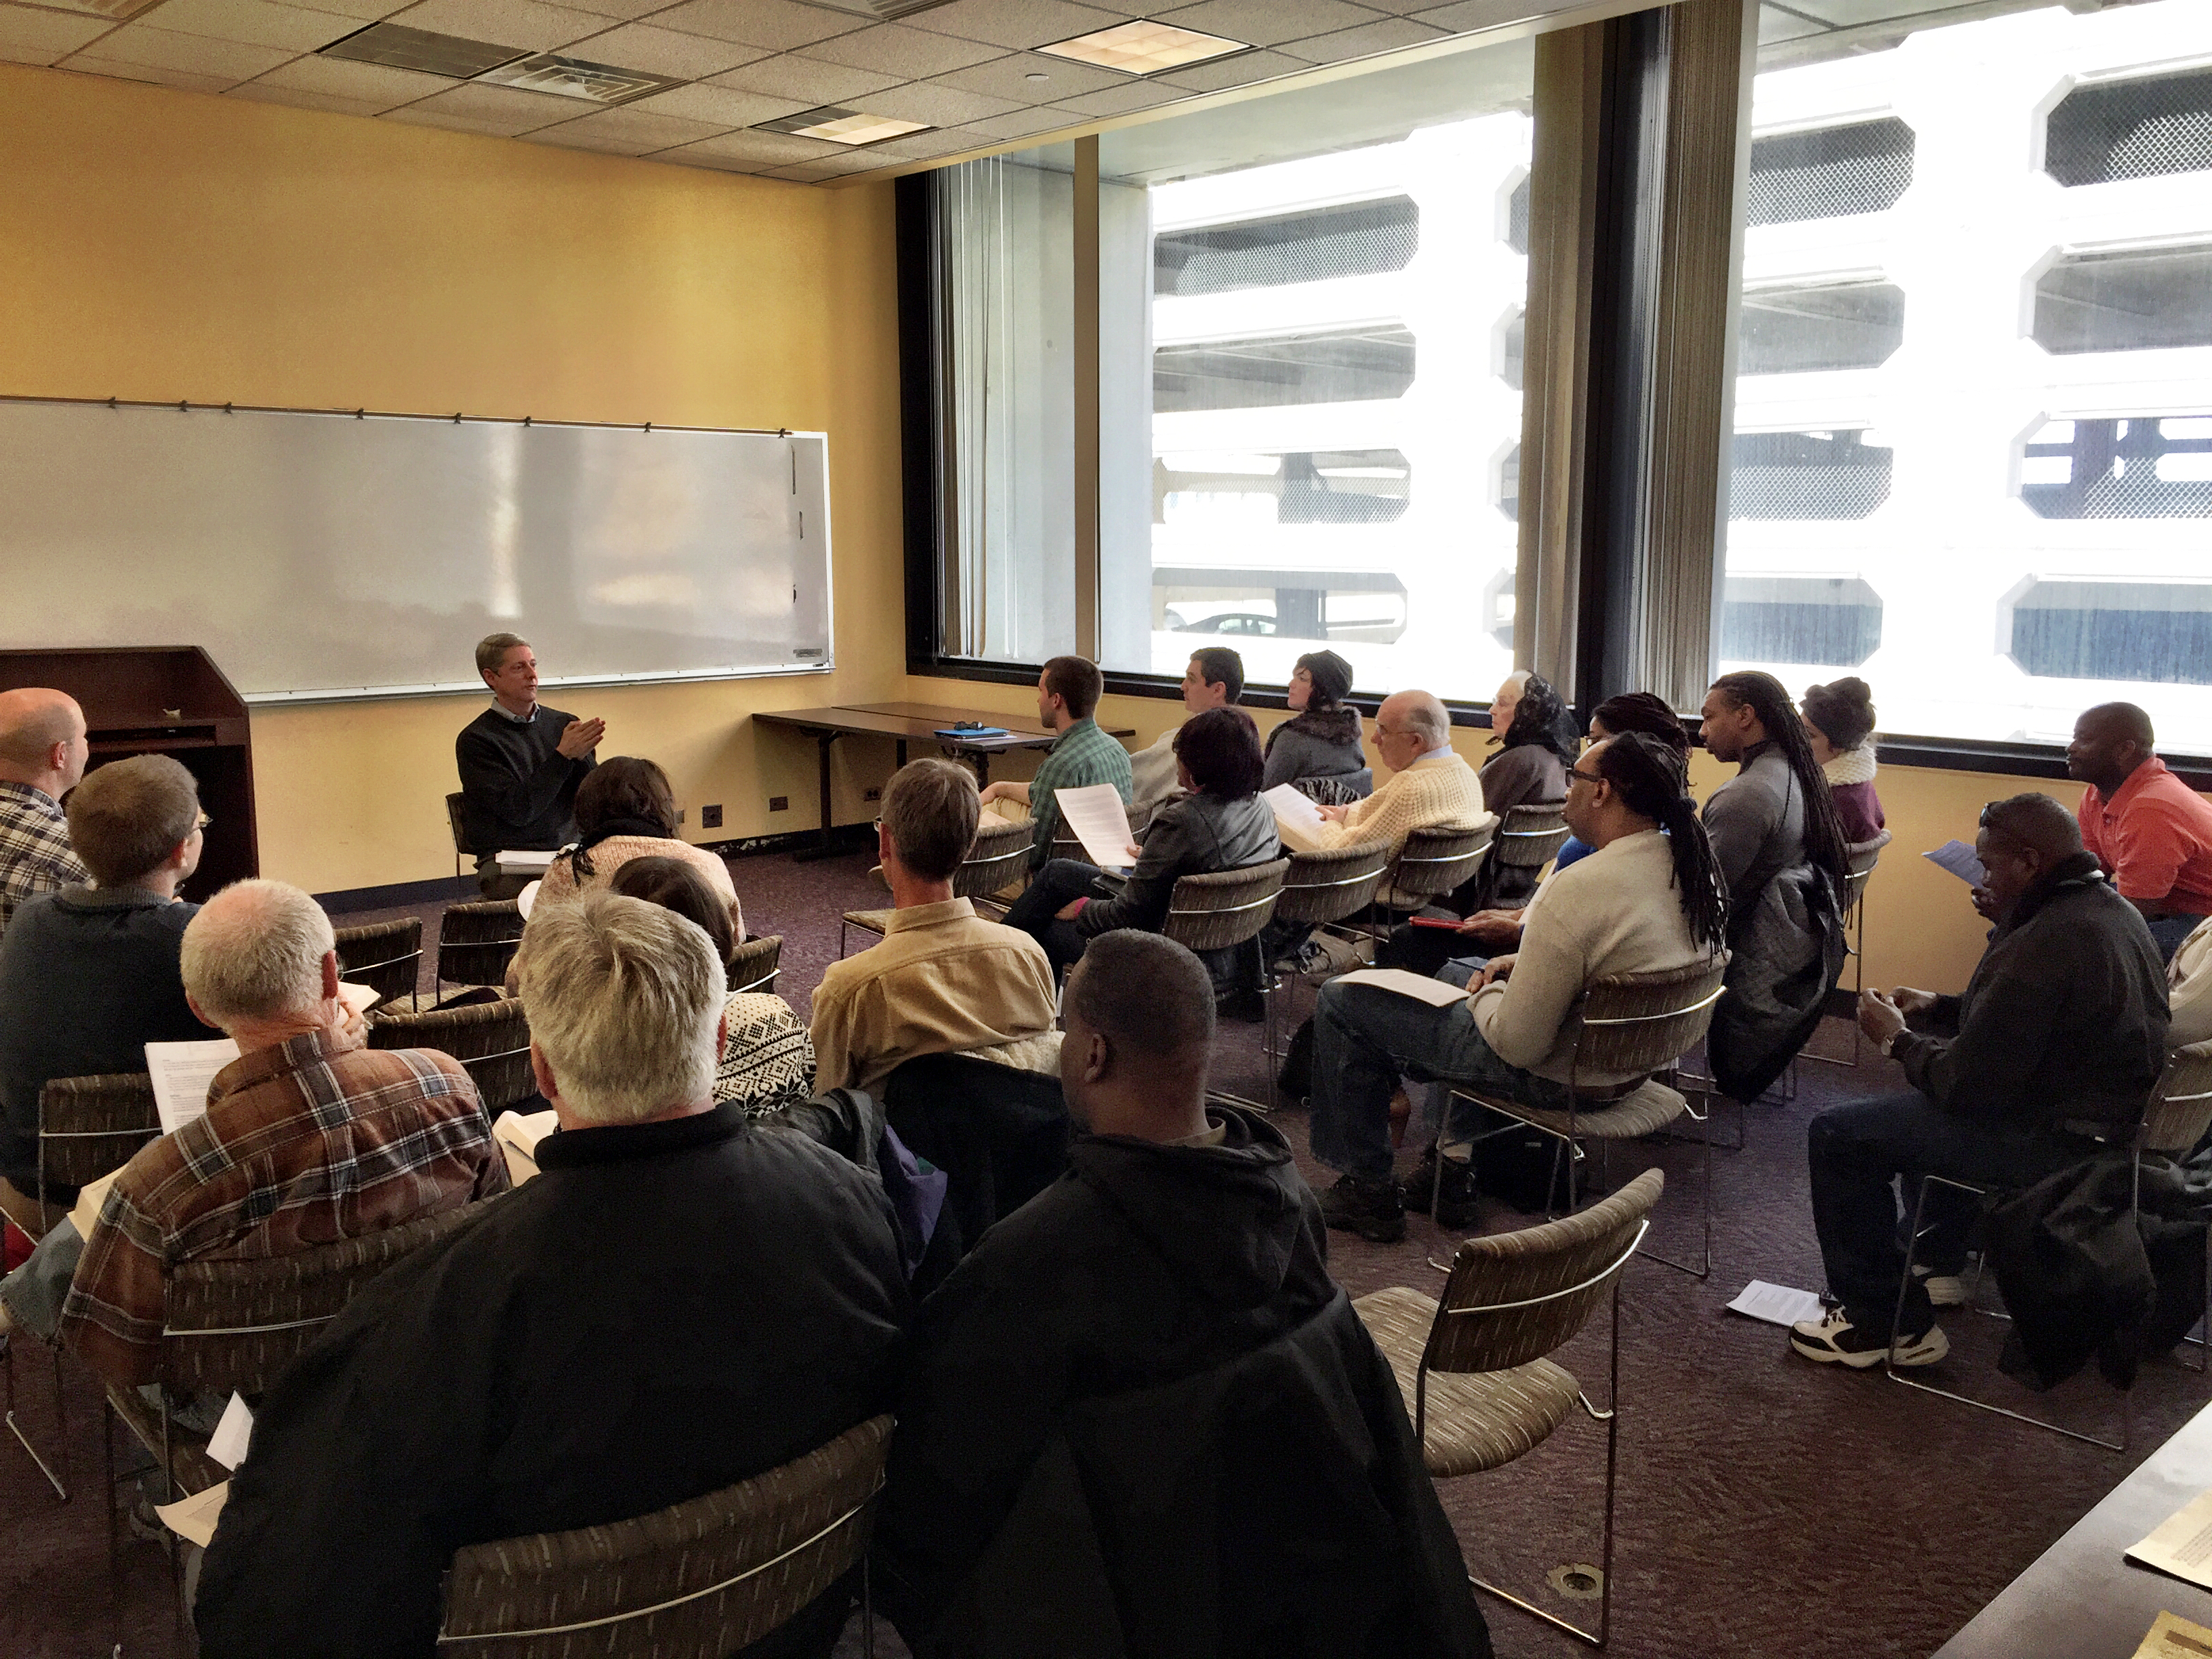
Public Discussions
Reason: An event that we can invite others to that is in a neutral setting.
Goal: To encourage Christian evangelism and make new contacts.
Topics:
“What Can I Know For Sure?”
“How Do I Deal With Problems?”
“What Did Jesus Really Say About…?”

Slide 13
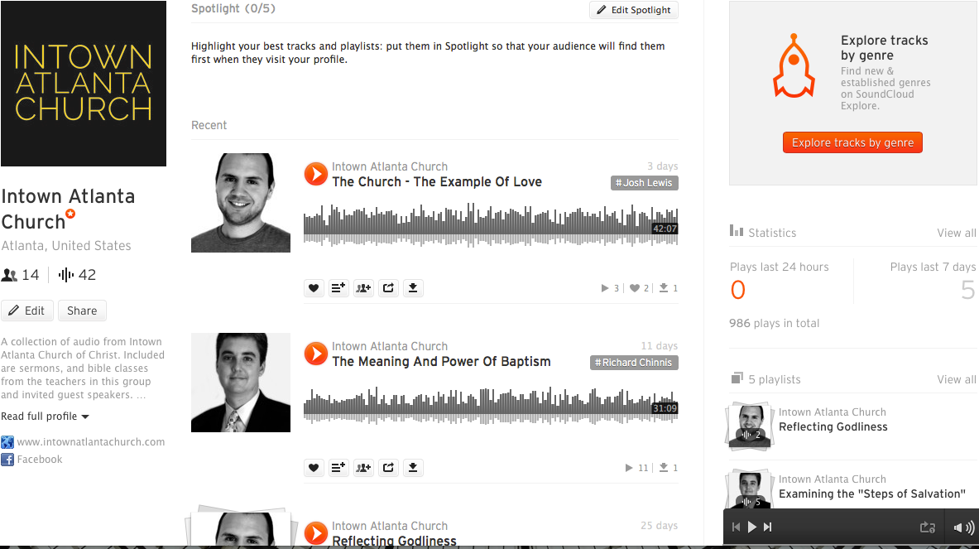
Intown Atlanta Social Media
Website: intownatlantachurch.com
Website: Soundcloud

