Slide 1
Can ONE BOOK CHANGE YOUR LIFE?
Psalms 19

Slide 2
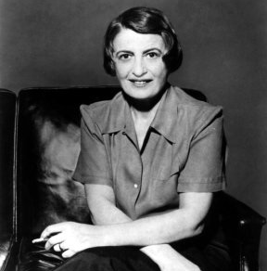
Ayn Rand

Slide 3
Ayn Rand
“What’s wrong with the modern world?” She answered, “Never before has the world been so desperately asking for answers to critical questions, and never before has the world been so frantically committed to the idea that no answers are possible. To paraphrase the Bible, “Father forgive us for what we are doing - and please don’t tell us.”
“What’s wrong with the modern world?” She answered, “Never before has the world been so desperately asking for answers to critical questions, and never before has the world been so frantically committed to the idea that no answers are possible. To paraphrase the Bible, “Father forgive us for what we are doing - and please don’t tell us.”
---Ayn Rand
Are we like that?

Slide 4
“The heavens declare the glory of God, and the sky above proclaims his handiwork. ² Day to day pours out speech, and night to night reveals knowledge. ³ There is no speech, nor are there words, whose voice is not heard. ⁴ Their voice goes out through all the earth, and their words to the end of the world. In them he has set a tent for the sun, ⁵ which comes out like a bridegroom leaving his chamber, and, like a strong man, runs its course with joy. ⁶ Its rising is from the end of the heavens, and its circuit to the end of them, and there is nothing hidden from its heat. The law of the Lord is perfect, reviving the soul; the testimony of the Lord is sure, making wise the simple; ⁸ the precepts of the Lord are right, rejoicing the heart; the commandment of the Lord is pure, enlightening the eyes; ⁹ the fear of the Lord is clean, enduring forever; the rules of the Lord are true, and righteous altogether. ¹⁰ More to be desired are they than gold, even much fine gold; sweeter also than honey and drippings of the honeycomb. ¹¹ MorWho can discern his errors? Declare me innocent from hidden faults.eover, by them is your servant warned; in keeping

Slide 5
them there is great reward. Keep back your servant also from presumptuous sins; let them not have dominion over me! Then I shall be blameless, and innocent of great transgression. ¹⁴ Let the words of my mouth and the meditation of my heart be acceptable in your sight, O Lord, my rock and my redeemer” (Psalms 19).

Slide 6
Are we searching for God?
100,000 Bible’s sold each year worldwide
Annual sales exceed $500 Million
25,000 Bible’s sold annually in U.S.
92% of Americans have at least one Bible
The average American family owns three Bible’s
The Bible changes life’s; it doesn’t supplant them
18% of professed Christians read the Bible daily
23% of professed Christians never read the Bible at all

Slide 7
God is revealed to us - Psalms 19
Glory of the Skies
Greatness of the Scriptures
Greatness of Purpose – it impacts the soul

Slide 8
God Reveals Himself…
Through the glory of the skies – three ways
Undeniable Message
Unending Message
Universal Message

Slide 9
God Reveals Himself…
Through the glory of the skies
Undeniable Message
“The heavens declare the glory of God, and the sky above proclaims his handiwork. ² Day to day pours out speech, and night to night reveals knowledge” (19:1-2; cf. Gen. 1:6-8; Psalms 8:3; 50:6; 97:6; Ro. 1:19-20)

Slide 10
God Reveals Himself…
Through the glory of the skies
Undeniable Message
^{19 “}For what can be known about God is plain to them, because God has shown it to them. ²⁰ For his invisible attributes, namely, his eternal power and divine nature, have been clearly perceived, ever since the creation of the world, in the things that have been made. So they are without excuse” (Ro. 1:19-20)

Slide 11
God Reveals Himself…
Through the glory of the skies
Undeniable Message
Unending Message
“Day to day pours out speech, and night to night reveals knowledge” (2)

Slide 12
God Reveals Himself…
Through the glory of the skies
Undeniable Message
Unending Message
Universal Message
“There is no speech, nor are there words, whose voice is not heard.⁴ Their voice goes out through all the earth, and their words to the end of the world” (3-4)

Slide 13
God Reveals Himself…
Through the glory of the skies
Undeniable Message
Unending Message
Universal Message
“For what can be known about God is plain to them, because God has shown it to them. ²⁰ For his invisible attributes, namely, his eternal power and divine nature, have been clearly perceived, ever since the creation of the world, in the things that have been made. So they are without excuse.” (Ro. 1:19-20)

Slide 14
God Reveals Himself…
Through the glory of the skies
Through the greatness of the scriptures
Through the soul – impacted by His grace
“The law of the Lord is perfect, reviving the soul; the testimony of the Lord is sure, making wise the simple; ⁸ the precepts of the Lord are right, rejoicing the heart; the commandment of the Lord is pure, enlightening the eyes; ⁹ the fear of the Lord is clean, enduring forever; the rules of the Lord are true, and righteous altogether. ¹⁰ More to be desired are they than gold, even much fine gold; sweeter also than honey and drippings of the honeycomb. ¹¹ Moreover, by them is your servant warned; in keeping them there is great reward” (19:7-11)

Slide 15
The Greatness of the Scriptures
Titles
Descriptions
Law
Testimony
Precepts
Commandments
Fear
Judgments
Perfect
Sure
Right
Pure
Clean
Righteous

Slide 16
The Greatness of the Scriptures
Titles
Descriptions
Impact Soul
Law
Testimony
Precepts
Commandments
Fear
Judgments
Perfect
Sure
Right
Pure
Clean
Righteous
Reviving the soul
Making wise the simple
Rejoice your heart
Enlightening the eyes
Remain forever
Righteous altogether

Slide 17
God Reveals Himself…
Through the glory of the skies
Through the greatness of the scriptures
Through the Greatness of Purpose – the soul is impacted by His grace

Slide 18
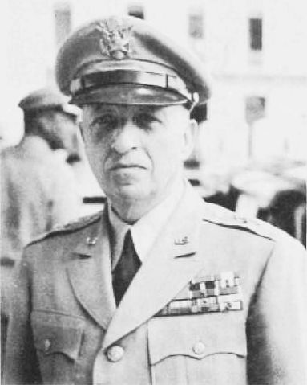
General Wm. K. Harrison
The most decorated soldier in the 30th Infantry Division, rated by General Eisenhower as the number one infantry division in World War II. General Harrison was the first American to enter Belgium, which he did at the head of the Allied forces. He received every decoration for valor except the Congressional Medal of Honor -- being honored with the Distinguished Silver Cross, the Silver Star, the Bronze Star for Valor, and the Purple Heart.

Slide 19
Spiritual nobility
“Now these Jews were more noble than those in Thessalonica; they received the word with all eagerness, examining the Scriptures daily to see if these things were so.” (Acts 17:11)

