Slide 1
The Point of it All
Ecclesiastes 12:1-14

Slide 2
12 Remember also your Creator in the days of your youth, before the evil days come and the years draw near of which you will say, “I have no pleasure in them”; ² before the sun and the light and the moon and the stars are darkened and the clouds return after the rain, ³ in the day when the keepers of the house tremble, and the strong men are bent, and the grinders cease because they are few, and those who look through the windows are dimmed, ⁴ and the doors on the street are shut—when the sound of the grinding is low, and one rises up at the sound of a bird, and all the daughters of song are brought low— ⁵ they are afraid also of what is high, and terrors are in the way; the almond tree blossoms, the grasshopper drags itself along, and desire fails, because man is going to his eternal home, and the mourners go about the streets— ⁶ before the silver cord is snapped, or the golden bowl is broken, or the pitcher is shattered at the fountain, or the wheel broken at the cistern, ⁷ and the dust returns to the earth as it was, and the spirit returns to God who gave it.

Slide 3
⁸ Vanity of vanities, says the Preacher; all is vanity. ⁹ Besides being wise, the Preacher also taught the people knowledge, weighing and studying and arranging many proverbs with great care. ¹⁰ The Preacher sought to find words of delight, and uprightly he wrote words of truth.
¹¹ The words of the wise are like goads, and like nails firmly fixed are the collected sayings; they are given by one Shepherd. ¹² My son, beware of anything beyond these. Of making many books there is no end, and much study is a weariness ¹³ The end of the matter; all has been heard. Fear God and keep his commandments, for this is the whole duty of man. ¹⁴ For God will bring every deed into judgment, with every secret thing, whether good or evil.

Slide 4
Faith
Experience
Awe
Resolve
The point
of it all…
Be Productive (11:1-6)
Be Joyful (11:7-12:1)
“But know that for all these things God will bring you into
Judgment” (11:9)

Slide 5
Remembering God (12:1)
The Lord remembered Hannah” (1 Sam. 1:19)
“Let my tongue stick to the roof of my mouth, if I do not remember you, if I do not set Jerusalem above my highest joy!” (Psa. 137:6).
“Because ye have not remembered the days of your youth, but have enraged me with all these things; therefore, behold, I have returned your deeds to your head, declares the Lord God.” (Ezek 16:43)
Remembering God is decisive and it is active.

Slide 6
The Fourth “R”
Resolve to enjoy life rather than endure it (11:7-12:1)
“7 Light is sweet, and it is pleasant for the eyes to see the sun. 8 So if a person lives many years, let him rejoice in them all; but let him remember that the days of darkness will be many. All that comes is vanity. 9 Rejoice, O young man, in your youth, and let your heart cheer you in the days of your youth. Walk in the ways of your heart and the sight of your eyes. But know that for all these things God will bring you into judgment. 10 Remove vexation from your heart, and put away pain from your body, for youth and the dawn of life are vanity. 12 Remember also your Creator in the days of your youth, before the evil days come and the years draw near of which you will say, “I have no pleasure in them;” “

Slide 7
The Fourth “R”
Resolve to enjoy life rather than endure it (11:7-12:1)
“7 Light is sweet, and it is pleasant for the eyes to see the sun. 8 So if a person lives many years, let him rejoice in them all; but let him remember that the days of darkness will be many. All that comes is vanity. 9 Rejoice, O young man, in your youth, and let your heart cheer you in the days of your youth. Walk in the ways of your heart and the sight of your eyes. But know that for all these things God will bring you into judgment. 10 Remove vexation from your heart, and put away pain from your body, for youth and the dawn of life are vanity. 12 Remember also your Creator in the days of your youth, before the evil days come and the years draw near of which you will say, “I have no pleasure in them;” “

Slide 8
The Fourth “R”
Resolve to enjoy life rather than endure it (11:7-12:1)
Resolve to give God the energy of your youth or your older years will be empty (12:1b-8)
“I have no pleasure in them” (1a)
“But Barzillai said to the king, “How many years have I still to live, that I should go up with the king to Jerusalem? I am this day eighty years old. Can I discern what is pleasant and what is not? Can your servant taste what he eats or what he drinks? Can I still listen to the voice singing man and singing women?” (2 Sam. 19:34-25)

Slide 9
The Fourth “R”
Resolve to enjoy life rather than endure it (11:7-12:1)
Resolve to give God the energy of your youth or your older years will be empty (12:1b-8)
“before the evil days come” (1b)
Time of trouble

Slide 10
The Fourth “R”
Resolve to enjoy life rather than endure it (11:7-12:1)
Resolve to give God the energy of your youth or your older years will be empty (12:1b-8)
“…years draw near of which you will say, “I have no pleasure in them” (1c)
Time of distress

Slide 11
The Fourth “R”
Resolve to enjoy life rather than endure it (11:7-12:1)
Resolve to give God the energy of your youth or your older years will be empty (12:1b-8)
“…before the sun and the light” (2a)
Time of darkness and gloominess

Slide 12
The Fourth “R”
Resolve to enjoy life rather than endure it (11:7-12:1)
Resolve to give God the energy of your youth or your older years will be empty (12:1b-8)
“…moon and the stars are darkened” (2b)
Time of life fading

Slide 13
The Fourth “R”
Resolve to enjoy life rather than endure it (11:7-12:1)
Resolve to give God the energy of your youth or your older years will be empty (12:1b-8)
“…clouds return after the rain,” (2c)
Depression

Slide 14
The Fourth “R”
Resolve to enjoy life rather than endure it (11:7-12:1)
Resolve to give God the energy of your youth or your older years will be empty (12:1b-8)
“…keepers of the house tremble,” (3a)
Loss of strength and hands shake

Slide 15
The Fourth “R”
Resolve to enjoy life rather than endure it (11:7-12:1)
Resolve to give God the energy of your youth or your older years will be empty (12:1b-8)
“…strong men are bent,” (3b)
Crooked legs

Slide 16
The Fourth “R”
Resolve to enjoy life rather than endure it (11:7-12:1)
Resolve to give God the energy of your youth or your older years will be empty (12:1b-8)
“…grinders cease because they are few” (3c)
Chewing capability

Slide 17
The Fourth “R”
Resolve to enjoy life rather than endure it (11:7-12:1)
Resolve to give God the energy of your youth or your older years will be empty (12:1b-8)
“…those who look through the windows are dimmed” (3d)
Vision capability

Slide 18
The Fourth “R”
Resolve to enjoy life rather than endure it (11:7-12:1)
Resolve to give God the energy of your youth or your older years will be empty (12:1b-8)
“…the doors on the street are shut—when the sound of the grinding is low” (4a)
Hearing capability

Slide 19
The Fourth “R”
Resolve to enjoy life rather than endure it (11:7-12:1)
Resolve to give God the energy of your youth or your older years will be empty (12:1b-8)
“…one rises up at the sound of a bird” (4b)
Sleep capability

Slide 20
The Fourth “R”
Resolve to enjoy life rather than endure it (11:7-12:1)
Resolve to give God the energy of your youth or your older years will be empty (12:1b-8)
“…all the daughters of song are brought low” (4c)
Speech/volume capability

Slide 21
The Fourth “R”
Resolve to enjoy life rather than endure it (11:7-12:1)
Resolve to give God the energy of your youth or your older years will be empty (12:1b-8)
“…afraid also of what is high” (5a)
Loss of Virility

Slide 22
The Fourth “R”
Resolve to enjoy life rather than endure it (11:7-12:1)
Resolve to give God the energy of your youth or your older years will be empty (12:1b-8)
“…terrors are in the way” (5b)
Fears intensify (driving, insecurity, etc.)

Slide 23
The Fourth “R”
Resolve to enjoy life rather than endure it (11:7-12:1)
Resolve to give God the energy of your youth or your older years will be empty (12:1b-8)
“…almond tree blossoms” (5c)
Hair changes

Slide 24
The Fourth “R”
Resolve to enjoy life rather than endure it (11:7-12:1)
Resolve to give God the energy of your youth or your older years will be empty (12:1b-8)
“…the grasshopper drags itself along” (5d)
Gait effected

Slide 25
The Fourth “R”
Resolve to enjoy life rather than endure it (11:7-12:1)
Resolve to give God the energy of your youth or your older years will be empty (12:1b-8)
“…desire fails” (5e)
Loss of appetite (sensual, diet, etc.)

Slide 26
The Fourth “R”
Resolve to enjoy life rather than endure it (11:7-12:1)
Resolve to give God the energy of your youth or your older years will be empty (12:1b-8)
“…man is going to his eternal home” (5f)
Departure from this life – new destination

Slide 27
The Fourth “R”
Resolve to enjoy life rather than endure it (11:7-12:1)
Resolve to give God the energy of your youth or your older years will be empty (12:1b-8)
“…mourners go about the streets” (5g)
Picture of mourners left behind (some stay and some leave – everyday)

Slide 28
The Fourth “R”
Resolve to enjoy life rather than endure it (11:7-12:1)
Resolve to give God the energy of your youth or your older years will be empty (12:1b-8)
“before the silver cord is snapped, or the golden bowl is broken, or the pitcher is shattered at the fountain, or the wheel broken at the cistern” (6)
Final act of dying – jar is smashed.
“and the dust returns to the earth as it was, and the spirit returns to God who gave it” (7)

Slide 29
The Fourth “R”
Resolve to enjoy life rather than endure it (11:7-12:1)
Resolve to give God the energy of your youth or your older years will be empty (12:1b-8)
Resolve to make God’s word and obsession not an option (12: 9-14)
“Besides being wise, the Preacher also taught the people knowledge, weighing and studying and arranging many proverbs with great care. ¹⁰ The Preacher sought to find words of delight, and uprightly he wrote words of truth” (9)

Slide 30
The Fourth “R”
Resolve to enjoy life rather than endure it (11:7-12:1)
Resolve to give God the energy of your youth or your older years will be empty (12:1b-8)
Resolve to make God’s word and obsession not an option (12: 9-14)
A wise person faithfully “teaches people knowledge” (9a)
A wise person carefully “studies” God’s word (9b)
A wise person effectively communicates – “words of delight”
A wise person correctly presents truth – “uprightly” he presents the word of God.

Slide 31
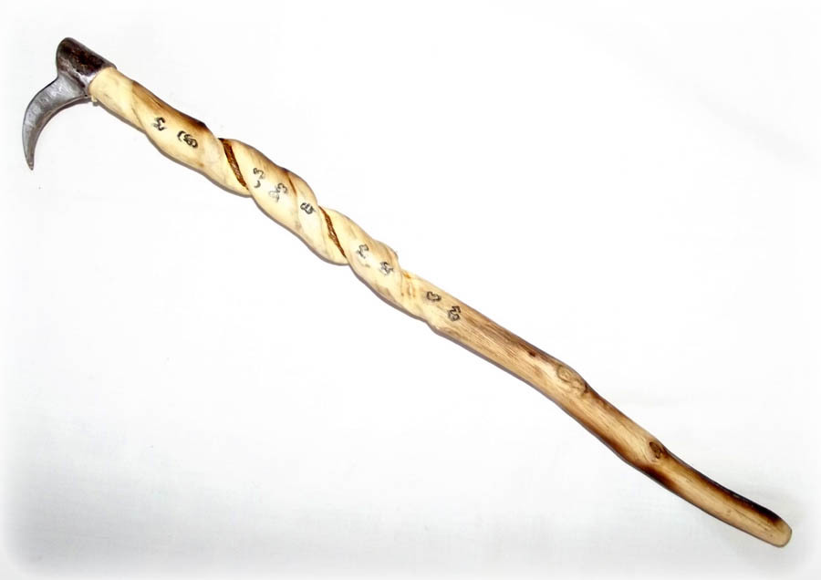
“The words of the wise are like goads, and like nails firmly fixed are the collected sayings; they are given by one Shepherd” (12:11)

Slide 32
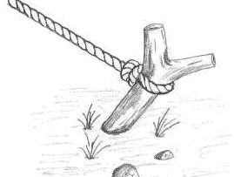
“The words of the wise are like goads, and like nails firmly fixed are the collected sayings; they are given by one Shepherd” (12:11)

Slide 33
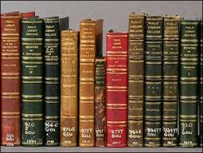
“My son, beware of anything beyond these. Of making many books there is no end, and much study is a weariness of the flesh” (12)

Slide 34
Resolve to make God’s word and obsession not an option
“The end of the matter; all has been heard. Fear God and keep his commandments, for this is the whole duty of man.” (12:13; cf. Prov. 1:7)
Love of God appears 88 times (45 OT/43 NT)
Trust in God appears 91 times (82 OT/9 NT)
Fear of God appears 278 times (235 OT/43 NT)
Why the emphasis?

Slide 35
The Point of it All
Resolve to enjoy life rather than endure it (11:7-12:1)
Resolve to give God the energy of your youth or your older years will be empty (12:1b-8)
Resolve to make God’s word and obsession not an option (12: 9-14)
¹⁴ For God will bring every deed into judgment, with every secret thing, whether good or evil.

Slide 36
The Point of it All
Ecclesiastes 12:1-14

