Slide 1
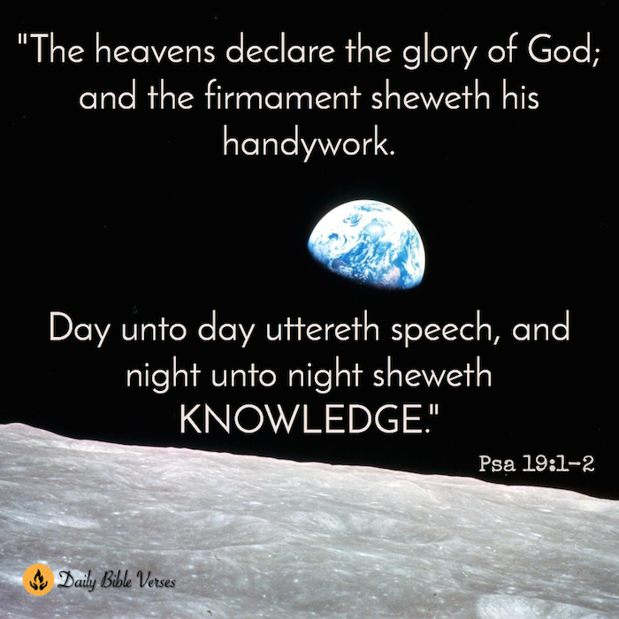

Slide 2
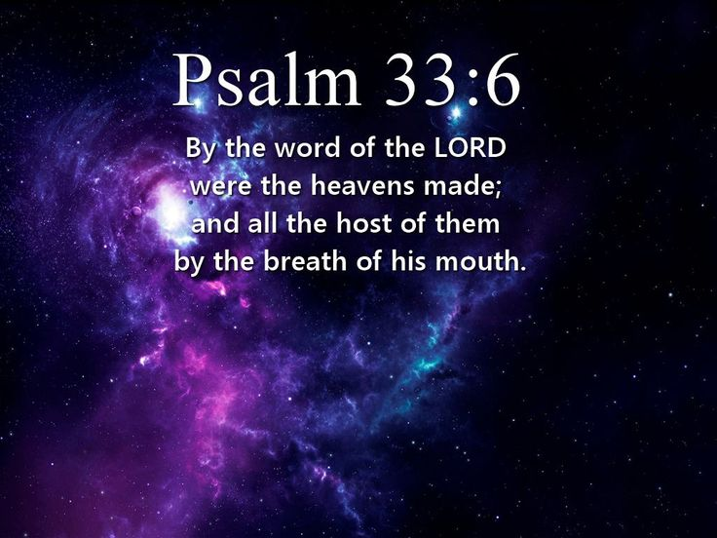

Slide 3
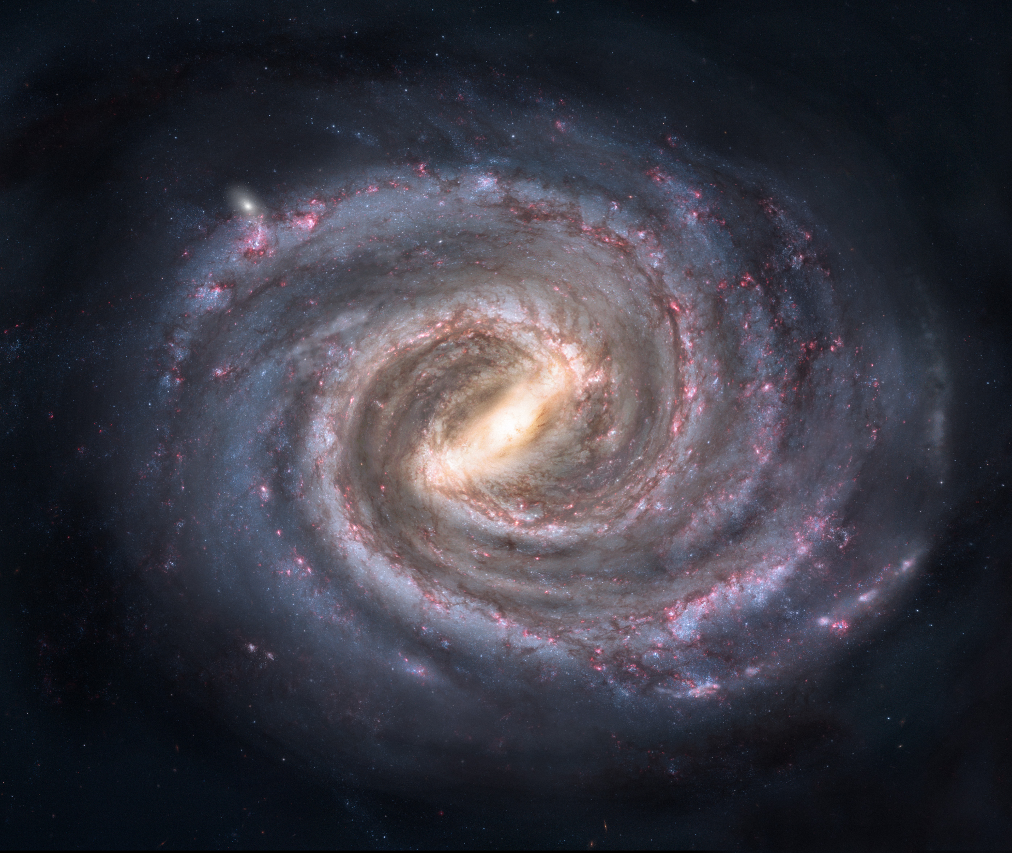

Slide 4
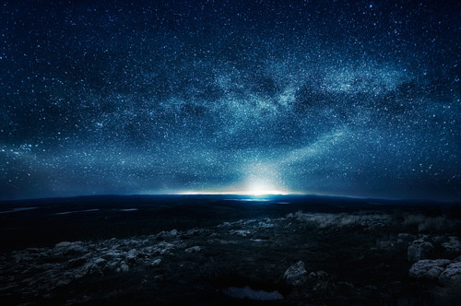
To whom then will you liken Me That I would be his equal?” says the Holy One. Lift up your eyes on high And see who has created these stars, The One who leads forth their host by number, He calls them all by name; Because of the greatness of His might and the strength of His power, Not one of them is missing.
Isa. 40:15-16

Slide 5
100,000 Light Years

Slide 6
Sun

Slide 8
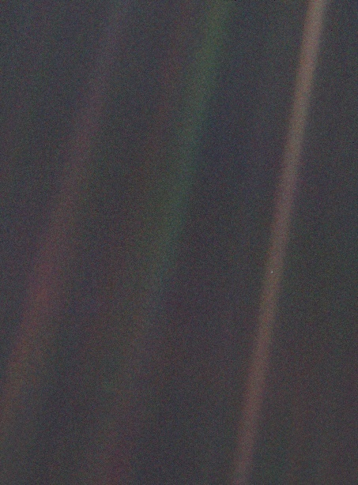

Slide 9
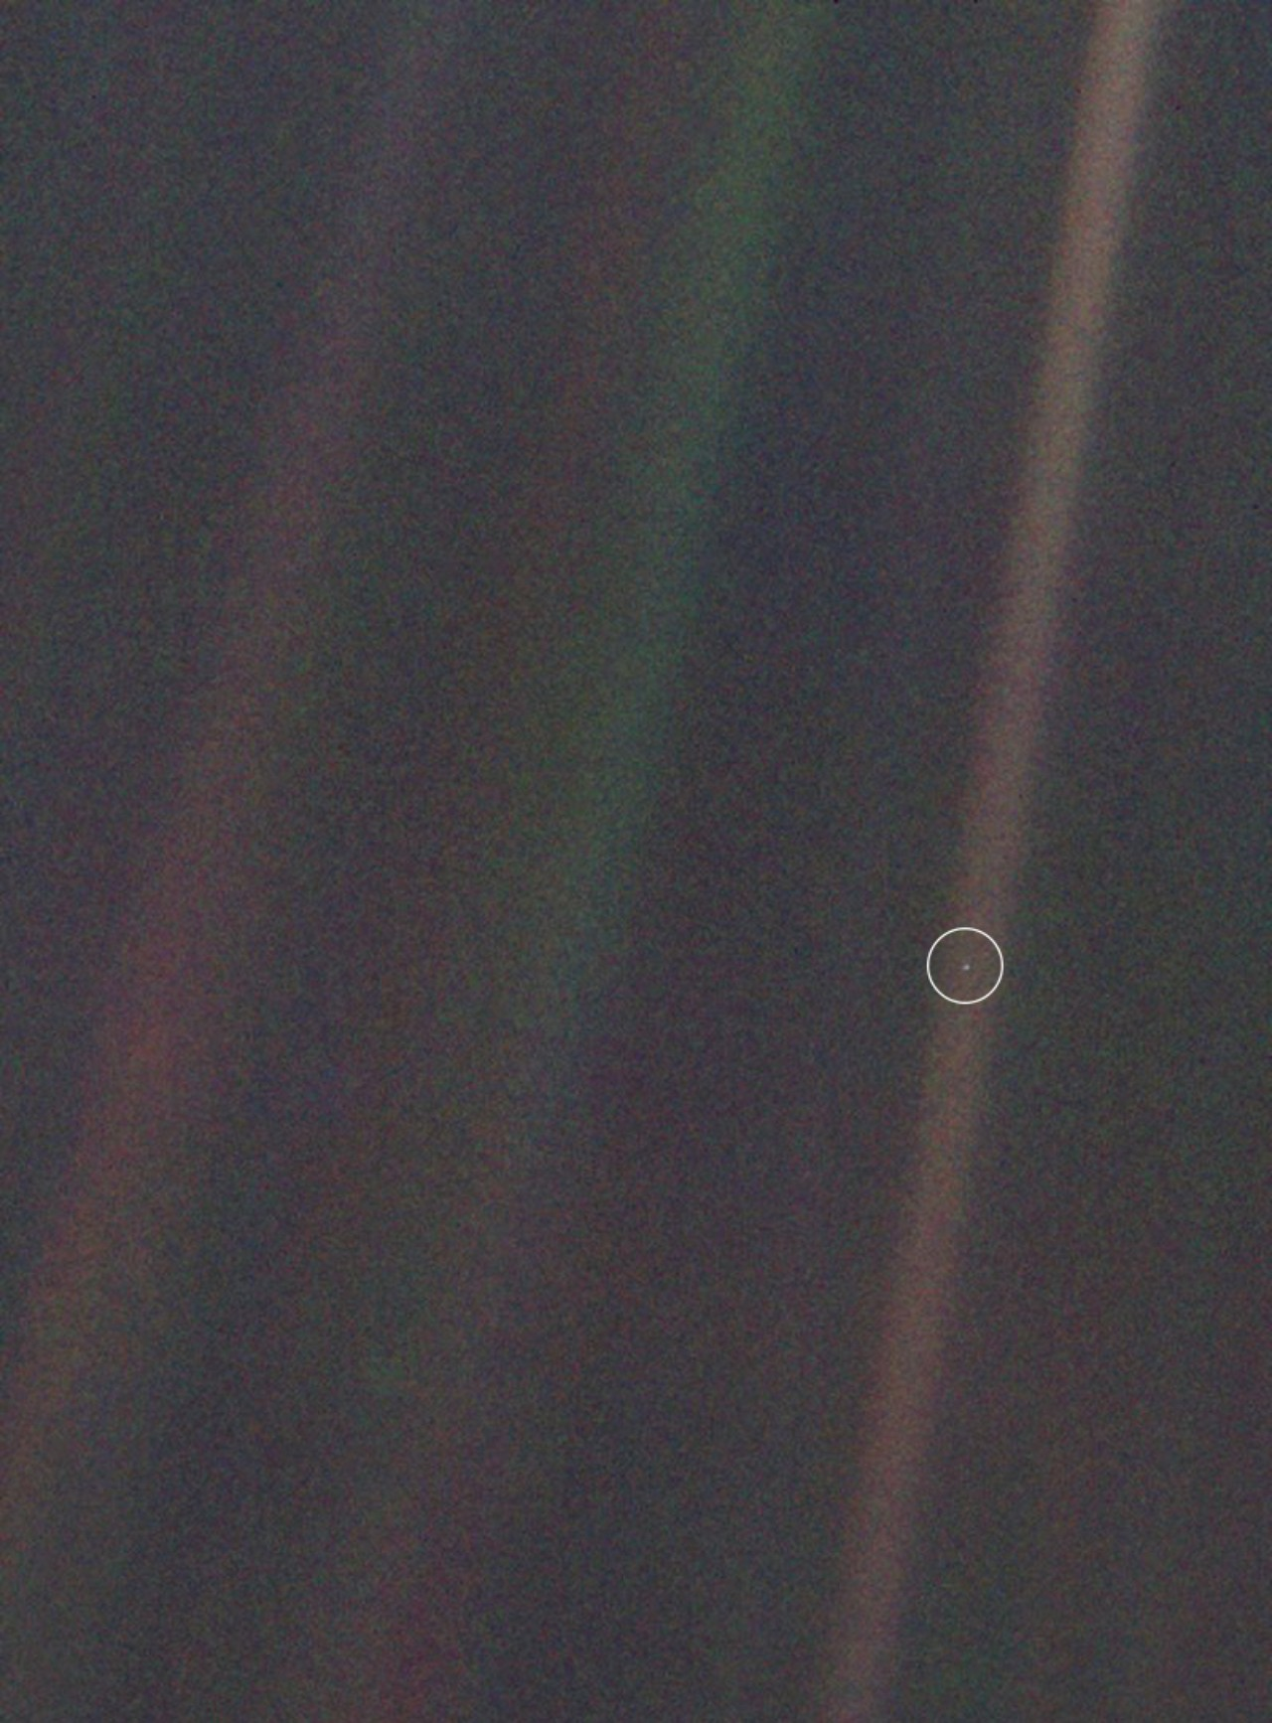

Slide 10
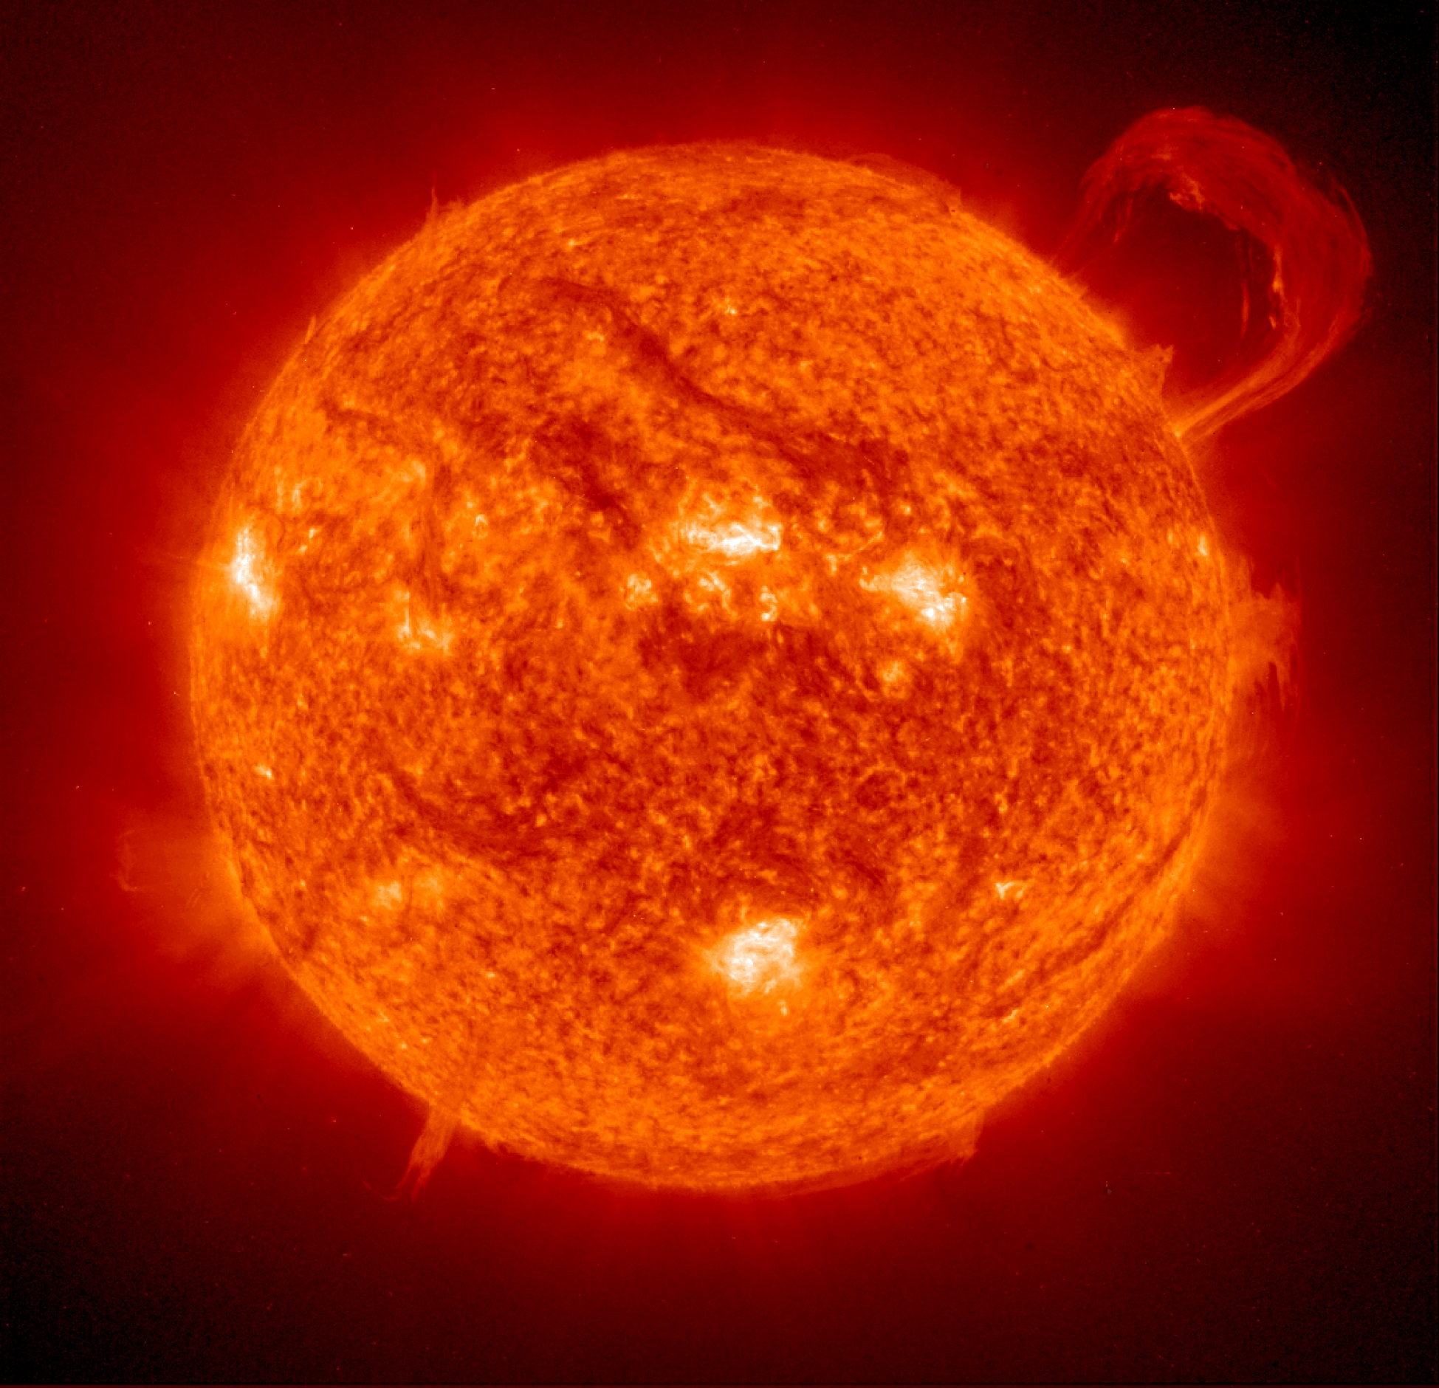

Slide 11
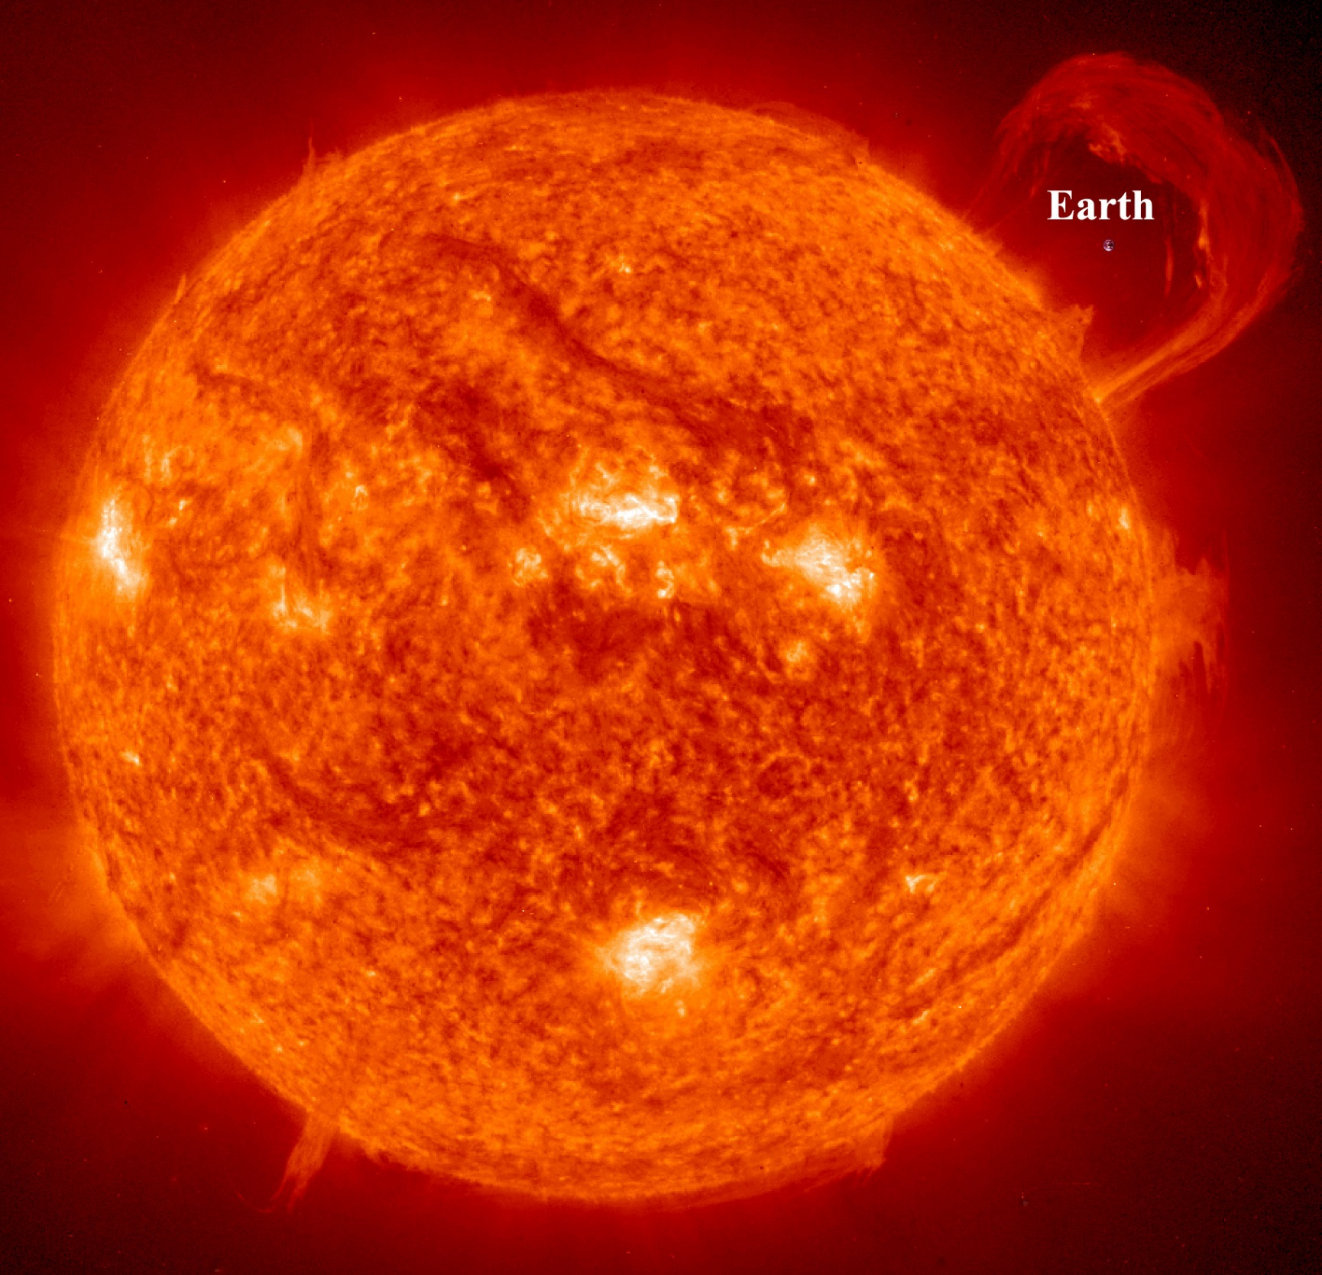

Slide 12
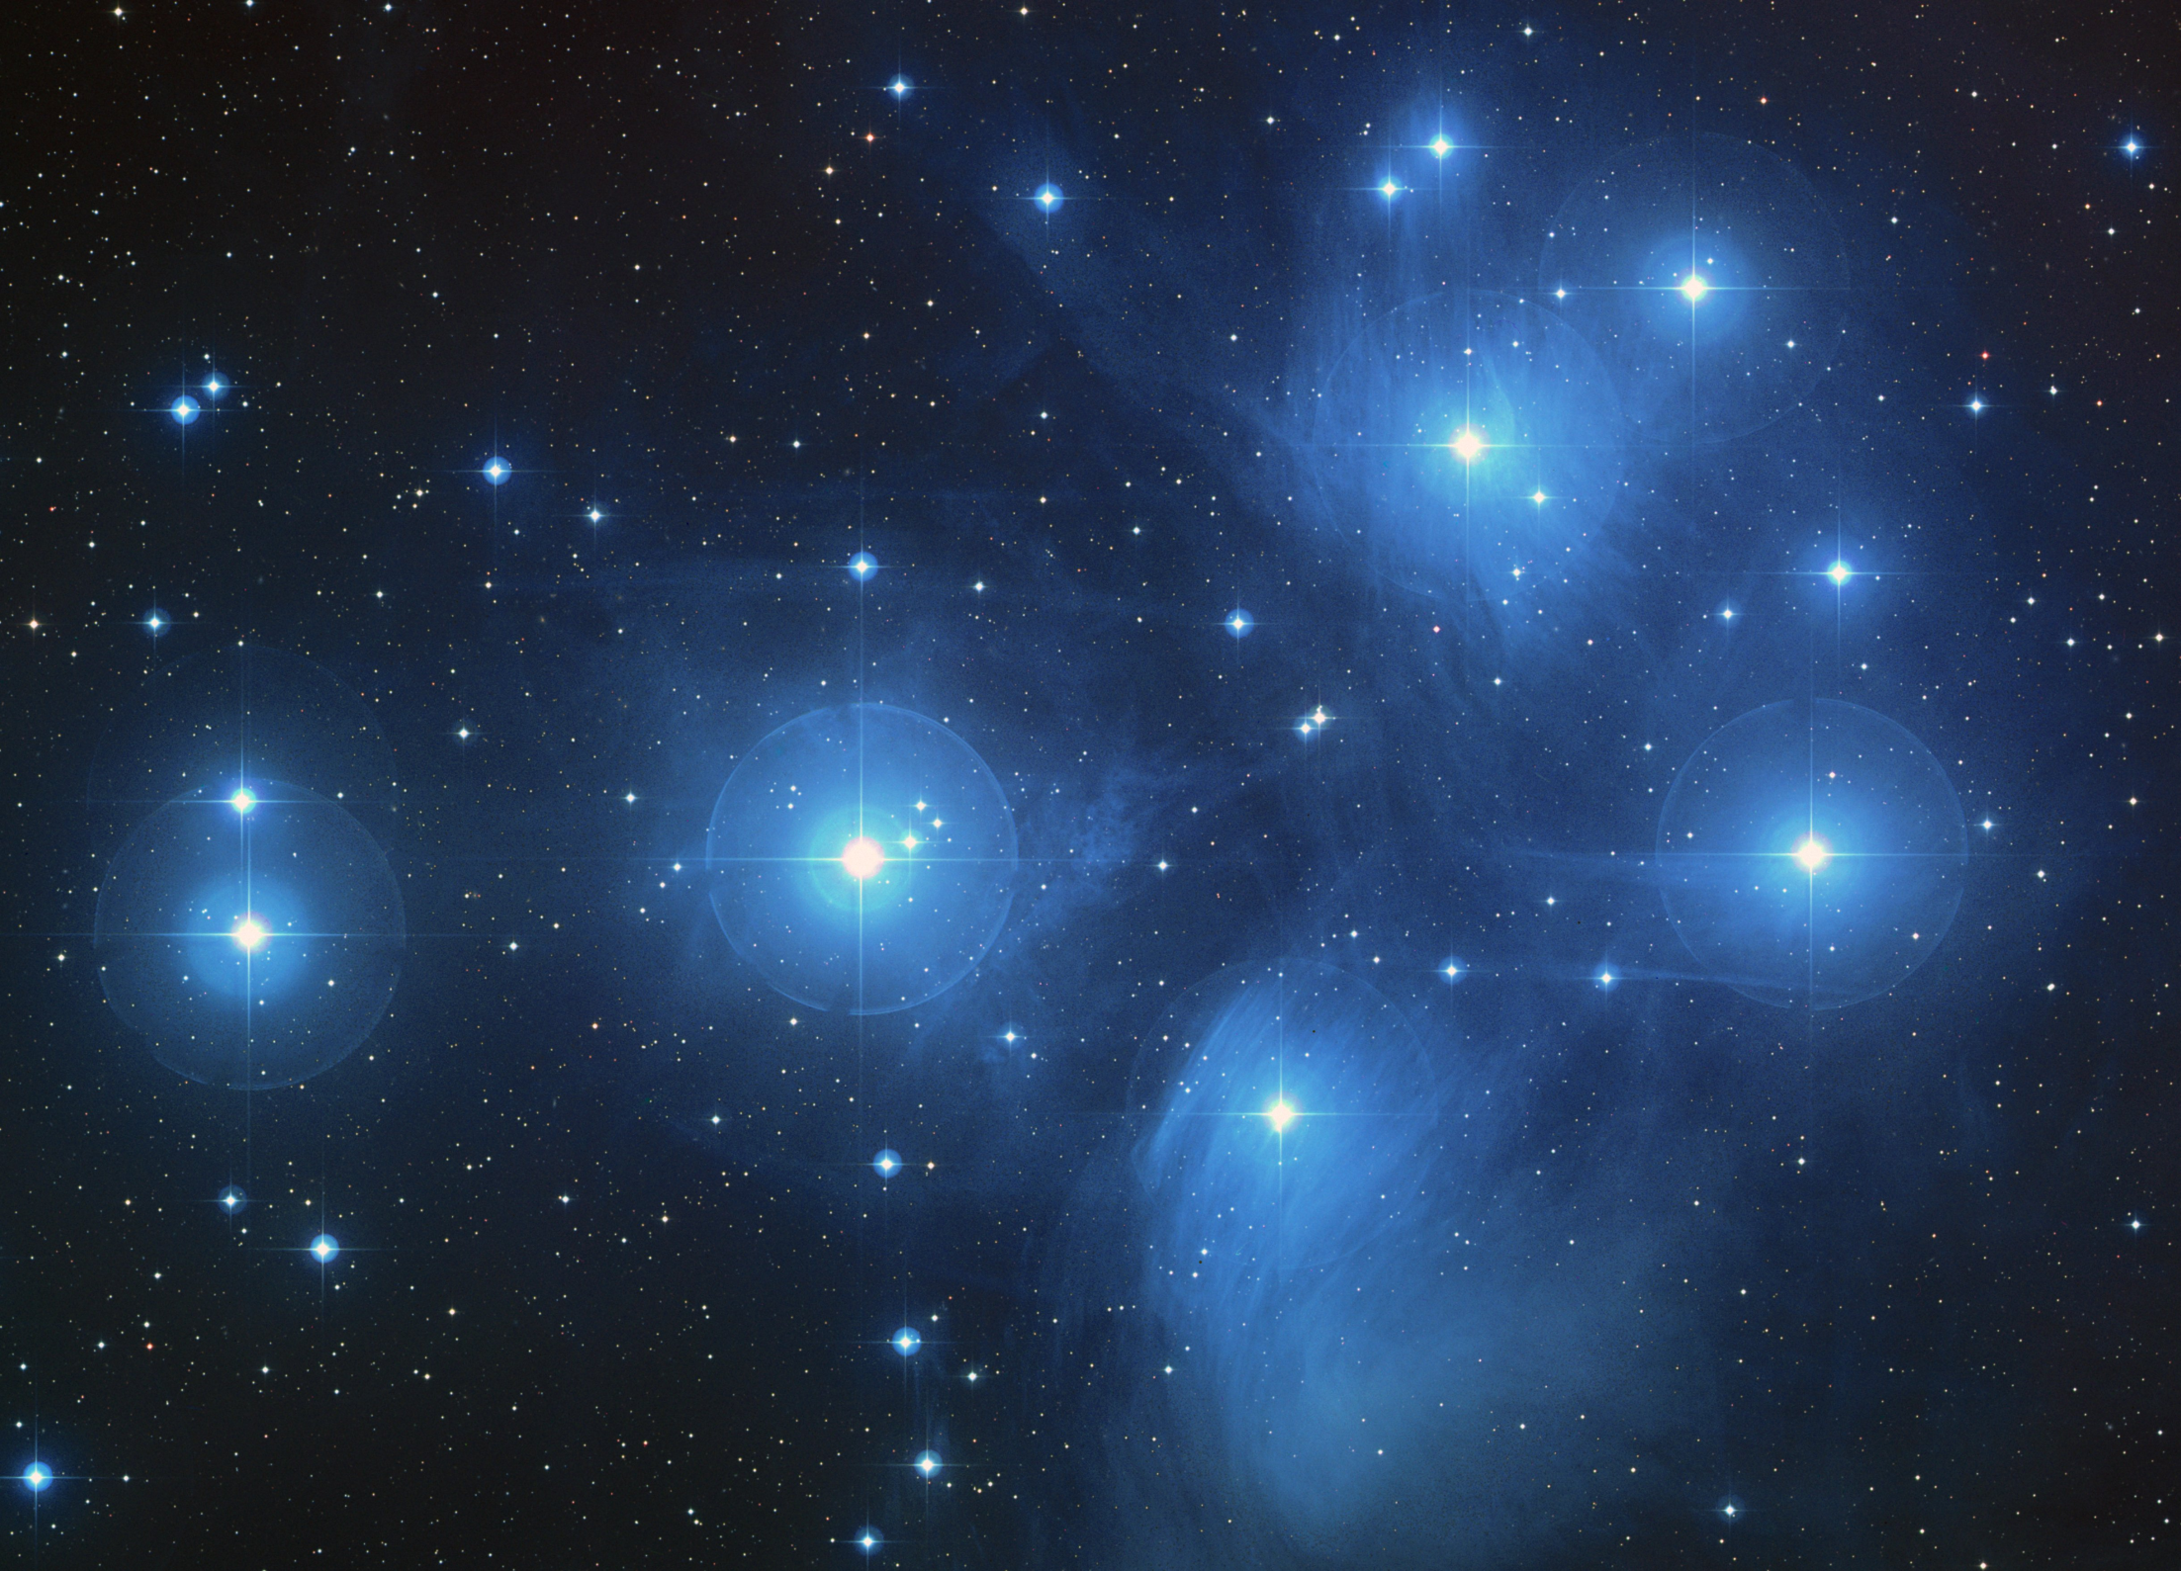

Slide 13
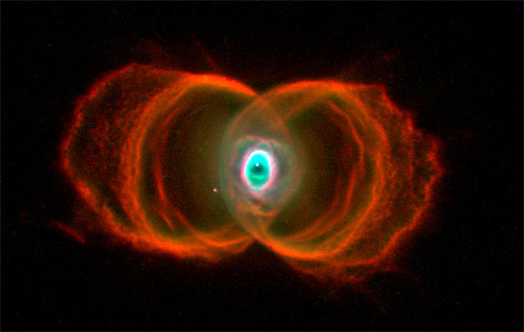

Slide 14
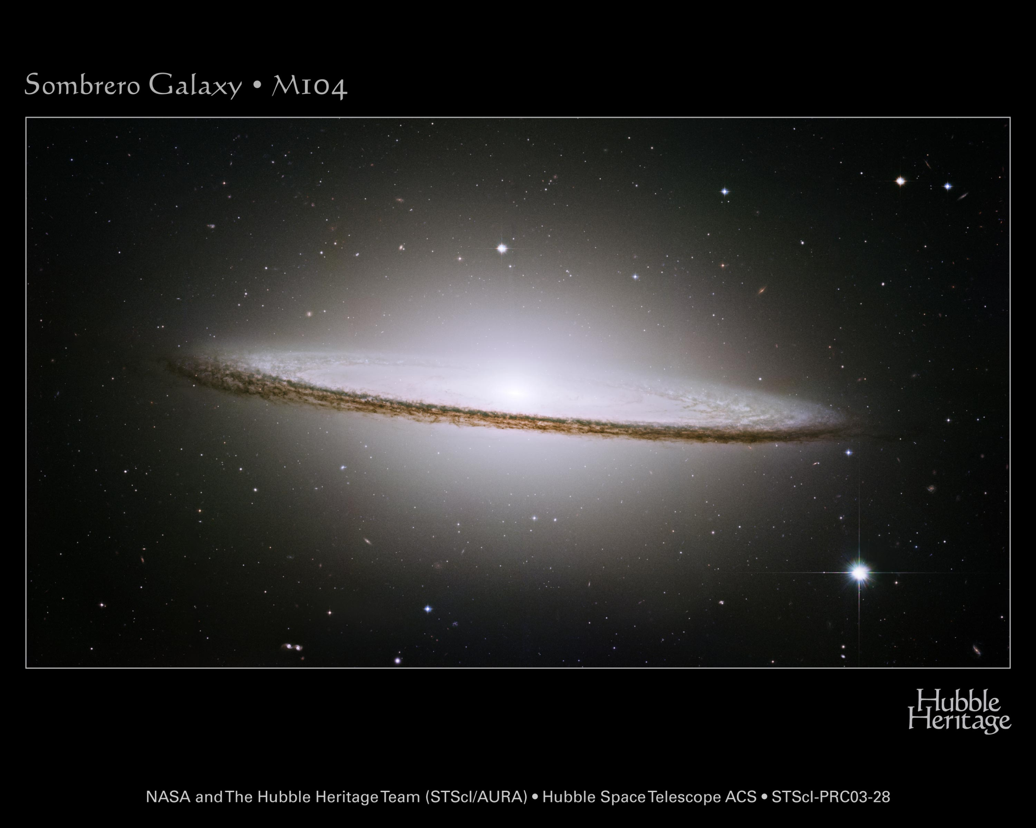

Slide 15
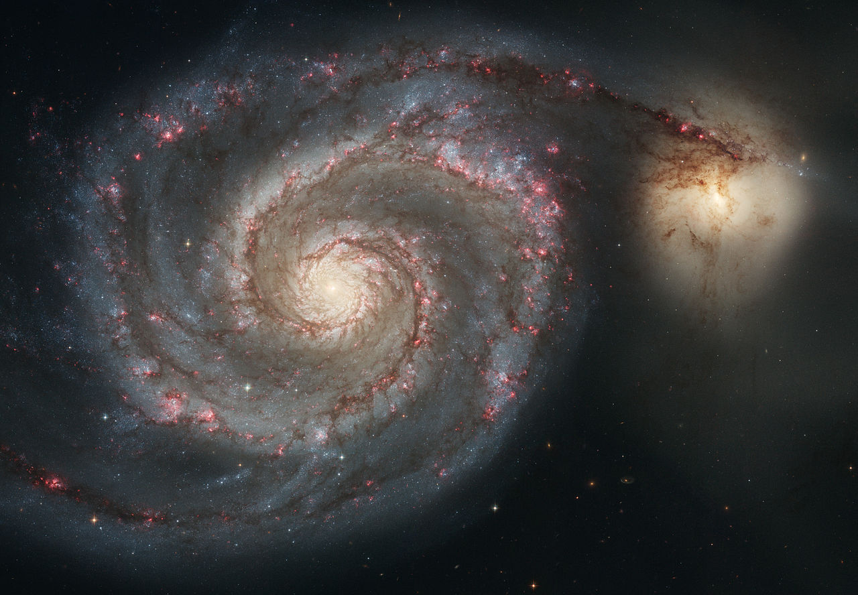

Slide 16
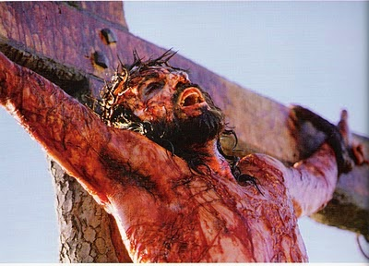

Slide 17
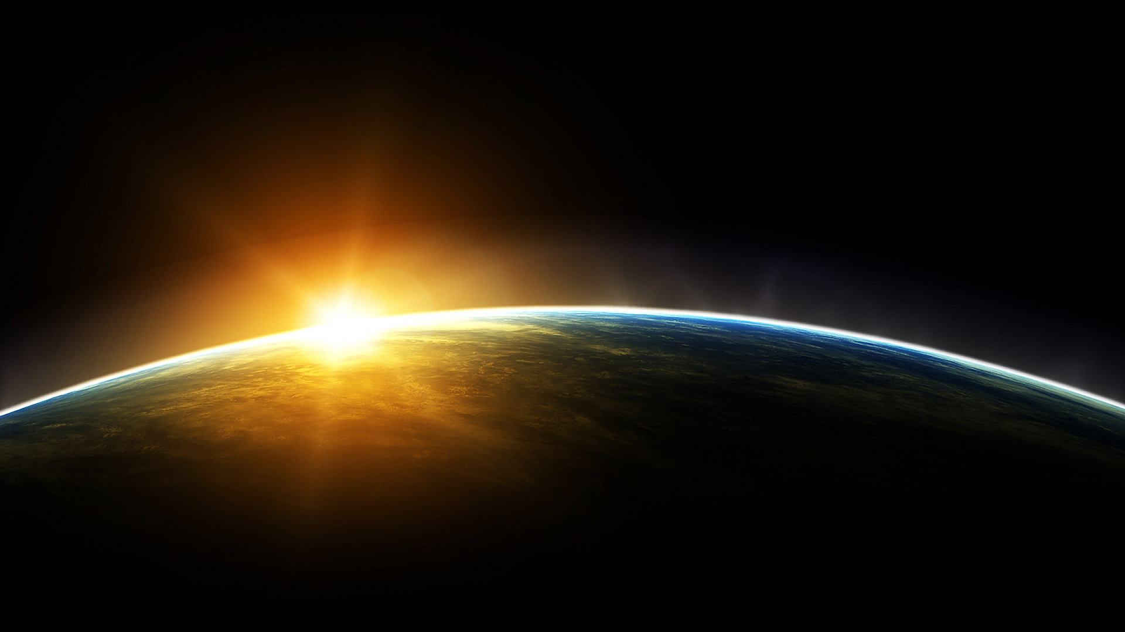
“For as high as the heavens are above the earth, so great is His steadfast love toward those who fear Him; as far as the east is from the west, so far does He remove our transgressions from us.
Psalm 103:11-12

Slide 18
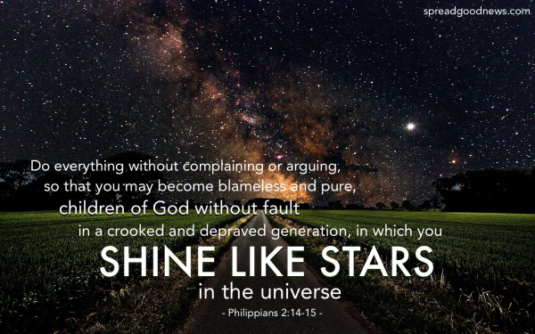

Slide 19
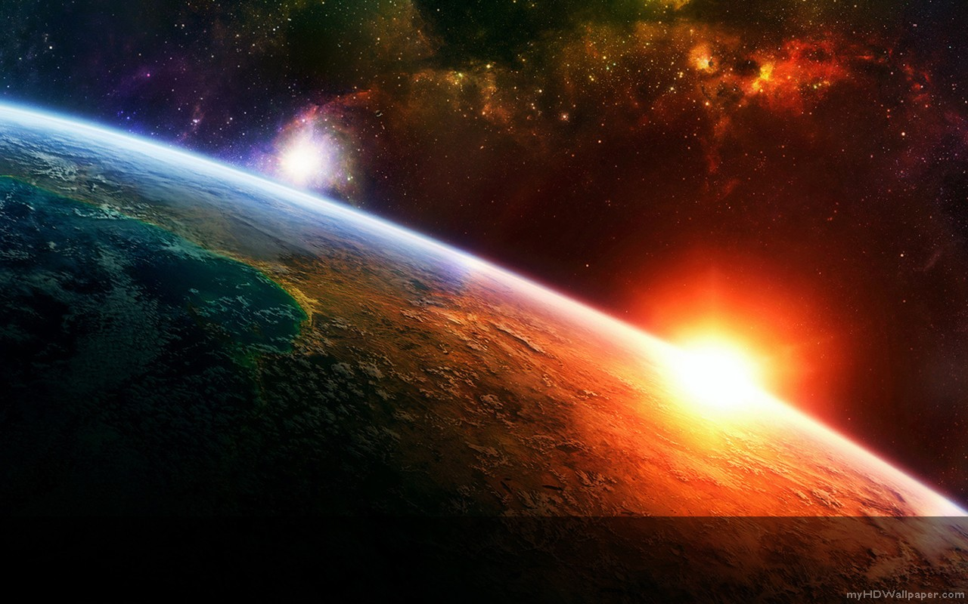
“Let your light so shine before men that they may see your good works and glorify your Father who is in heaven.” Matt. 5:16

