Slide 1
Seven Pillars of Wisdom
Proverbs 9:1; 8:12-14

Slide 2
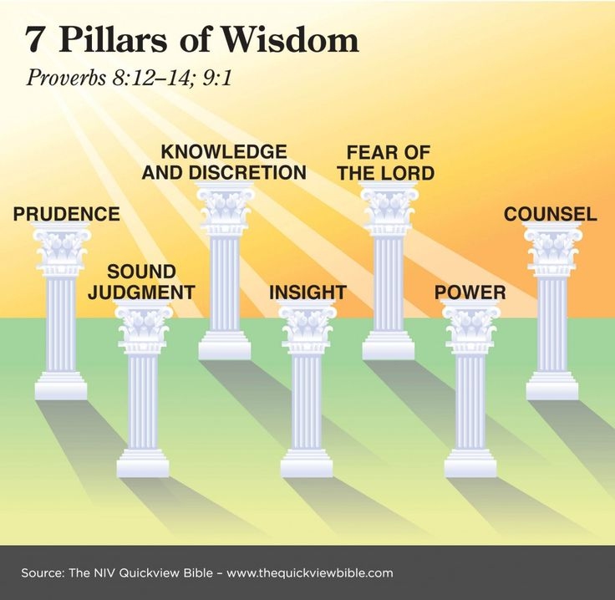
The seven pillars of Proverbs 9:1
“Wisdom has built her house; she has hewn her seven pillars.”
¹² I, wisdom, dwell with prudence, and I find knowledge and discretion. ¹³ The fear of the Lord is hatred of evil. Pride and arrogance and the way of evil and perverted speech I hate. ¹⁴ I have counsel and sound wisdom (judgment); I have insight; I have strength (power)” (Pro. 8:12-14).

Slide 4
The Seven Pillars
Prudence (12a)
Knowledge and Discretion (12b)
Fear of the Lord (13)
Counsel (14a)
Sound Judgment (14b)
Insight (14c)
Power (14d)

Slide 5
Seven Pillars of Wisdom
Proverbs 9:1; 8:12-14

