Slide 1
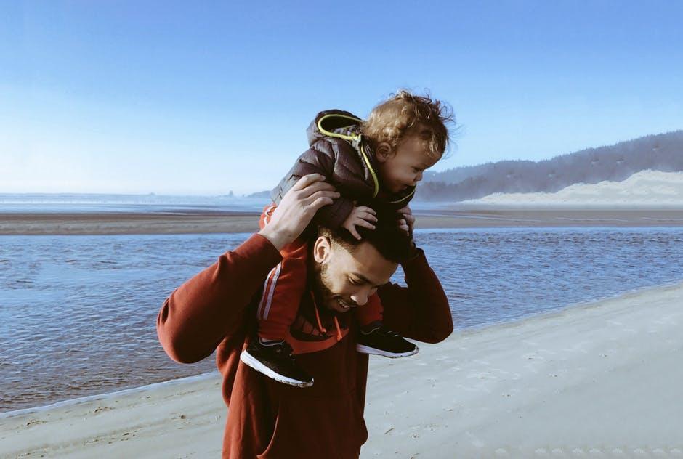
What Parents Need

Slide 3
Do I Need…
To provide a large group of peers for my children?
Give a “perfect”, problem-free environment?
To be the perfect parent?

