Slide 1
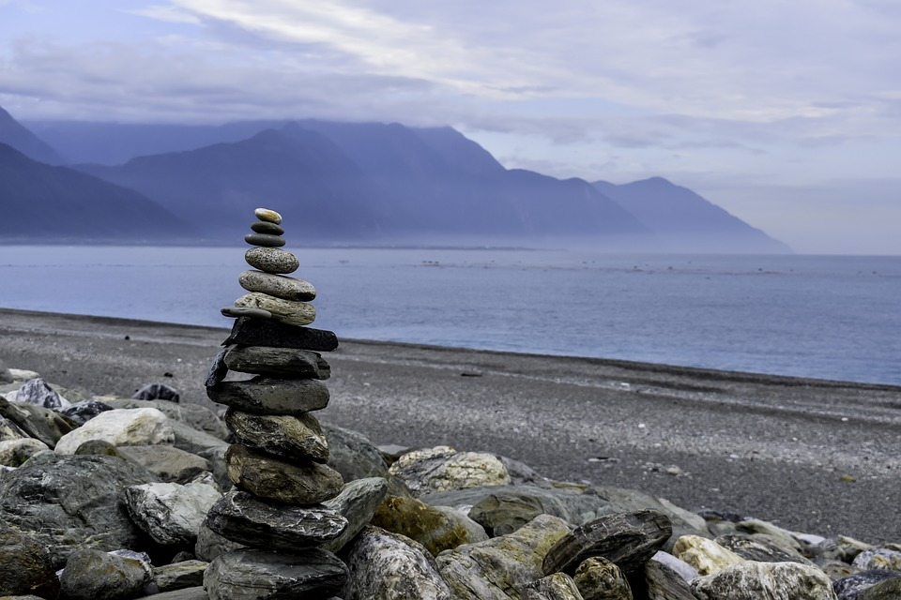
The Seventh Psalm
Confidence Born of Integrity

Slide 2
Does your integrity allow you to firmly state that you are blameless?
Would your integrity drive you to stand before God, or turn in fear?
Is you integrity sincere, or a front to hide a darker nature?

Slide 3
Are you striving for an integrity that will allow you to weather difficulty and walk in confidence before God?

