Slide 1
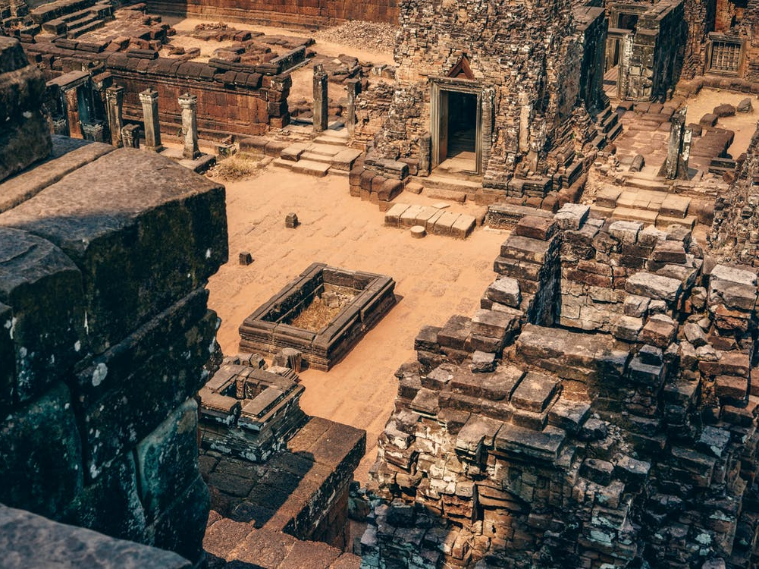
Learning from the Fall of Israel
II Kings 17

Slide 2
Factors Behind the Fall
While God always remembered His people, Israel failed to keep Him before their eyes.
Israel constantly struggled with the need to have their trust in something they could see and touch.
Whenever God extended mercy through the prophets, Israel would respond with rejection.

Slide 3
Factors Behind the Fall
Israel placed no real value on their Covenant with God. It was a cheap object to be discarded.
God held Israel responsible for the ways in which their idolatry affected others like Judah.

Slide 4
Are These Factors Familiar?
Do we struggle to remember what God has done?
Are we tempted to trust in the physical?
Do we take God’s mercy for granted?
Is our covenant with God something we treasure?
Are we influencing others for good or evil?

