Slide 1
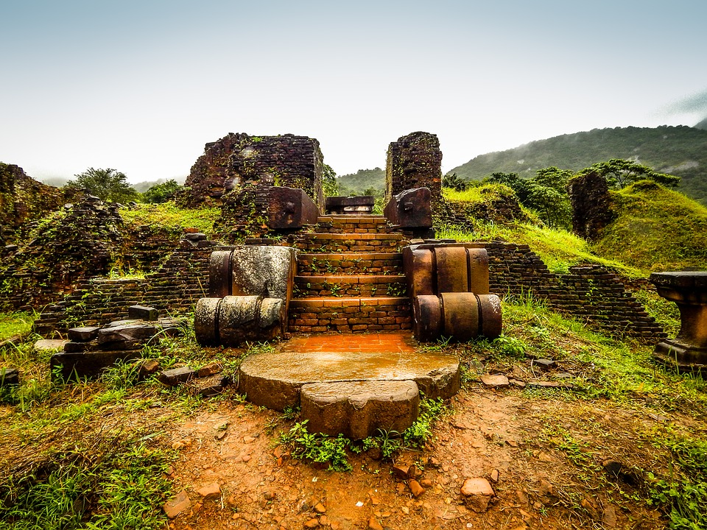
Exploring the Ethics of the Kings

Slide 2
Kings and Chronicles are not a rich source of material for role models.
We must be careful that we take the intended lessons and not supply our own.
It is dangerous to make assumptions about these stories and then make assertions about how God will act.

Slide 3
But the high places were not removed from Israel; nevertheless Asa’s heart was blameless all his days. - II Chronicles 15:17
He walked in the way of his father Asa and did not depart from it, doing right in the sight of the LORD. The high places, however, were not removed; - II Chronicles 20:32-33a

Slide 4
What About Those High Places?
The first assumption is that efforts were not made to remove the high places...

Slide 5
The high places, however, were not removed; the people had not yet directed their hearts to the God of their fathers.
Jehoash did right in the sight of the LORD all his days in which Jehoiada the priest instructed him. Only the high places were not taken away; the people still sacrificed and burned incense on the high places

Slide 6
Only the high places were not taken away; the people still sacrificed and burned incense on the high places.
He did right in the sight of the LORD, according to all that his father Amaziah had done. Only the high places were not taken away; the people still sacrificed and burned incense on the high places.

Slide 7
What About Those High Places?
The first assumption is that efforts were not made to remove the high places...
The second is to equate their existence with the king’s participation.
The story of the high places is not about God’s indifference; but a build up to the point where it became too late for Israel.

Slide 8
What of God’s Mercy to Uzziah?
Uzziah was not immediately put to death: Instead, he was given a long drawn out sentence of suffering.
How we react to God’s mercy makes a strong statement about what we’re seeking.

Slide 9
What of David and the Showbread?
First, Jesus unequivocally states that David and his men were in the wrong.
Second, David took responsibility for his actions causing the death of a city.
Is this a foundation to build on?

Slide 10
Being determined to find the truth does not mean you’ve set yourself up as an unmerciful judge.
We can’t force everyone to follow God’s Word, but we can determine to do so as a group of God’s people.

