Slide 1
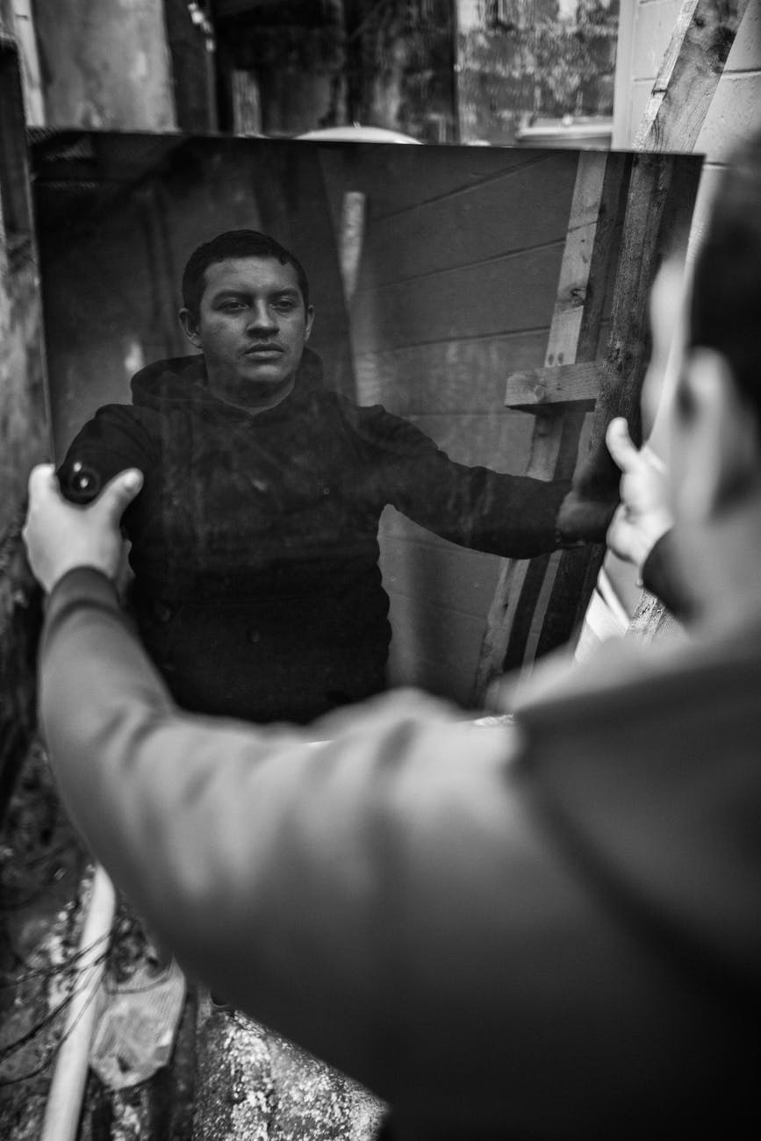
What Does Conversion Look Like?
A Study in the Book of Acts

Slide 2
The Foundation of Pentecost
They heard a message of Jesus Christ: Crucified and Risen
This message clearly convicted them of their sin.
They could not remain unchanged, but sought the solution.
They were compelled to immediately act; they were immersed in water, having their sins forgiven.
They came out as a different people—their lives immediately began to reflect the changes of their conversion.

Slide 3
The Urgency of the Ethiopian
Now that he’d found a source for answers, his only question was “what’s stopping us now?”
He did not need to be pushed along, and he was not interested in any delays.

Slide 4
The Desire of the Centurion
Cornelius demanded that no portion of God’s will be kept from him and his family.
His desire was to know everything that God required and expected of him.

Slide 5
The Action of the Merchant
Lydia’s request was not born out of a desire to simply have a stamp of approval.
The great change in her life was reflected by a commitment to be busy with the work.

Slide 6
Taking it With Us:
Is my conversion paired with a lasting Urgency?
Do I still have a desire to know what God requires?
Is my life one of dedicated involvement to the cause of Christ?
Can You Tell the Difference?

