Slide 1
The High Cost of A Ruined Reputation

Slide 2
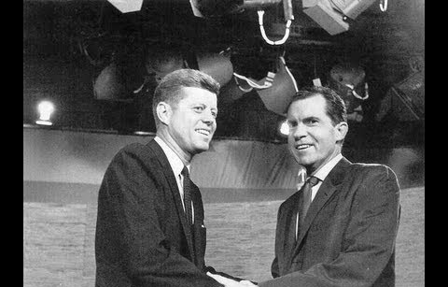

Slide 3
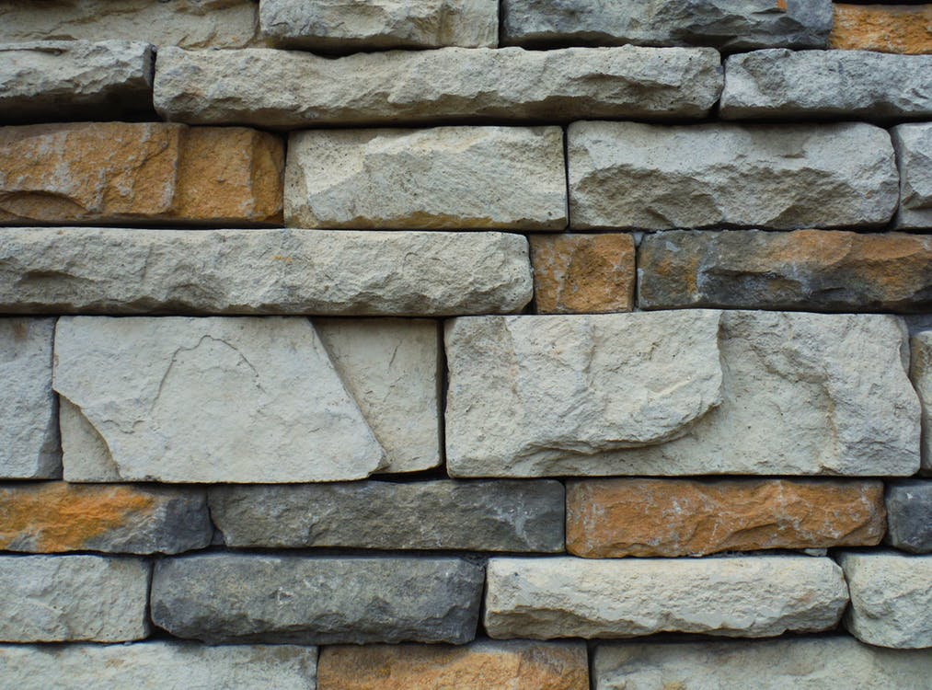
The Foundation of Our Influence:
Our character should reflect God’s nature to those around us.
We should have confidence that our behavior backs our message.
Inconsistency will cause others to ignore the gospel.

Slide 4
A Reflection on Our God:
The downfall of God’s people allows His enemies to speak ill of Him.
We will be held accountable when our behavior is the cause of this.
We must be concerned for God’s name.

Slide 5
Taking It With Us:
Is your life consistent enough to be an example for others?
Is their behavior that would put your reputation at risk?
Are there steps you need to take to restore your relationship?

