Slide 1
Then Comes the Judgment

Slide 2
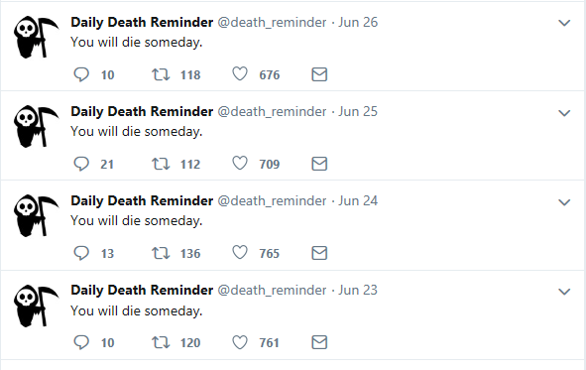

Slide 3
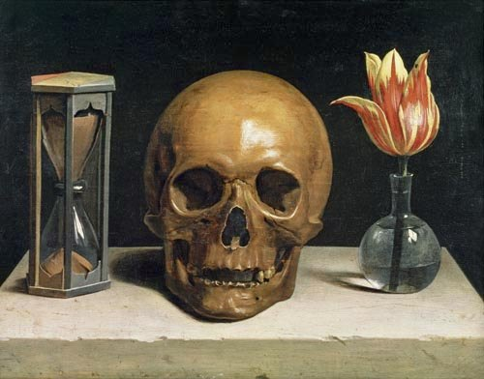

Slide 4
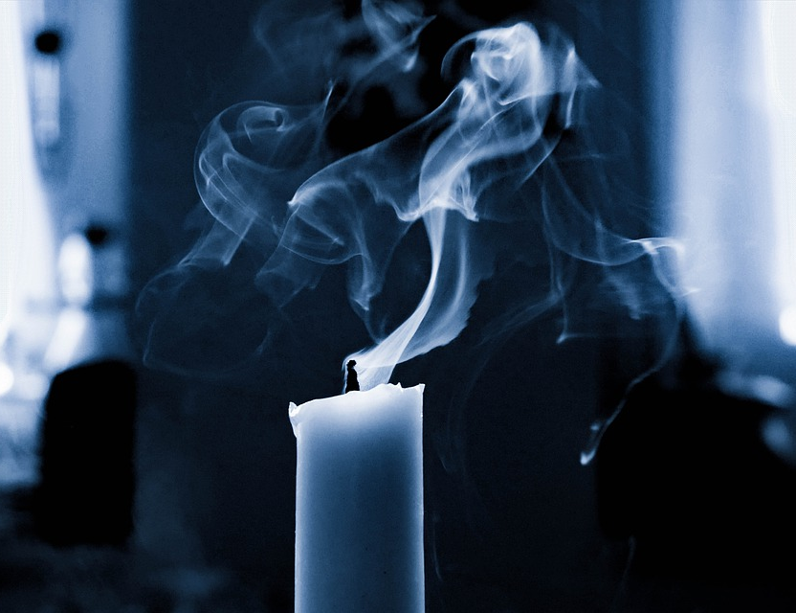
When we push “the end” out of our minds, we are pushing away a core part of who we are.
Refusing to think on our deaths does not prevent them from coming— it only leaves us unprepared.

Slide 5
Remember that this world’s possessions are only temporary.
Take the ends of others to heart.
Take time to be still.

