Slide 1
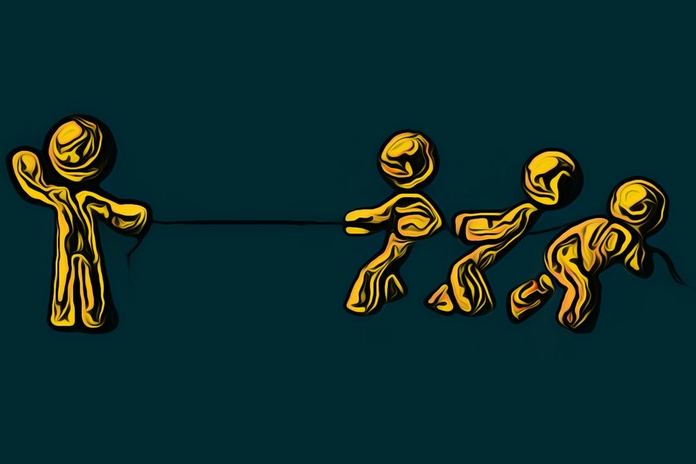
Is Baptism a Fight Worth Having?

Slide 2
What Happens During Baptism?

Slide 3
ADAM | CHRIST
Made the choice to rebel | Made the choice to obey
Rebellion brought sin and death | Obedience brought righteousness and life.
THE INDIVIDUAL
Made the Choice to Sin (5:12) | ???????
Death Reigned Over Us (5:14) | Righteousness and Life (5:17)

Slide 4
What Happens During Baptism?
We are moved from the era of sin and death, into the era of righteousness and life.
We become clothed as children of God.

Slide 5
What Else is Optional?
It is hard to imagine other acts of obedience treated as merely good ideas.
The mark left in the NT is impossible to ignore: Acts 2:38; 8:12-13, 36-38; 9:18; 10:48; 16:15; 16:33; 18:8 19:3; 22:16…etc.

Slide 6
Clear Out Distractions
We must help others see that the NT does not treat baptism as an afterthought.
Accusations of squabbling ignore that convictions from God’s Word cannot be compromised.

Slide 7
Baptism opens the door to incredible spiritual blessings.
The significance of baptism should continue to impact and motivate.

