Slide 1
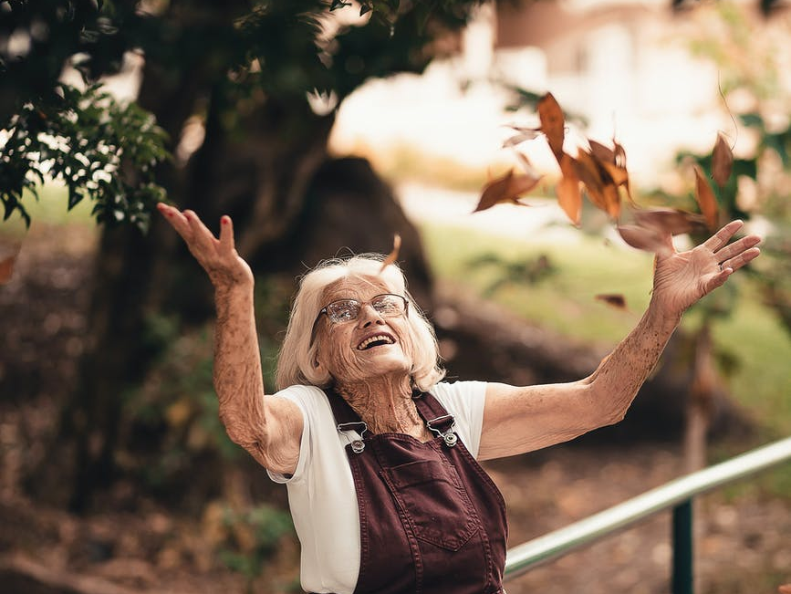
Reason to Rejoice
1 Peter 1:3-6

Slide 2
We Have a Living Hope
The world’s relationship with hope is one of desire met with disappointment.
The believer’s relationship with hope is rooted in guarantees.

Slide 3
An Eternal Inheritance
Imperishable...
Undefiled...
Unfading...

Slide 4
A Sure Salvation
God’s promise of salvation is to rescue His people from a fallen world.
He has promised that He will enable us to ensure until that day.

Slide 5
A Foundation of Joy
A Living Hope...
An Eternal Inheritance...
A Sure Salvation...

