Slide 1
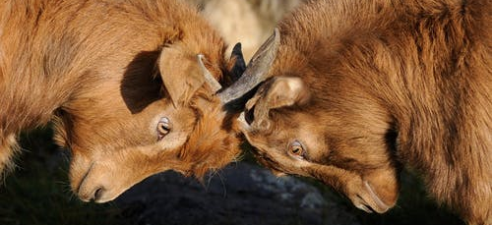
Godly Love and Communication
1 Corinthians 13:7

Slide 2
BELIEVES ALL THINGS
A choice to assume good in the intent and actions of others…
Calls on us to remember that we are dealing with our brethren.

Slide 3
HOPES ALL THINGS
Refuses to see the failures of others as the final word…
Requires that we leave room for progress and growth.

Slide 4
BEARS/ENDURES ALL THINGS
Must I take offense at every perceived grievance or slight?
What am I unable to Cover if I have Love?

Slide 5
CHALLENGES
Make Personal Application
Think better of your brethren
Give grace, take no offense

Slide 6
