Slide 1
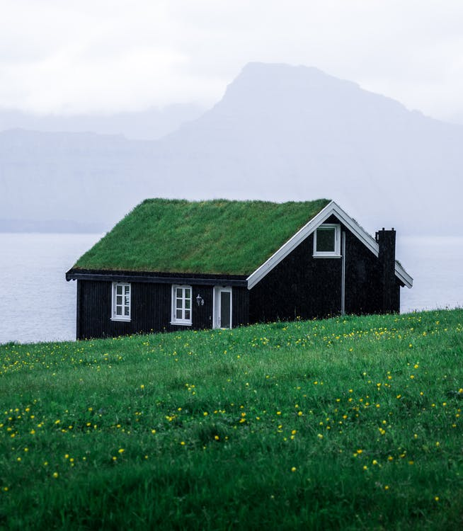
The Character of My Home
Psalm 101

Slide 2
The Foundation of a Home
David’s standards of devotion were based on showing loyalty to a loyal God…
And an appreciation for God’s “good times” as well as the “bad.”
He sought to create a home where God would be eager to dwell.

Slide 3
No Shelter For Evil
David set out with dedication to remove any trace of that which was wicked.
He understood that wicked people & actions have direct influence on our lives.
He desired a home with a reputation for harboring good and turning away evil.

Slide 4
Good Influences/Examples
David sought to bring the righteous into the spotlight—to be a model for others.
He also understood that the example for good behavior had to start with himself.

Slide 5
Challenges
Parents must actively work to direct.
Older Christians; please lend your wisdom.
Younger children must grow to appreciate.

