Slide 1
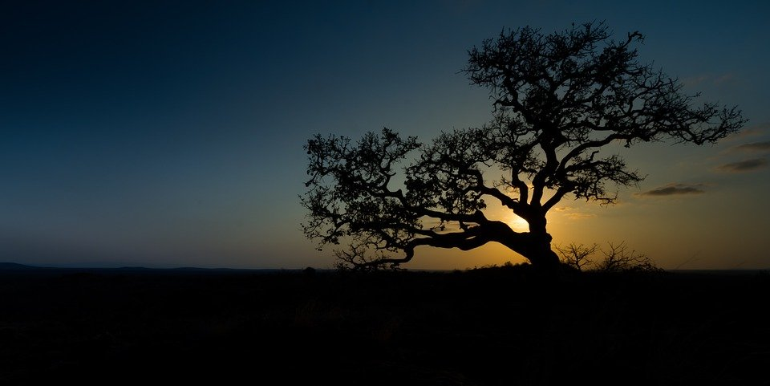
Parables that Direct Our Sight
Luke 13:1-9

Slide 2
Blinded By Circumstance?
The crowds equated outward circumstance as Divine commentary on the inward life.
This attitude prevented real self-examination.
Both the wicked and the righteous can fall prey.
We must clear away any external factors that keeps us from honestly look at our lives.

Slide 3
Needed Realizations:
There was no use for a barren tree: God’s people are not called to take up space.
My inactivity hinders the activity of others:
My inactivity serves as a judgment on myself.

Slide 4
The Patience and the Fury:
The actions of the owner should call to my attention how often God has checked for fruit.
The actions of the owner should also cause me to take note of where God has set His limits.

Slide 5
Challenges
Don’t be Blinded by Externals.
Bad Results Should Drive Positive Change.
Be Fruitful in Every Season of Life.

Slide 6
Parables that Direct Our Sight
Luke 13:1-9

