Slide 1
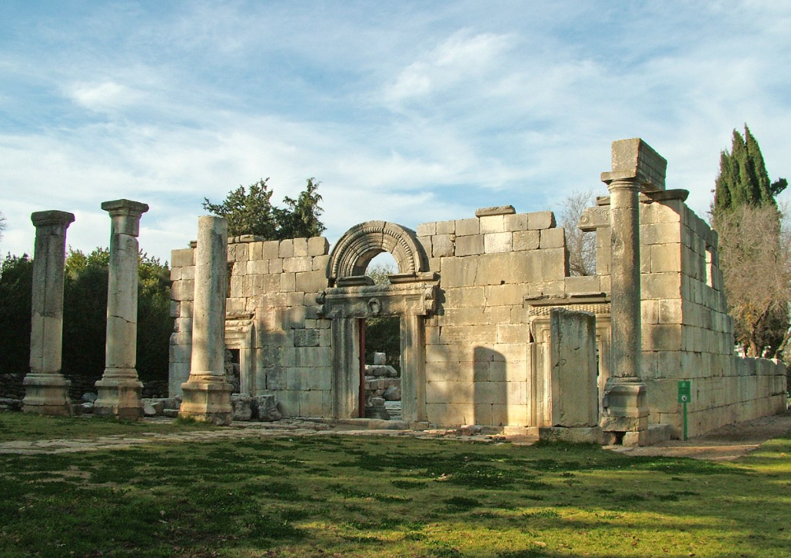
Going to church WITH JESUS Luke 4:14-30

Slide 2
If you went to church with Jesus…
You would find the Word of God reading the word of God!
Jesus is the Word of God! (John 1:1, 14; Revelation 19:13)
Reading the Word is vital! (Luke 4:16, Eph. 3:4, 1st Tim. 4:13)
Luke 4:14-30

Slide 3
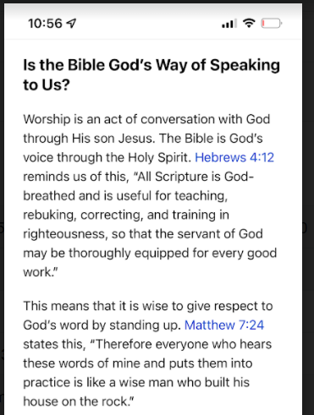

Slide 4
If you went to church with Jesus…
You would find the Word of God reading the word of God!
Jesus is the Word of God! (John 1:1, 14; Revelation 19:13)
Reading the Word is vital! (Luke 4:16, Eph 3:4, 1st Tim 4:13)
You would find the word of God respected!
The practice of standing was a sign of respect. (Luke 4:16)
In the days of Ezra and Nehemiah (Nehemiah 8:5-6, 8, 3)
Jesus opened the book and found the place… (Luke 4:17)
Luke 4:14-30

Slide 5
If you went to church with Jesus…
You would find the Word of God reading the word of God!
You would find the word of God respected!
You would hear a relevant message from God’s Word!
Today this Scripture is fulfilled! (Luke 4:21)
The prophet Isaiah’s scroll (61:1-2)
The Gospel! (Luke 4:18, Romans 1:16)
“Release the captives! Recovery of sight!”
Luke 4:14-30

Slide 6
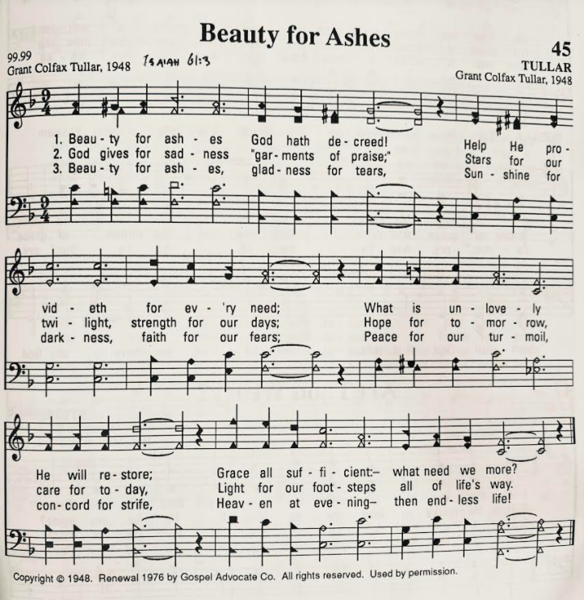
Beauty for Ashes
(Isaiah 61:3)

Slide 7
If you went to church with Jesus…
You would find the Word of God reading the word of God!
You would find the word of God respected!
You would hear a relevant message from God’s Word!
You would likely react with some big compliments!
“…all were speaking well of Him.” (Luke 4:22, 15)

Slide 8
If you went to church with Jesus…
You would find the Word of God reading the word of God!
You would find the word of God respected!
You would hear a relevant message from God’s Word!
You would likely react with some big compliments!
You might receive an unexpected rebuke!
Hometown hero viewed as hometown zero!
Example of the faithful being faithless! (Luke 4:23-27)
Rebukes for everyone! (Luke 14:1-14)

Slide 9
If you went to church with Jesus…
You would find the Word of God reading the word of God!
You would find the word of God respected!
You would hear a relevant message from God’s Word!
You would likely react with some big compliments!
You might receive an unexpected rebuke!
Hopefully you wouldn’t leave in a rage!
“…all the people… were filled with rage…” (Luke 4:28)

Slide 10
If you went to church with Jesus…
You would find the Word of God reading the word of God!
You would find the word of God respected!
You would hear a relevant message from God’s Word!
You would likely react with some big compliments!
You might receive an unexpected rebuke!
Hopefully you wouldn’t leave in a rage!
Hopefully you would repent and leave rejoicing!
The spirit of Zaccheus! (Luke 19:8)

