Slide 1
Be Faithful Unto Death
Message to the church at Smyrna
(Rev. 2:8-11)

Slide 2
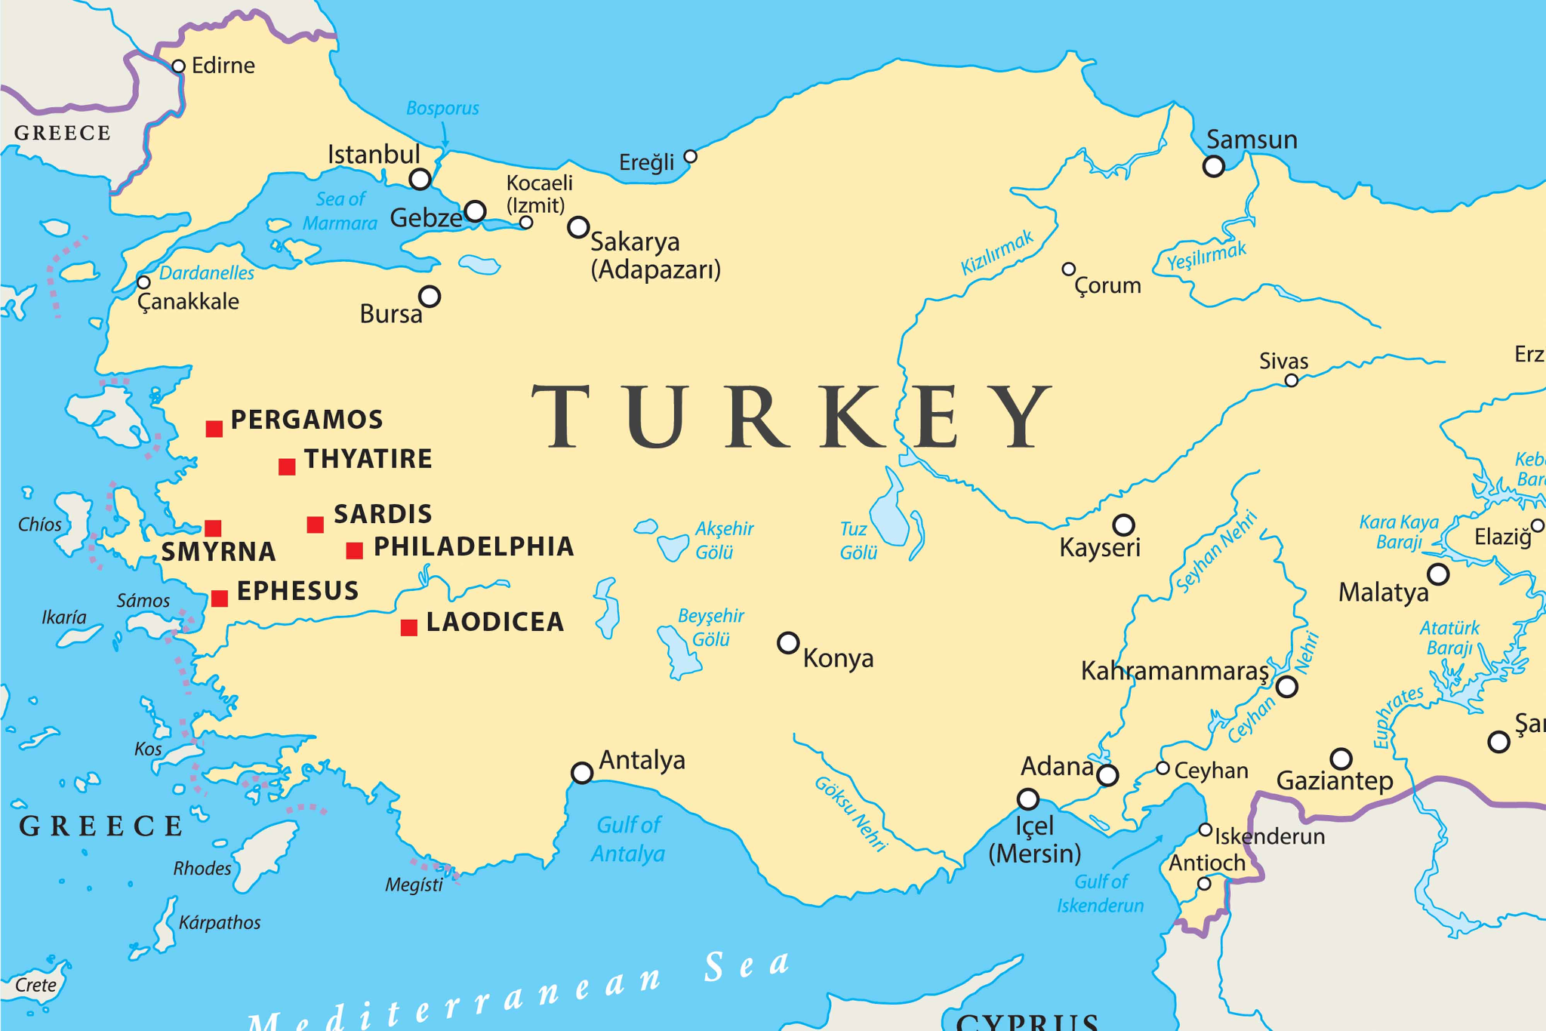

Slide 3
Smyrna and the Imperial Cult
Wealthy City
City of great wealth and architecture
Gymnasiums, stadiums, theaters, libraries, gardens, and temples encircled Mt. Pagus like a crown*
Imperial Cult Definition: worship of the emperor as deity.
26 AD - temple built to Tiberius (later Domitian in 96AD)
won the honor of “temple warden”
Polycarp--a famous Christian martyr--was, perhaps, Smyrna and was killed for not renouncing Christ**
*Philostratus, Apollonius of Tyana; Strabo, Geography
**Martyrdom of Polycarp, Letter written in 155AD

Slide 4
Message to Smyrna (Rev. 2:8-11)
8 “And to the angel of the church in Smyrna write,
‘These things says the First and the Last, who was dead, and came to life: 9 “I know your works, tribulation, and poverty (but you are rich); and I know the blasphemy of those who say they are Jews and are not, but are a synagogue of Satan. 10 Do not fear any of those things which you are about to suffer. Indeed, the devil is about to throw some of you into prison, that you may be tested, and you will have tribulation ten days. Be faithful until death, and I will give you the crown of life.
11 “He who has an ear, let him hear what the Spirit says to the churches. He who overcomes shall not be hurt by the second death.” ’
Notes:
What does the messenger know?

Slide 5
Message to Smyrna (Rev. 2:8-11)
8 “And to the angel of the church in Smyrna write,
‘These things says the First and the Last, who was dead, and came to life: 9 “I know your works, tribulation, and poverty (but you are rich); and I know the blasphemy of those who say they are Jews and are not, but are a synagogue of Satan. 10 Do not fear any of those things which you are about to suffer. Indeed, the devil is about to throw some of you into prison, that you may be tested, and you will have tribulation ten days. Be faithful until death, and I will give you the crown of life.
11 “He who has an ear, let him hear what the Spirit says to the churches. He who overcomes shall not be hurt by the second death.” ’
Notes:
What does the messenger know?

Slide 6
“I know…”
“I know your works [and] tribulation…”
Tribulation: thlipsis - a pressing or pressure
Things are not as they seem:
“I know your…poverty”
“But you are rich”
“I know…those who say…they are Jews”
“But are a synagogue of Satan.”

Slide 7
Message to Smyrna (Rev. 2:8-11)
8 “And to the angel of the church in Smyrna write,
‘These things says the First and the Last, who was dead, and came to life: 9 “I know your works, tribulation, and poverty (but you are rich); and I know the blasphemy of those who say they are Jews and are not, but are a synagogue of Satan. 10 Do not fear any of those things which you are about to suffer. Indeed, the devil is about to throw some of you into prison, that you may be tested, and you will have tribulation ten days. Be faithful until death, and I will give you the crown of life.
11 “He who has an ear, let him hear what the Spirit says to the churches. He who overcomes shall not be hurt by the second death.” ’
Notes:
What else does the messenger know, specifically about the future?
But what does he command?

Slide 8
Message to Smyrna (Rev. 2:8-11)
8 “And to the angel of the church in Smyrna write,
‘These things says the First and the Last, who was dead, and came to life: 9 “I know your works, tribulation, and poverty (but you are rich); and I know the blasphemy of those who say they are Jews and are not, but are a synagogue of Satan. 10 Do not fear any of those things which you are about to suffer. Indeed, the devil is about to throw some of you into prison, that you may be tested, and you will have tribulation ten days. Be faithful until death, and I will give you the crown of life.
11 “He who has an ear, let him hear what the Spirit says to the churches. He who overcomes shall not be hurt by the second death.” ’
Notes:
What else does the messenger know, specifically about the future?
But what does he command?

Slide 9
Message to Smyrna (Rev. 2:8-11)
8 “And to the angel of the church in Smyrna write,
‘These things says the First and the Last, who was dead, and came to life: 9 “I know your works, tribulation, and poverty (but you are rich); and I know the blasphemy of those who say they are Jews and are not, but are a synagogue of Satan. 10 Do not fear any of those things which you are about to suffer. Indeed, the devil is about to throw some of you into prison, that you may be tested, and you will have tribulation ten days. Be faithful until death, and I will give you the crown of life.
11 “He who has an ear, let him hear what the Spirit says to the churches. He who overcomes shall not be hurt by the second death.” ’
Notes:
What else does the messenger know, specifically about the future?
But what does he command?

Slide 10
Message to Smyrna (Rev. 2:8-11)
8 “And to the angel of the church in Smyrna write,
‘These things says the First and the Last, who was dead, and came to life: 9 “I know your works, tribulation, and poverty (but you are rich); and I know the blasphemy of those who say they are Jews and are not, but are a synagogue of Satan. 10 Do not fear any of those things which you are about to suffer. Indeed, the devil is about to throw some of you into prison, that you may be tested, and you will have tribulation ten days. Be faithful until death, and I will give you the crown of life.
11 “He who has an ear, let him hear what the Spirit says to the churches. He who overcomes shall not be hurt by the second death.” ’
Notes:
What else does the messenger know, specifically about the future?
But what does he command?

Slide 11
Commands
“Do not fear…”
Prison; tribulation 10 days
“Be faithful unto death…”
Crown of life (consider James 1:12)
“...Let him hear…”
“He who overcomes shall not be hurt by the second death.”

Slide 12
Message to Smyrna (Rev. 2:8-11)
8 “And to the angel of the church in Smyrna write,
‘These things says the First and the Last, who was dead, and came to life: 9 “I know your works, tribulation, and poverty (but you are rich); and I know the blasphemy of those who say they are Jews and are not, but are a synagogue of Satan. 10 Do not fear any of those things which you are about to suffer. Indeed, the devil is about to throw some of you into prison, that you may be tested, and you will have tribulation ten days. Be faithful until death, and I will give you the crown of life.
11 “He who has an ear, let him hear what the Spirit says to the churches. He who overcomes shall not be hurt by the second death.” ’
Notes:
What else does the messenger know, specifically about the future?
But what does he command?

Slide 13
Message to Smyrna (Rev. 2:8-11)
8 “And to the angel of the church in Smyrna write,
‘These things says the First and the Last, who was dead, and came to life: 9 “I know your works, tribulation, and poverty (but you are rich); and I know the blasphemy of those who say they are Jews and are not, but are a synagogue of Satan. 10 Do not fear any of those things which you are about to suffer. Indeed, the devil is about to throw some of you into prison, that you may be tested, and you will have tribulation ten days. Be faithful until death, and I will give you the crown of life.
11 “He who has an ear, let him hear what the Spirit says to the churches. He who overcomes shall not be hurt by the second death.” ’
Notes:
Who is the messenger?

Slide 14
The Perfect Messenger
“The First and the Last”
Isaiah 44:6-8
“Who was dead and came to life”
Acts 2:22-24
6“Thus says the Lord, the King of Israel,
And his Redeemer, the Lord of hosts:
‘I am the First and I am the Last;
Besides Me there is no God.
7 And who can proclaim as I do?
Then let him declare it and set it in order for Me,
Since I appointed the ancient people.
And the things that are coming and shall come,
Let them show these to them.
8 Do not fear, nor be afraid;
Have I not told you from that time, and declared it?
You are My witnesses.
Is there a God besides Me?
Indeed there is no other Rock;
I know not one.’ ”
22 “Men of Israel, hear these words: Jesus of Nazareth, a Man attested by God to you by miracles, wonders, and signs which God did through Him in your midst, as you yourselves also know— 23 Him, being delivered by the determined purpose and foreknowledge of God, you have taken by lawless hands, have crucified, and put to death; 24 whom God raised up, having loosed the pains of death, because it was not possible that He should be held by it.

Slide 15
Be Faithful Unto Death
Message to the church at Smyrna
(Rev. 2:8-11)

Slide 16
50 Now this I say, brethren, that flesh and blood cannot inherit the kingdom of God; nor does corruption inherit incorruption…54 So when this corruptible has put on incorruption, and this mortal has put on immortality, then shall be brought to pass the saying that is written: “Death is swallowed up in victory.”
55 “O Death, where is your sting?
O Hades, where is your victory?”
56 The sting of death is sin, and the strength of sin is the law. 57 But thanks be to God, who gives us the victory through our Lord Jesus Christ.
58 Therefore, my beloved brethren, be steadfast, immovable, always abounding in the work of the Lord, knowing that your labor is not in vain in the Lord. (1 Cor. 15:50, 54-58)

