Slide 2
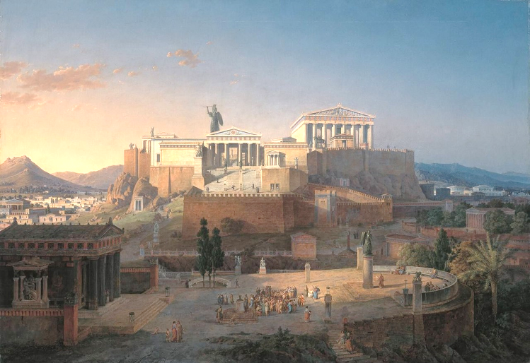
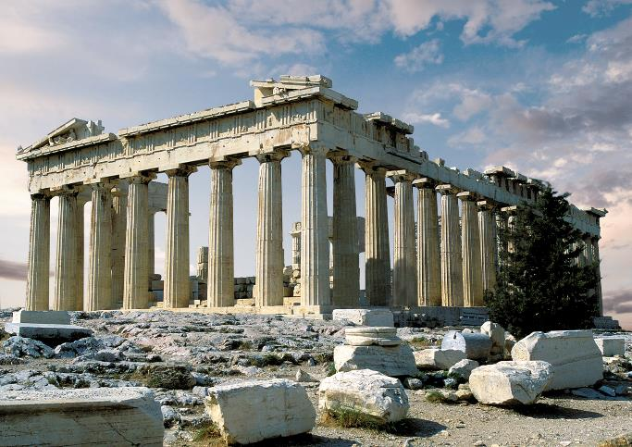
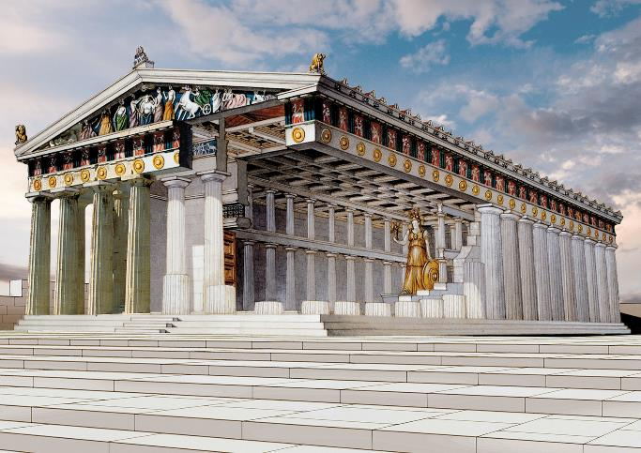
“The church is the only organization on earth that exists for the sake of those who aren’t a part of it yet.”
“Then they took him and brought him to a meeting of the Areopagus, where they said to him, ‘May we know what this new teaching is that you are presenting?’” Acts 17:19

Slide 3
“I URGE YOU TO IMITATE ME!”
He opened his eyes.
“So he reasoned in the synagogue with both Jews and God-fearing Greeks, as well as in the market- place day by day with those who happened to be there.”
Acts 17:17
“…from Issachar, men who understood the times and knew what Israel should do...”
1 Chronicles 12:32
“As I walked around and looked…”
Acts 17:23

Slide 4
“I URGE YOU TO IMITATE ME!”
He opened his eyes.
He exposed his heart.
“Now while Paul waited for them at Athens, his spirit was provoked within him when he saw that the city was given over to idols.”
Acts 17:16
“While Paul was waiting for them
in Athens, he was greatly distressed to see that the city was full of idols.”
Acts 17:16
“For all the Athenians and the foreigners who were there spent their time in nothing else but either to tell or to hear some new thing.”
Acts 17:21

Slide 5
“I URGE YOU TO IMITATE ME!”
He opened his eyes.
He exposed his heart.
He engaged his mind.
“As was his custom, Paul went into the synagogue, and on three Sabbath days he reasoned with them from the Scriptures.”
Acts 17:2
“Therefore he reasoned in the synagogue with the Jews and with the Gentile worshipers, and in the marketplace daily with those who happened to be there.” Acts 17:17
“Every Sabbath he reasoned in
the synagogue, trying to persuade Jews and Greeks.” Acts 18:4

Slide 6
“I URGE YOU TO IMITATE ME!”
He opened his eyes.
He exposed his heart.
He engaged his mind.
“A group of Epicurean and Stoic philosophers began to debate with him. Some of them asked, ‘What is this babbler trying to say?’ Others remarked, ‘He seems to be advocating foreign gods.’” Acts 17:18
“For what I received I passed on to you as of
first importance: that Christ died for our sins according to the Scriptures, that he was buried, that he was raised on the third day according to the Scriptures…” 1 Corinthians 15:3, 4
“Paul was preaching the good news about Jesus and the resurrection.”
Acts 17:18

Slide 7
“I URGE YOU TO IMITATE ME!”
He opened his eyes.
He exposed his heart.
He engaged his mind.
He connected his God.
“Because He has appointed a day on which He will judge the world in righteousness by the Man whom He has ordained. He has given assurance of this to all by raising Him from the dead.” Acts 17:31
God created us – vs. 24
God is close to us – vs. 27, 28
God holds us accountable – vs. 29, 30
Shine
Speak
Acts 17:24-31
Invite
Welcome

Slide 8
Some reject.
Some reject.
Some consider.
Some believe.
Some reject.
Some consider.

