Slide 1
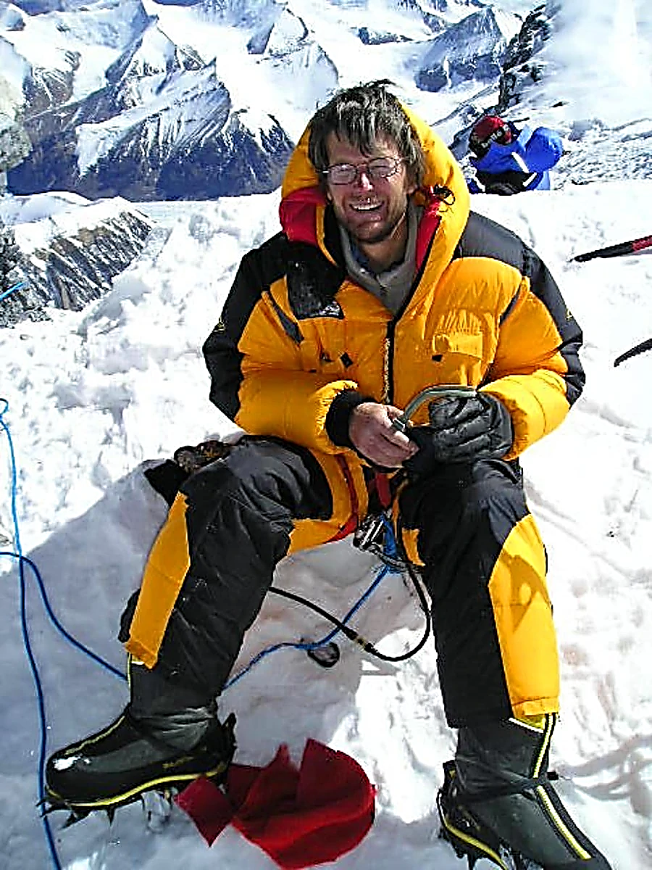

Slide 2
“Sing for joy, O heavens, and exult O earth; break forth, O mountains, into singing! For the Lord has comforted his people and will have compassion on his afflicted.”
Isaiah 49:13
“...The Lord, the Lord, the compassionate and gracious God, slow to anger, abounding in love and faithfulness, maintaining love to thousands, and forgiving wickedness, rebellion and sin.”
Exodus 34:5-7

Slide 3
GOD PROVES:
God’s Power Is Not Dictated
By The Army’s Size
“Now to Him who is able to do far more abundantly beyond all that we ask or think, according to the power that works within us, to Him be the glory in the church and in Christ Jesus to all generations forever and ever. Amen.”
Ephesians 3:20-21

Slide 4
GOD PROVES:
God’s Power Is Not Dictated
By The Enemy’s Schemes
Location (v23)
Captains (v24)
“No temptation has overtaken you but such as is common to man; and God is faithful, who will not allow you to be tempted beyond what you are able, but with the temptation will provide the way of escape also, so that you will be able to endure it.”
1 Corinthians 11:13
Supplies (v25)
Timing (v26)

Slide 5
GOD PROVES:
God’s Power Is Not Dictated
By The Battle’s Location
“Then a man of God came near and spoke to the king of Israel and said, “Thus says the Lord, ‘Because the Arameans have said, “The Lord is a god of the mountains, but He is not a god of the valleys,” therefore I will give all this great multitude into your hand, and you shall know that I am the Lord.”
1 Kings 20:28
“Make sure that your character is free from the love of money, being content with what you have; for He, Himself has said, “I will never desert you, nor will I ever forsake you.”
Hebrews 13:5

