Slide 2
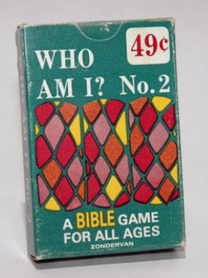
Who am I?
I am a city in the OT.
I am associated with Sodom and Gomorrah.
My name means “small”.
I am the city that Lot fled to when he was rescued.
My name starts with a Z.

Slide 3
Lessons from Zoar
Genesis 19:22

Slide 4
From Zoar, we learn of…
The gravity of sin (Genesis 18:20).
The Scriptures teach us that God can hear sin (Genesis 18:20-21, 19:12-13).
God to Cain, “the voice of your brother’s blood is crying out to Me from the ground.” (Genesis 4:10)
James 5:4, “Behold, the pay of the laborers… cries out…”
The voice of sin was never more audible than on the cross! (Matthew 27:46; Luke 23:46)

Slide 5
What was the sin of Sodom?!
Ezekiel 16:49-50
arrogance,
abundant food,
careless ease,
but she did not help…
Luke 17:28

Slide 6
From Zoar, we learn of…
The beauty of grace. (Genesis 19:16)
“But… he hesitated.”
Have you ever hesitated before God? (Jude 22-23)
“The compassion of the Lord was upon him.”
“Ummm, God, one more thing…” (Genesis 19:19-22)
“Grace upon grace.” John 1:16, Romans 2:4
“The Lord knows how to rescue the godly from temptation.” (2nd Peter 2:7-9)

Slide 7
From Zoar, we learn of…
The reality of judgment. (Genesis 19:24)
“The Lord rained on Sodom and Gomorrah brimstone and fire from the Lord out of heaven.”

Slide 8
What is brimstone?!
An inflammable mineral substance found in quantities on the shores of the Dead Sea
Rocks composed of sulfur.
Literally means “burning stone”.
If a match is put to brimstone, it will burn in a peculiar way, like a liquid fire, and it emits noxious fumes.
The stone melts like wax but the dripping is a peculiar thick fire, like a piece of wax on fire.
Revelation 20:10

Slide 9
From Zoar, we learn of…
The reality of judgment. (Genesis 19:24)
“The Lord rained on Sodom and Gomorrah brimstone and fire from the Lord out of heaven.”
2nd Peter 2:6, Jude 7
The judgment of fire was not the only judgment that day! (Genesis 19:26, Luke 17:28-32)
Luke 9:62

Slide 10
Lessons from Zoar
The gravity of sin. (Genesis 18:20)
“The wages of sin is death.” (Romans 6:23)
The beauty of grace. (Genesis 19:16)
“But God, being rich in mercy… made us alive…” (Ephesians 2:5-6)
The reality of judgment. (Genesis 19:24)
“It is appointed unto man once to die, and after this the judgment.” (Hebrews 9:27)

