Slide 1
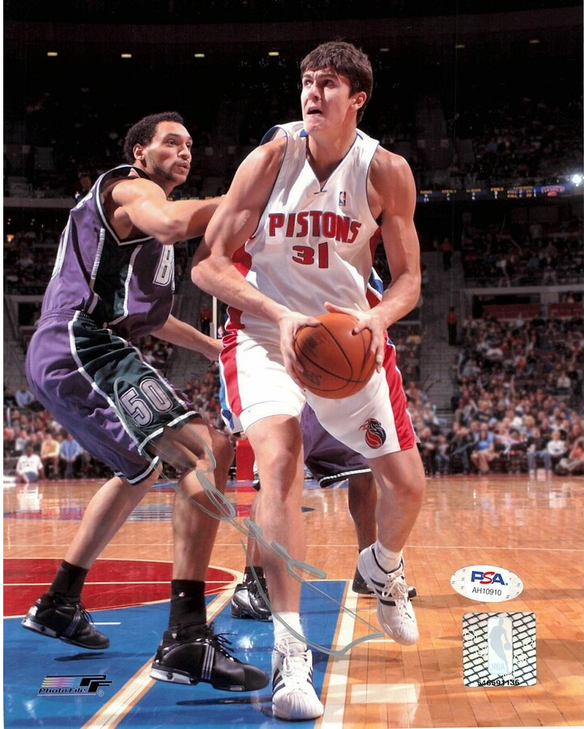
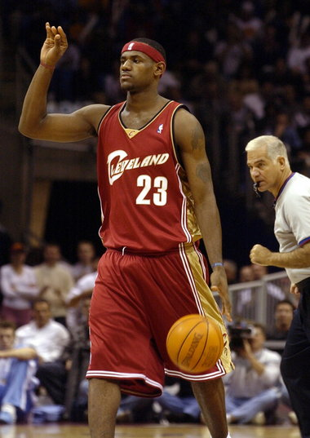

Slide 2
“I’d do a lot of things differently now…I could say I didn’t get a proper chance, but that’s simply an excuse; it’s up to a young player to prove himself, work hard, and wait for his chance. My approach was completely different. As a No. 2 pick coming from Europe, I thought I was sent by God, so I got into fights, got drunk before practices, spiting everyone, but I was spiting myself.”
–Darko Milicic
“And though [Lebron] still had to carry his teammates’ bags, a typical duty for a rook, there was something undeniable about his maturity, poise, and work ethic. It was how early he showed up to practice. It was how hard he trained, going game speed with every rep. He worked out six days a week. He biked 25-30 miles most days. Whenever he spotted a weakness in his game, he’d tell his coaches, “We need to study that .”

Slide 3
“Now as to the love of the brethren, you have no need for anyone to write to you, for you yourselves are taught by God to love one another; 10 for indeed you do practice it toward all the brethren who are in all Macedonia. But we urge you, brethren, to excel still more.”
1 Thessalonians 4:9-10
“7 But as you excel in everything—in faith, in speech, in knowledge, in all earnestness, and in our love for you—see that you excel in this act of grace also (referencing the collection for needy saints).”
2 Corinthians 8:7
“15 Practice these things, immerse yourself in them, so that all may see your progress.”
1 Timothy 4:15
“Good is the enemy of great…Few people attain great lives, in part because it's just so easy to settle for a good life. The vast majority of companies never become great, precisely because the vast majority become quite good- and that is their main problem.”

Slide 4
“Because you have raged against me and your complacency has come into my ears, I will put my hook in your nose and my bit in your mouth, and I will turn you back on the way by which you came.”
2 Kings 19:28
“For the simple are killed by their turning away, and the complacency of fools destroys them.”
Proverbs 1:32
“At that time I will search Jerusalem with lamps, and I will punish the men who are complacent, those who say in their hearts, ‘The Lord will not do good, nor will he do ill.”
Zephaniah 1:12

Slide 5
Six Necessities For Growth:
Confront The Brutal Facts (With Hope)
Conduct An Autopsy Of Your Walk Of Faith
Engage in Dialogue With Your Neighbor
“For if anyone is a hearer of the word and not a doer, he is like a man who looks intently at his natural face in a mirror. For he looks at himself and goes away and at once forgets what he was like.”
James 1:22
Hope Because: God’s Promises
Hope Because: Scriptures Examples

