Slide 1
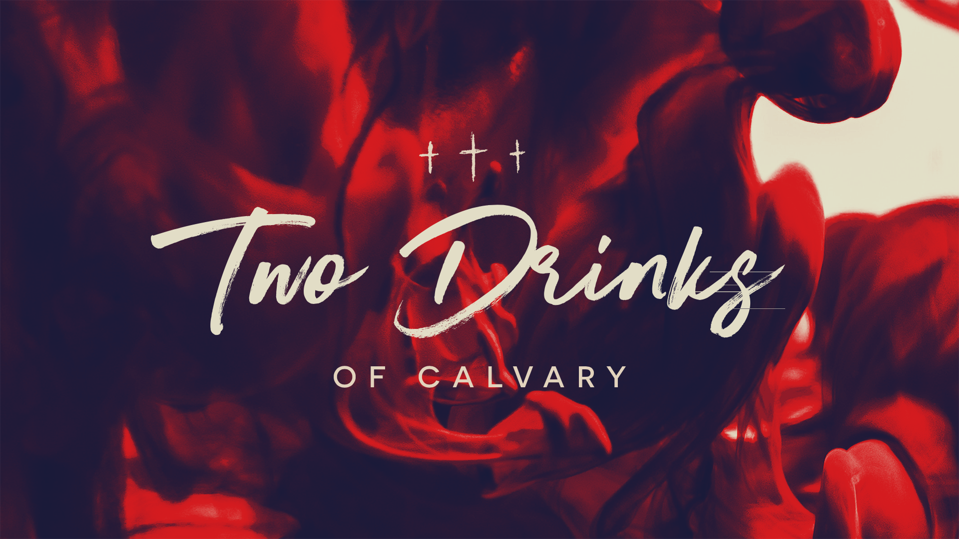
“18 knowing that you were not redeemed with perishable things like silver or gold from your futile way of life inherited from your forefathers, 19 but with precious blood, as of a lamb unblemished and spotless, the blood of Christ.”
1 Peter 1:18-19
“And I will put enmity Between you and the woman, And between your seed and her seed; He shall bruise you on the head, And you shall bruise him on the heel ”
Genesis 3:15
“22 Indeed, under the law almost everything is purified with blood, and without the shedding of blood there is no forgiveness of sins ”
Hebrews 9:22

Slide 2
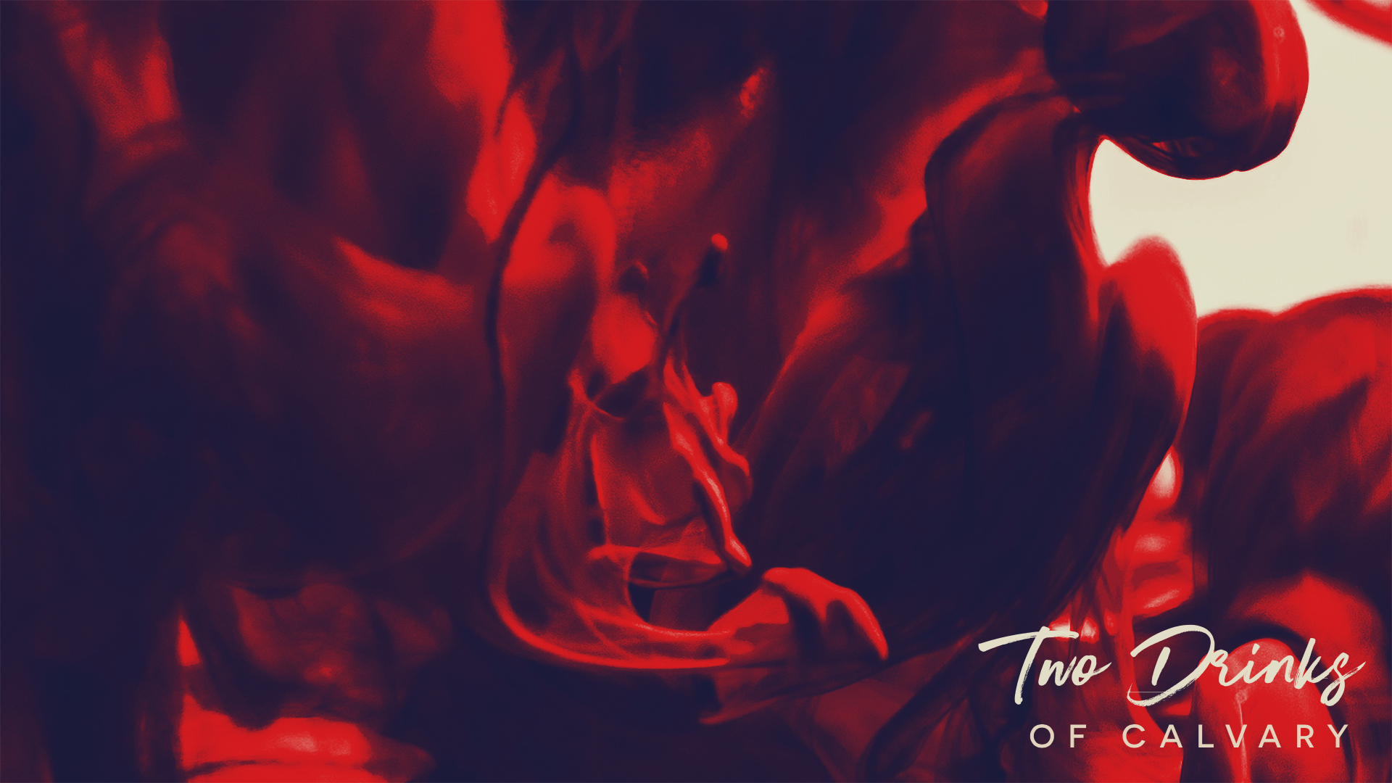
The Events Of Calvary: Pain & Torture
Scourged
Beaten
Crown Of Thorns
Crucified
“They *dressed Him up in purple, and after twisting a crown of thorns, they put it on Him.”
Mark 15:17
“They kept beating His head with a reed, and spitting on Him, and kneeling and bowing before Him.”
Mark 15:19
“…and after having Jesus scourged, he handed Him over to be crucified .”
Mark 15:15

Slide 3
The Events Of Calvary: A Drink Rejected
A Cup Of Wine Mixed With Myrrh
“22 Then they *brought Him to the place Golgotha, which is translated, Place of a Skull. 23 They tried to give Him wine mixed with myrrh; but He did not take it. 24 And they *crucified Him.”
Mark 15:22-24
“33 And when they came to a place called Golgotha, which means Place of a Skull, 34 they gave Him wine to drink mixed with gall; and after tasting it, He was unwilling to drink .”
Matthew 27:33-34
“Maybe Jesus Didn’t Drink Wine” (Matthew 26)
“Maybe Jesus Was Remaining Silent” (Matthew 27)

Slide 4
The Events Of Calvary: A Drink Rejected
A Cup Of Wine Mixed With Myrrh
“It was customary to give those about to be crucified a pain-numbing and mind-numbing drink, to lessen their awareness of the agony awaiting them.”
“25 And He said to them, “O foolish men and slow of heart to believe in all that the prophets have spoken! 26 Was it not necessary for the Christ to suffer these things and to enter into His glory?”
Luke 24:25
“Gall and myrrh are words meaning in this case the same thing, a bitter infusion. This had the effect of stupefying the mind and the nerves.”

Slide 5
The Events Of Calvary: A Drink Accepted
A Cup Of Sour Wine
“34 At the ninth hour Jesus cried out with a loud voice, “Eloi, Eloi, lama sabachthani?” which is translated, “My God, My God, why have You forsaken Me?” 35 When some of the bystanders heard it, they began saying, “Behold, He is calling for Elijah.” 36 Someone ran and filled a sponge with sour wine, put it on a reed, and gave Him a drink, saying, “Let us see whether Elijah will come to take Him down.” 37 And Jesus uttered a loud cry, and breathed His last.”

Slide 6
The Events Of Calvary: An Example To Follow
Which Drink Will We Choose?
“I have said these things to you, that in me you may have peace. In the world, you will have tribulation. But take heart; I have overcome the world .”
John 16:33
“Therefore, since Christ has suffered in the flesh, arm yourselves also with the same purpose, because he who has suffered in the flesh has ceased from sin .”
1 Peter 4:1
“For it has been granted to you that for the sake of Christ, you should not only believe in him but also suffer for his sake.”
Philippians 1:29
“Indeed, all who desire to live a godly life in Christ Jesus will be persecuted .”
2 Timothy 3:12

Slide 7
The Events Of Calvary: An Example To Follow
Which Drink Will We Choose?
“Therefore, since Christ has suffered in the flesh, arm yourselves also with the same purpose, because he who has suffered in the flesh has ceased from sin .”
1 Peter 4:1
At Work & School
In Dating Relationships & Marriage

