Slide 1
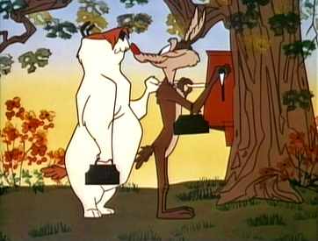

Slide 2
-Surviving The Wolves Of The World-
”But we your people, the sheep of your pasture, will give thanks to you forever; from generation to generation we will recount your praise”
Psalm 79:13
” Watch out for false prophets. They come to you in sheep’s clothing, but inwardly they are ferocious wolves .”
Matthew 7:15
” Fear not, little flock, for it is your Father's good pleasure to give you the kingdom ”
Luke 12:32
” I know that after I leave, savage wolves will come in among you and will not spare the flock.”
Acts 20:29
” Go! I am sending you out like lambs among wolves.”
Luke 10:3

Slide 3
Surviving The Danger of Wolves:
We Must Beware The Danger
Appreciation
Intentionality
“15 “Beware of the false prophets, who come to you in sheep’s clothing, but inwardly are ravenous wolves”
Matthew 7:15
“15 Therefore be careful how you walk, not as unwise men but as wise,16 making the most of your time, because the days are evil.”
Ephesians 5:15-16

Slide 4
Surviving The Danger of Wolves:
Stay Close To The Flock
“It is flocking together in large groups that protect sheep from predators because predators will go after the outliers in the flock “
“I know that after I leave, savage wolves will come in among you and will not spare the flock ”
Acts 20:29
Accountability
“Brothers, if anyone is caught in any transgression, you who are spiritual should restore him in a spirit of gentleness. Keep watch on yourself, lest you too be tempted. Bear one another's burdens, and so fulfill the law of Christ .”
Galatians 6:1-2
“And let us consider how to stir up one another to love and good works, not neglecting to meet together, as is the habit of some, but encouraging one another, and all the more as you see the Day drawing near.”
Hebrews 10:24-25
“If your brother sins against you, go and tell him his fault, between you and him alone. If he listens to you, you have gained your brother.”
Matthew 18:15
“Therefore encourage one another and build one another up, just as you are doing .”
1 Thessalonians 5:11
Encouragement
Growth

Slide 5
-Surviving The Wolves Of The World-
“Am I A Shepherd Or Am I A Sheep?”
“Am I Acting Like A Wolf Or Am I Living Like A Sheep?”

