Slide 1
“10 Then Baruch read from the book the words of Jeremiah in the house of the Lord in the chamber of Gemariah the son of Shaphan the scribe, in the upper court, at the entry of the New Gate of the Lord’s house, to all the people.”
Jeremiah 36:8-9

Slide 2
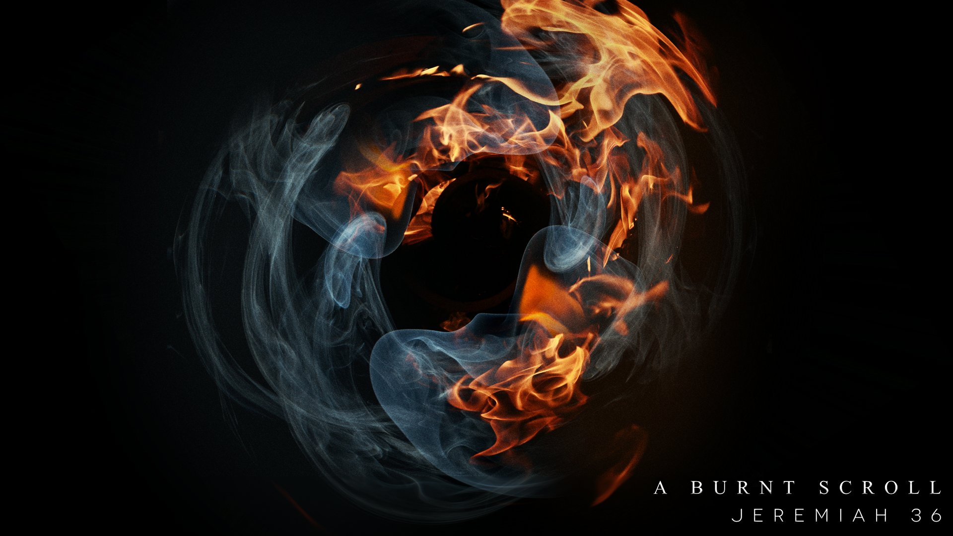
Jehoiakim’s Response To Challenging Passages:
Jehoiakim Stopped Reading
Keep Reading With Understanding
“23 When Jehudi had read three or four columns, the king cut it with a scribe’s knife and threw it into the fire that was in the brazier, until all the scroll was consumed in the fire that was in the brazier.”
Jeremiah 36:23
“Now therefore say to the people of Judah and those living in Jerusalem, ‘This is what the Lord says: Look! I am preparing a disaster for you and devising a plan against you. So turn from your evil ways, each one of you, and reform your ways and your actions .”
Jeremiah 18:11
“Now these Jews were more noble than those in Thessalonica; they received the word with all eagerness, examining the Scriptures daily to see if these things were so.”
Acts 17:11
Be Challenged By The Word of God
“But he answered, “It is written, “‘Man shall not live by bread alone, but by every word that comes from the mouth of God.”
Matthew 4:4
“For the word of God is living and active, sharper than any two-edged sword, piercing to the division of soul and of spirit, of joints and of marrow, and discerning the thoughts and intentions of the heart .”
Hebrews 4:12

Slide 3
Jehoiakim’s Response To Challenging Passages:
Jehoiakim Dismissed The Warnings
“At that time I will search Jerusalem with lamps and punish those who are complacent, who are like wine left on its dregs, who think, ‘The Lord will do nothing, either good or bad.’ They have a mindset in life that nothing bad will happen…I can just keep living the way I’m living .”
Zephaniah 1:12
“24 “Therefore everyone who hears these words of mine and puts them into practice is like a wise man who built his house on the rock. 25 The rain came down, the streams rose, and the winds blew and beat against that house; yet it did not fall, because it had its foundation on the rock. 26 But everyone who hears these words of mine and does not put them into practice is like a foolish man who built his house on sand. 27 The rain came down, the streams rose, and the winds blew and beat against that house, and it fell with a great crash.”
Matthew 7:24-27
“Listen! The report is coming—a great commotion from the land of the north! It will make the towns of Judah desolate, a haunt of jackals.”
Jeremiah 10:22
“Yet the king and all his servants who heard all these words were not afraid, nor did they rend their garments. 25 Even though Elnathan and Delaiah and Gemariah pleaded with the king not to burn the scroll, he would not listen to them.”
Jeremiah 36:24-25

