Slide 1
-The Parable Of The Lost Sheep-
” Watch out for false prophets. They come to you in sheep’s clothing, but inwardly they are ferocious wolves .”
Matthew 7:15
” I know that after I leave, savage wolves will come in among you and will not spare the flock.”
Acts 20:29
” Fear not, little flock, for it is your Father's good pleasure to give you the kingdom ”
Luke 12:32
”But we your people, the sheep of your pasture, will give thanks to you forever; from generation to generation we will recount your praise”
Psalm 79:13

Slide 2
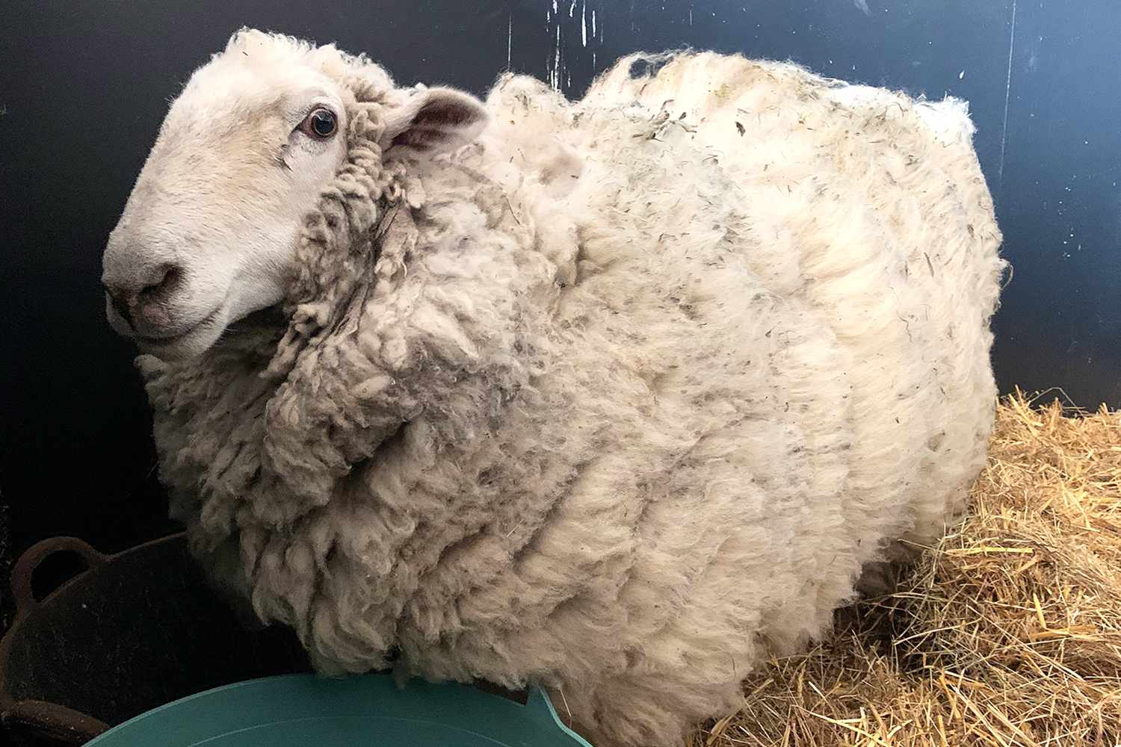

Slide 3
-The Parable Of The Lost Sheep-
” Now the tax collectors and sinners were all gathering around to hear Jesus. 2 But the Pharisees and the teachers of the law muttered, “This man welcomes sinners and eats with them.”
Luke 15:1-2

Slide 4
Breaking Down The Parable:
The Shepherd Notices The Lost Sheep
The Shepherd Represents: Jesus
The Shepherd Goes After & Finds The Lost Sheep
The Lost Sheep Represents: Spiritual Lost
The Shepherd Rejoices Over The Lost Sheep
“All the people saw this and began to mutter, “He has gone to be the guest of a sinner.”9 Jesus said to him (Zacchaeus), “Today salvation has come to this house, because this man, too, is a son of Abraham. 10 For the Son of Man came to seek and to save the lost ”
Luke 19:7,9-10

Slide 5
This Parable Reminds Us:
You, Individually, Are Valuable In The Eyes of Jesus
The Shepherd’s Salvation Isn't Cheap
“You were bought at a price. Therefore honor God with your bodies.”
1 Corinthians 6:20

Slide 6
“Am I A Shepherd Or Am I A Sheep?”
“Am I Acting Like A Wolf Or Am I Living Like A Sheep?”
“Am I A Lost Sheep or A Saved Sheep?”

