Slide 1
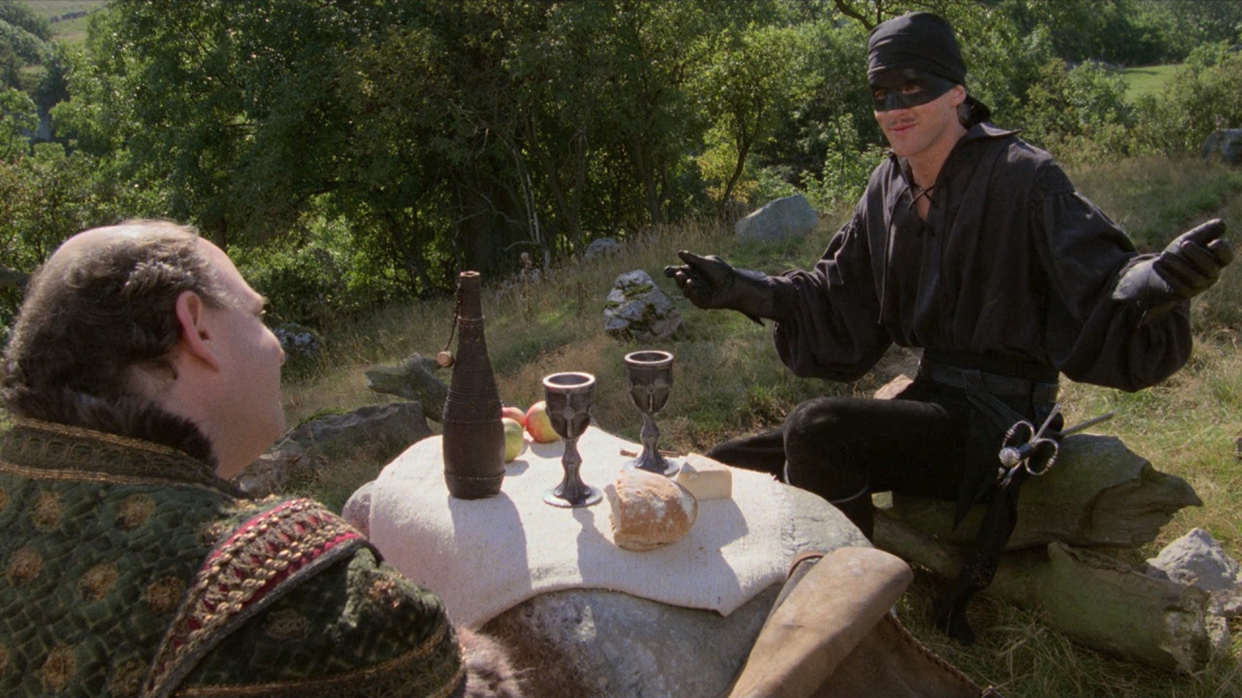

Slide 2
“Put on the whole armor of God that you may be able to stand against the schemes of the devil”
Ephesians 6:11
“Be-sober minded; be watchful, for your adversary the devil prowls around like a roaring lion seeking someone to devour”
1 Peter 5:8

Slide 3
Dear Wormwood,
“There are things for humans to do all day long without His minding in the least—sleeping, washing, eating, drinking, making love, playing, praying, working. Everything has to be twisted before it is any use to us."
(Letter 23: pg. 120)
The Devil Will Attack Subtly

Slide 4
“Now the serpent was more crafty than any of the wild animals the Lord God had made. He said to the woman, "Did God really say, 'You must not eat from any tree in the garden'?" 2 The woman said to the serpent, "We may eat fruit from the trees in the garden, 3 but God did say, 'You must not eat fruit from the tree that is in the middle of the garden, and you must not touch it, or you will die.'" 4 "You will not certainly die."
Genesis 3:1-4
“He was a murderer from the beginning and does not stand in the truth because there is no truth in him. Whenever he speaks a lie, he speaks from his own nature, for he is a liar and the father of lies."
John 8:44
The Devil Will Attack Subtly

Slide 5
Social
Media
U.S
Politics
Bad
Relationships
The Devil Will Attack Subtly

Slide 6
Dear Wormwood,
“I once had a patient (that is what they call humans in this book), a sound atheist, who used to read in the British Museum. One day, as he sat reading, I saw a train of thought in his mind beginning to go the wrong way. (probably thoughts about eternity or maybe there being a God…) If I had lost my mind and begun to attempt a defense by argument, I should have been undone. But I was not such a fool. I struck instantly at the part of the man I had best under my control and suggested that it was time he had some lunch. The enemy (God) presumably made the counter suggestion that this was more important than lunch…I said, 'Quite. In fact, it is much too important to tackle at the end of the morning'… Once he was in the street, the battle was won."
(Letter 1: pg. 3)
The Devil Will Attack
With Distractions

Slide 7
The Devil Will Attack
With Distractions
The Rich Man
Luke 12
“But Martha was distracted with all her preparations; and she came up to Him and said, “Lord, do You not care that my sister has left me to do all the serving alone? Then tell her to help me.” 41 But the Lord answered and said to her, “Martha, Martha, you are worried and bothered about so many things; 42 but only one thing is necessary, for Mary has chosen the good part, which shall not be taken away from her."
Luke 10:40-42
“for Demas, having loved this present world, has deserted me and gone to Thessalonica”
2 Timothy 4:10
Martha
Luke 10
Demas
2 Timothy 4

