Slide 1
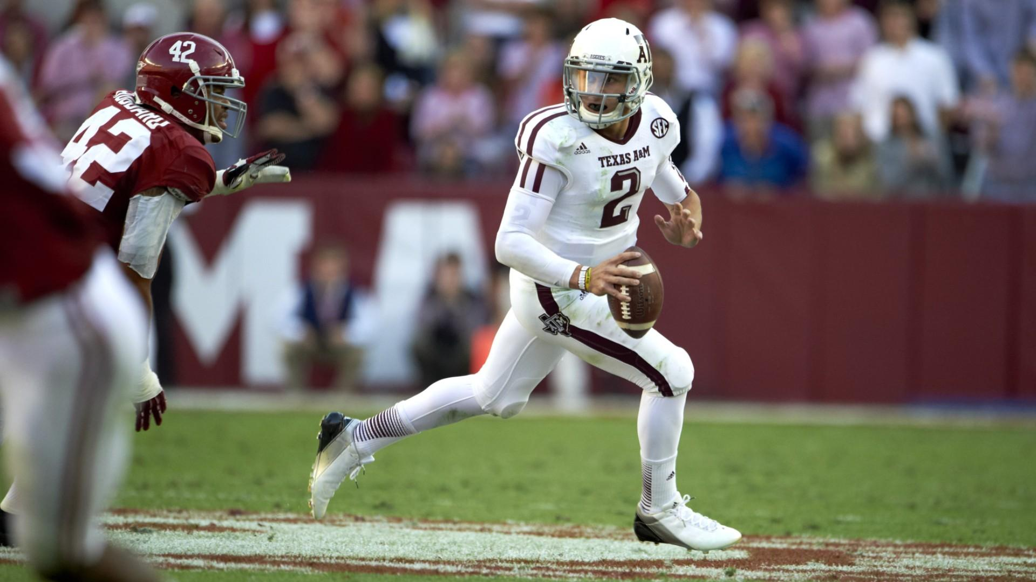

Slide 2
“6 And without faith it is impossible to please God, because anyone who comes to him must believe that he exists and that he rewards those who earnestly seek him.”
Hebrews 11:6
“The apostles said to the Lord, “Increase our faith!”
Luke 17:5

Slide 3
Accepting God’s Call:
God’s Two Requests For Abraham
“Leave Your Home”
“31 Terah took Abram his son and Lot the son of Haran, his grandson, and Sarai his daughter-in-law, his son Abram's wife, and they went forth together from Ur of the Chaldeans to go into the land of Canaan, but when they came to Haran, they settled there. 32 The days of Terah were 205 years, and Terah died in Haran. Now the Lord said to Abram, “Go from your country and your kindred and your father's house to the land that I will show you. 2 And I will make of you a great nation, and I will bless you and make your name great, so that you will be a blessing. 3 I will bless those who bless you, and him who dishonors you I will curse, and in you all the families of the earth shall be blessed.”
Genesis 1131-32; 12:1-3

Slide 4
Accepting God’s Call:
God’s Two Requests For Abraham
“Leave Your Home”
“Sacrifice Your Son”
“After these things God tested Abraham and said to him, “Abraham!” And he said, “Here I am.” 2 He said, “Take your son, your only son Isaac, whom you love, and go to the land of Moriah, and offer him there as a burnt offering on one of the mountains of which I shall tell you.”
Genesis 22:1-2

Slide 5
Accepting God’s Call:
Abraham’s Possible Excuses
“8 By faith Abraham, when called to go to a place he would later receive as his inheritance, obeyed and went, even though he did not know where he was going. 17 By faith Abraham, when God tested him, offered Isaac as a sacrifice. He who had embraced the promises was about to sacrifice his one and only son .”
Hebrews 11:8, 17
Family
“So Abraham Arose.”
Genesis 12:4; 22:3
Financial
Age

Slide 6
Accepting God’s Call:
Film Room Question…
Does My Faith Look Like Abraham’s?
“So faith comes from hearing, and hearing through the word of Christ.”
Romans 10:17

