Slide 1
March 1-2-3, 2024

Slide 2
Ready…Set…GROW!
Friday night – Growing in Hope
Sat night – Growing via Daily Bible Reading
Sunday class – Growing in Holiness
Sunday morning – Growing in Evangelism
Sunday evening – Growing in Peace of Mind

Slide 3
Growing through Daily Bible Reading

Slide 4
Growing through Daily Bible Reading
Key 1: Read with Purpose
TO KNOW GOD
Key 2: Read it Right
CONSIDER THE WORD

Slide 5
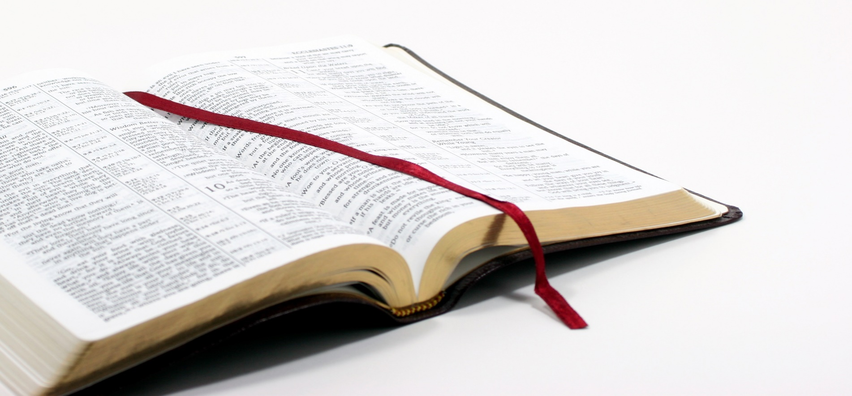
PATH the Chapter
Praise God
Admonishes me
Trust
Hope
Growing through Daily Bible Reading

Slide 6
Growing through Daily Bible Reading
Key 1: Read with Purpose
TO KNOW GOD
Key 2: Read it Right
CONSIDER THE WORD
Key 3: Don’t Quit!
DON’T “CATCH UP”

Slide 7
Growing through Daily Bible Reading

