Slide 1
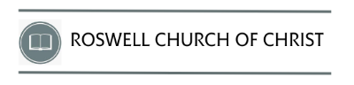
March 1-2-3, 2024

Slide 2
Growing in Peace of Mind

Slide 3

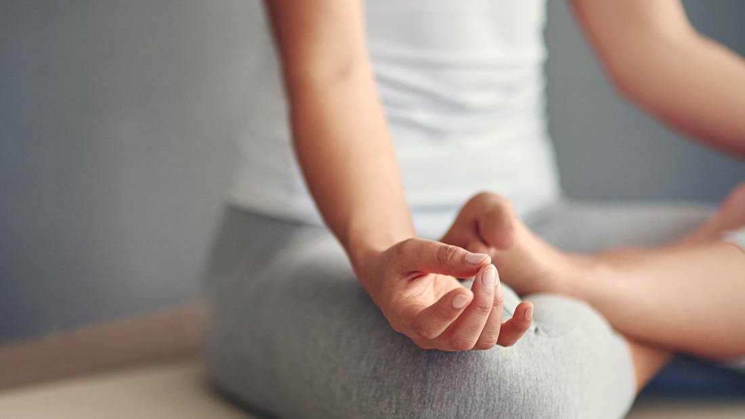



Slide 4

Paul’s day to day life …
Not free of worry or stress
Many relationship issues and problems
His work often at risk as churches rejected him
Significant health issues
Life was difficult and hard
Plenty that provoked anxiety and fear

Slide 5
Growing in Peace of Mind
1. Get rid of
bitterness and
grudges.

Slide 6
Growing in Peace of Mind
2. Don’t live
in the
past.

Slide 7
Growing in Peace of Mind
3. Do what you
can, where you are, with what you have.

Slide 8
Growing in Peace of Mind
4. Build relationships and count on them.

Slide 9
Growing in Peace of Mind
5. Work from a
deep trust in God that all will come out right.

Slide 10
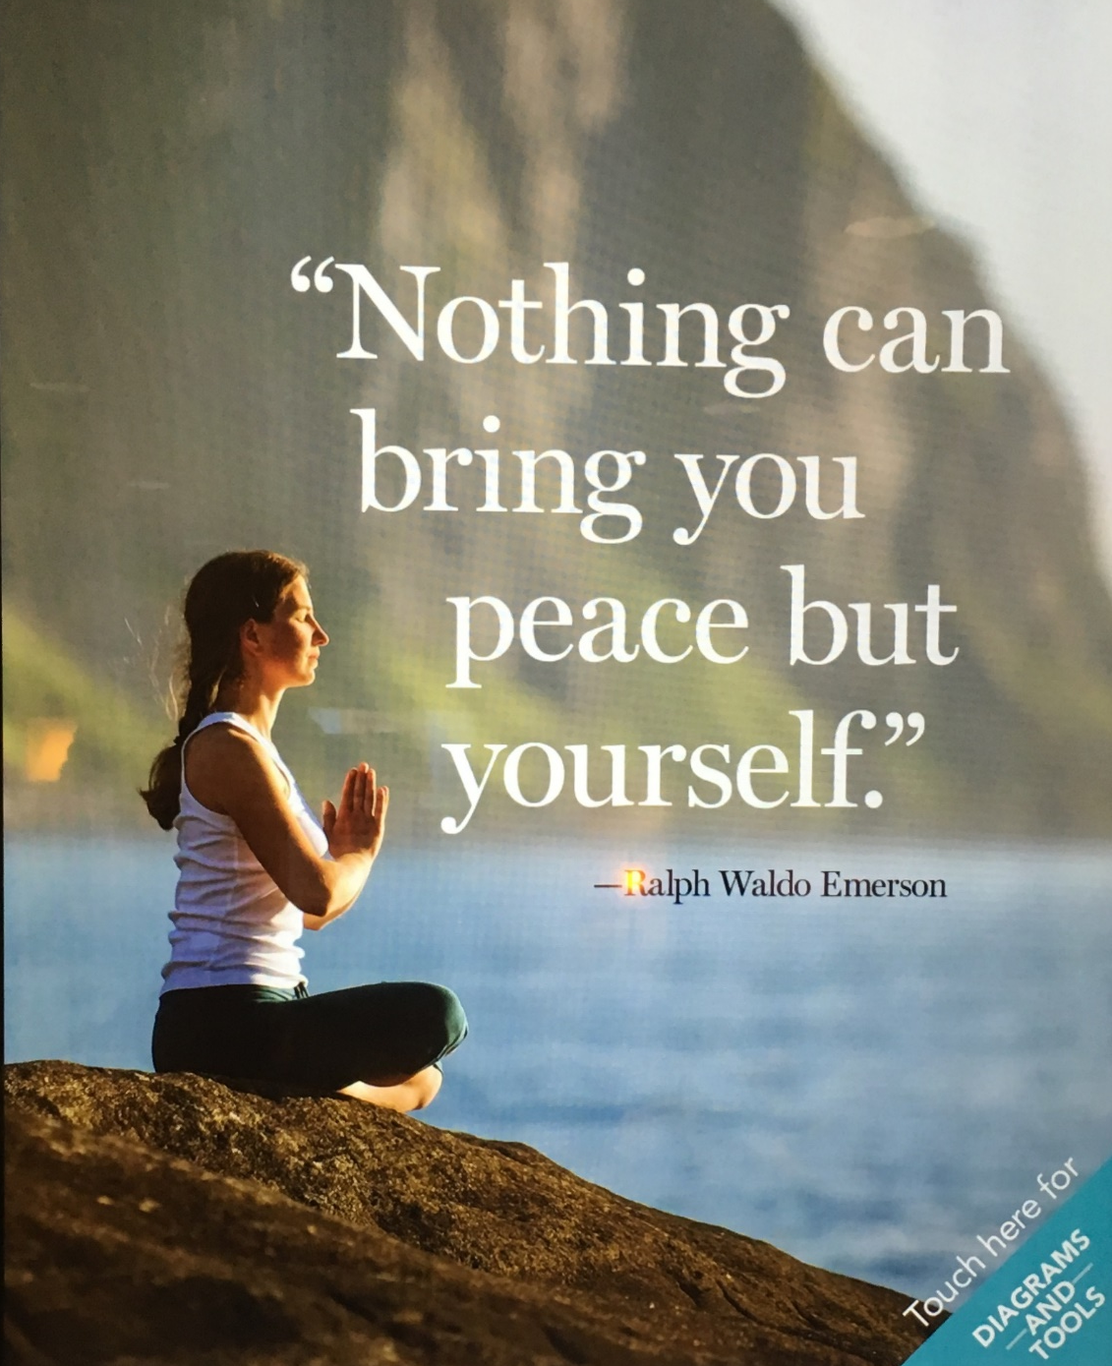

Slide 11
Growing in Peace of Mind
5. Work from a
deep trust in God that all will come out right.

Slide 12
Growing in Peace of Mind

