Slide 1
“A day without prayer is a day without blessing and a life without prayer is a life without power ”

Slide 2
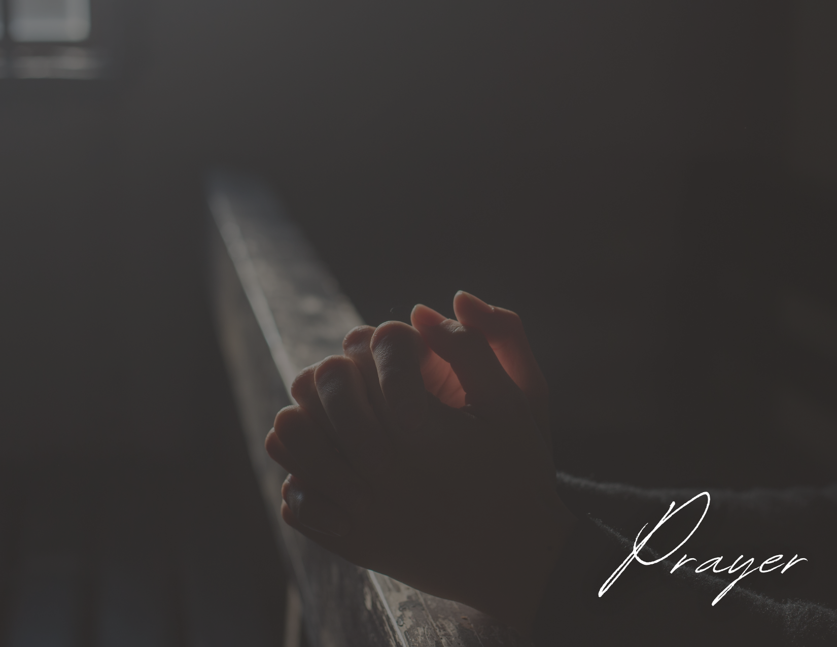
There Is Power In Prayer
“2 You desire but do not have, so you kill. You covet but you cannot get what you want, so you quarrel and fight. You do not have because you do not ask God”
James 4:2
“16 Rejoice always, 17 pray continually, 18 give thanks in all circumstances; for this is God’s will for you in Christ Jesus ”
1 Thessalonians 5:17
“16 Therefore confess your sins to each other and pray for each other so that you may be healed. The prayer of a righteous person is powerful and effective.17 Elijah was a human being, even as we are. He prayed earnestly that it would not rain, and it did not rain on the land for three and a half years.18 Again he prayed, and the heavens gave rain, and the earth produced its crops”
James 5:16-18
“Which of you, if your son asks for bread, will give him a stone? 10 Or if he asks for a fish, will give him a snake? 11 If you, then, though you are evil, know how to give good gifts to your children, how much more will your Father in heaven give good gifts to those who ask him!”
Matthew 7:9-11
“Devote yourselves to prayer, being watchful and thankful”
Colossians 4:2

Slide 3
There Is Power In Prayer
Example: Hezekiah
“20 Then Isaiah son of Amoz sent a message to Hezekiah: “This is what the Lord, the God of Israel, says: I have heard your prayer concerning Sennacherib king of Assyria 32 “Therefore this is what the Lord says concerning the king of Assyria: “‘He will not enter this city or shoot an arrow here. He will not come before it with shield or build a siege ramp against it. 33 By the way that he came he will return; he will not enter this city, declares the Lord. 34 I will defend this city and save it, for my sake and for the sake of David my servant ”
2 Kings 19:20, 32-34

Slide 4
There Is Power In Prayer
Example: Jabez
“We do not pray to tell God what he does not know, nor to remind him of things he has forgotten. He already cares for the things we pray about... He has simply been waiting for us to care about them with him”
“Jabez cried out to the God of Israel, “Oh, that you would bless me and enlarge my territory! Let your hand be with me, and keep me from harm so that I will be free from pain.” And God granted his request”
1 Chronicles 4:10

Slide 5
Why Isn't God Answering My Prayer?
For Prayers To Be Answered It Requires Submission From The One Praying
“He who turns away his ear from listening to the law, Even his prayer is an abomination.”
Proverbs 28:9
“22 and whatever we ask we receive from Him, because we keep His commandments and do the things that are pleasing in His sight.”
1 John 3:22
“3 You ask and do not receive, because you ask with wrong motives, so that you may spend it on your pleasures.”
James 4:3
“He who shuts his ear to the cry of the poor, Will also cry himself and not be answered.”
Proverbs 21:13
“7 You husbands in the same way, live with your wives in an understanding way, as with someone weaker, since she is a woman; and show her honor as a fellow heir of the grace of life, so that your prayers will not be hindered.”
1 Peter 3:7
“And when you are praying, do not use meaningless repetition as the Gentiles do, for they suppose that they will be heard for their many words. 8 So do not be like them; for your Father knows what you need before you ask Him.”
Matthew 6:7-8

Slide 6
Why Isn't God Answering My Prayer?
For Prayers To Be Answered It Requires Faith From The One Praying
“And when you are praying, do not use meaningless repetition as the Gentiles do, for they suppose that they will be heard for their many words. 8 So do not be like them; for your Father knows what you need before you ask Him.”
Matthew 6:7-8
“Is any one of you sick? He should call the elders of the church to pray over him and anoint him with oil in the name of the Lord. And the prayer offered in faith will make the sick person well; the Lord will raise him up.”
James 5:14-15
“6 But he must ask in faith without any doubting, for the one who doubts is like the surf of the sea, driven and tossed by the wind.”
James 1:6

Slide 7
Why Isn't God Answering My Prayer?
For Prayers To Be Answered (Yes) It Must Be In Accordance With God’s Will
“I was given a thorn in my flesh, a messenger of Satan, to torment me. 8 Three times I pleaded with the Lord to take it away from me. 9 But he said to me, “My grace is sufficient for you, for my power is made perfect in weakness.” Therefore I will boast all the more gladly about my weaknesses, so that Christ’s power may rest on me.10 That is why, for Christ’s sake, I delight in weaknesses, in insults, in hardships, in persecutions, in difficulties. For when I am weak, then I am strong.”
2 Corinthians 12:7-10
“And going a little farther he fell on his face and prayed, saying, “My Father, if it be possible, let this cup pass from me; nevertheless, not as I will, but as you will .”
Matthew 26:36

Slide 8
3 Applications For The Road
Stop Giving In To The Lies Of The Devil
Make Sure You Are In A Position For Your Prayers To Be Heard
It’s Time To Make Prayer A Daily Habit In Our Lives

