Slide 1
Roswell church of Christ
Bible Basics and Evangelism

Slide 2
What Are the Enemies of Evangelism?
Measures of success
What to do
Time
Lack of knowledge
Pre-judging
Confidence
Fear
Lack of faith
Understanding our role

Slide 3
What About the Basics
What does that mean in ...
Football?
Basketball?
Leading Singing?
Praying?
Evangelism?
How does a Christian who is charged with spreading the Word view them?

Slide 4
How Can We Understand the Bible?
We need an approach
We must understand how it is organized
We must understand when and how it was written
We must understand which parts of the Bible apply to us

Slide 5
How Can We Understand the Bible?
What do we mean by an approach?
Do we just open it randomly and start reading
The Bible should be treated and studied like any other book
It requires effort, Tim 2:15 (Study to show thyself approved ...)
If we study, we can understand what God has intended (but remember Deut. 29:29)
Being committed to live for God with faith results in understanding and acceptance

Slide 6
By Leon Mauldin ...
Before creation, before time began, God had a plan. He planned to create this universe, and the earth to be inhabited by man (Isaiah 45:18). Also, He designed a plan by which man could be saved; that plan was the redemption that would be in His Son Christ Jesus. Though all have sinned, and the wages of sin is death (separation from God), the sinless Son of God would die on the cross as a sacrifice for all of us. Although God’s plan for salvation in Christ was complete, much time would pass after the creation before Jesus would come to this earth.

Slide 7
By Leon Mauldin ...
…Enough time was required for God to prepare man for the coming of His Son. Time was needed to teach that sin is not to be treated lightly, that it is ugly, destructive, and costly. This was seen in the continual shedding of blood of the animal sacrifices … Time was required to develop a nation, and a lineage, through which Jesus would be born…
As you study each book of the Old Testament, keep in mind that God never lost sight of His purpose. If you are studying the patriarchs (Abraham, Isaac, Jacob, Joseph), these are not merely interesting stories; throughout this period God was looking ahead to the coming of His Son. These men are in the Bible because they had an important role in God’s plan.

Slide 8
3 Minute Study by Tim Smelser THE BIBLE TIMELINE

Slide 9
Where Do We Start?
Understand How the Bible is Organized
It is divided into two sections ...
The Old Testament contains 39 books originally written in Hebrew by about 32 men over a period dating from about 1500 B.C. to 400 B.C. This part of the Bible tells of man’s earliest existence and of God’s first covenants with man.
The New Testament contains 27 books originally written in Greek by 8 men over a period dating from about 52 A.D. to 97 A.D. This is the record of God’s covenant for man today. It is called “new” for the first covenant was set aside when this was given (Heb. 7:18; Heb. 8:13).

Slide 10
The Old Testament Books

Slide 11
The Old Testament Books

Slide 12
The Bible Is Inspired of God
40 men wrote the Bible as God’s Spirit directed them, 2 Peter 1:21.
They used the words given by the Holy Spirit, 1 Cor. 2:10-13; 1 Thes. 2:13.
The Bible is inspired (God-breathed), 2 Tim. 3:16-17; Eph. 3:3-5.
The unity of the Bible is one proof of its inspiration. These forty men lived over a span of 1600 years and had no possible way to confer with one another. They came from various backgrounds and social levels; they even wrote in different languages. Yet the Bible is without contradiction! Had the Bible been the work of 40 minds it would surely be filled with conflicting human opinions. Its unity proves that the Bible is from one mind-the mind of God!

Slide 13
The Three Dispensations
The Patriarchal (Father-rule) began at Creation and lasted until the giving of the law on Mt. Sinai. Recorded in Gen. 1 to Ex. 20.
The Mosaic or Jewish (National) began at Mt. Sinai and lasted until the crucifixion of Christ. Its history is found from Exodus 20 to Acts 2. This law was to last for a definite time (Gal. 3:19-29). It was nailed to the cross (Col. 2:14-18). It was done away (2 Cor. 3). We no longer are bound by it.
The Christian (International / for all) began at Jerusalem on the first Pentecost after the resurrection of Christ and will last until the end of time. The record is in Acts 2 through Revelation. We live under this period now. Heb. 1:1-2; 10:8-10.

Slide 14
The Three Dispensations

Slide 15
The Patriarchal Dispensation
The word “patriarch” means “father, leader, chief, ruler”; this period is literally called the age of “Father-Rule.”
God revealed His will directly to the heads of the families who in turn taught their children (Heb. 1:1-2). There is no evidence of any written law during this age.
As God spoke to the fathers by dreams, angels, or visions, they would instruct their children. (Gen. 18:19).
Worship consisted of animal sacrifices offered upon altars (Gen. 8:2).

Slide 16
The Patriarchal Dispensation
Let’s keep in mind the Bible was written for religious ends not scientific or chronological purposes. We are not given an exact date for creation. Based on what is revealed, the Patriarchal period lasted at least 2500 years, maybe longer.
This period begins with Creation, recorded in Gen. 1, and continues until the giving of the Ten Commandments recorded in Exodus 20.
The Bible record of the Patriarchal Period does not go into detail about every event or person, but what is told answers some important questions which give us a deeper understanding of the rest of the Bible.

Slide 17
The Patriarchal Dispensation
All things started with a miracle of God, Genesis 1:1-2:3.
Man created in God’s image-spirit, intelligence, dominion, Gen. 1:26-28; 2:7-8.
Institution of marriage-woman, a help suitable for man, Gen. 2:18-24.
Man’s first relationship with God was ideal. God placed man in the Garden of Eden and provided every necessary thing, Gen. 2:8-17.
Man is created in God’s image; thus, God did not force Adam to serve Him. The devil tempted; man fell by his own choice; his return will be by choice, Gen. 3:1-13; Rom. 6:16-18.

Slide 18
The Patriarchal Dispensation
Man’s wickedness increased; God destroyed the world, Gen. 6:5-7.
Through the righteousness of Noah eight souls were spared, Gen. 6:8-10:32.
God has promised to destroy the world again, 2 Pet. 3:1-14.
The Tower of Babel-confusing of tongues, Gen. 11:1-9.
The descendants of Shem, Ham, and Japheth, Gen. 10, 11.
The Land promise (Canaan, Palestine), Gen. 12:1.
The Nation promise (Israel, Hebrews, Jews), Gen. 12:2.
The Spiritual promise (Christ), Gen. 12:3, “bless all families ...” Gal. 3:26-29.

Slide 19
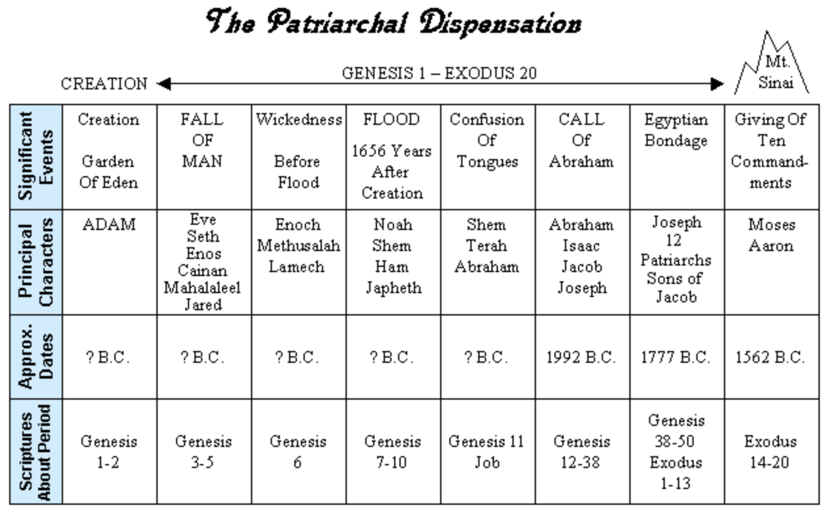
The Patriarchal Dispensation

Slide 21
The Law of Moses

Slide 22
The Law of Moses

Slide 23
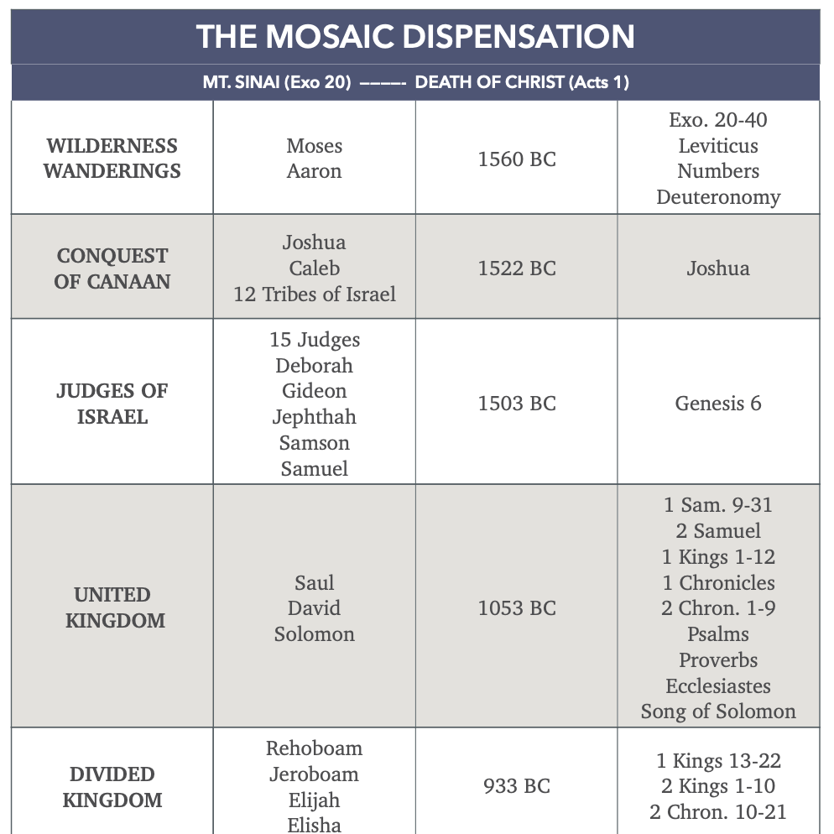
The Mosaic Dispensation

Slide 24
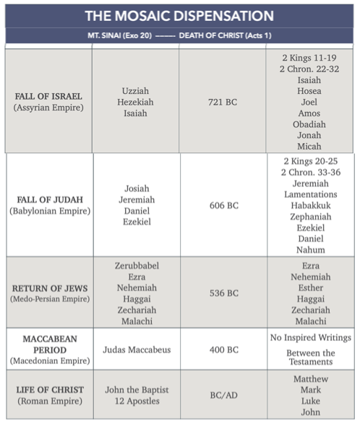
The Mosaic Dispensation

Slide 25
The Christian Dispensation
This period is also referred to as the “Gospel Age” because the gospel is the message preached, Mark 16:15‐16.
We call it the “Christian Period” because those who obey the gospel are called “Christians,” Acts 11:26.
Jesus Christ is the focal point of all the Biblical history, and through Him God now speaks to us, Heb. 1:1‐2.
During the Patriarchal and Mosaic Periods God was preparing the way for the coming of Christ.
Many prophecies and promises pointed to salvation through Christ, and to the establishment of His kingdom, 1 Pet. 1:10‐12.

Slide 26
The Christian Dispensation
Central Theme Is Christ, Gal. 4:4-5; Matt. 1:21-25.
The Gospels tell of the life, death, and resurrection of Christ.
The book of Acts records the history of how the apostles preached the gospel and of what the early church did as they received it.
The books of Romans through Revelation are letters written to churches and individual Christians exhorting them to faithfulness and guarding them against false doctrine.

Slide 27
The Christian Dispensation
The Birth And Life Of Christ
John the Baptist prepared the way, Matt. 3:1-6.
The law and the prophets prophesied until John, Matt. 11:13.
John bore witness that Jesus is the Son of God, John 1:29-34.
His earthly ministry was in preparation for the kingdom, Mark 1:14-15.
Jesus preached to the Jews only, Matt. 15:24
During His lifetime, He sent apostles only to Jews, Matt. 10:5-7.

Slide 28
The Christian Dispensation
The Death Of Christ
The Christian Period begins with the death of Christ, for at death His will became “of force,” Heb. 9:16-17; Col. 2:14.
The church was not established till after His death, Matt. 16:18.
The gospel was not preached to “all the world” till then, Mark 16:15-16.

Slide 29
The Christian Period

Slide 30
