Slide 2
The Challenges of YOUTH
BUILDING
A GODLY
LIFE

Slide 3
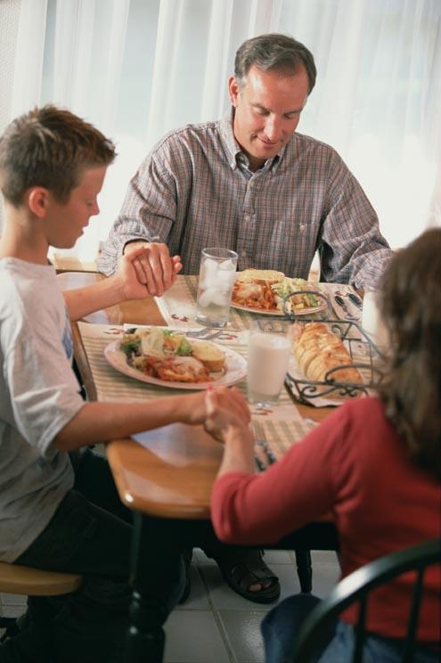
The Challenges Of Youth
How Important is Parenting
Manoah knew the importance:
  Judges 13:8 Teach us
  Judges 13:12 Rule of life
Work of life
His son is found in the “Chapter of Faith” (Hebrews 11:32)
1 Peter 5:8
CHALLENGE

Slide 4

SIX
LESSONS
FOR
PARENTS

Slide 5

SIX LESSONS OF PARENTING
There are consequences TO life and IN life
  Galatians 6:7-8
  The challenge is not to be a father or mother; the challenge is to be a PARENT!
  What we are as PARENTS our children will largely become: CONSEQUENCES!

Slide 6
SIX LESSONS OF PARENTING
There are consequences TO life and IN life
  Galatians 6:7-8
  Genesis 19:32 Lot
  2 Chronicles 33 Manasseh
  2 Timothy 1:5 Eunice / Lois
CHILDREN LEARN WHAT THEY LIVE
Galatians 5:16-26

Slide 7
IF CHILDREN LIVE WITH
THE WORKS OF THE FLESH
Sexual promiscuity … no boundaries
Materialism … love the world
Drug use … imitation
Hatred … learn to hate
Quarrelling … contentious
Jealousy … self-centered
Fits of anger … angry adults
Envy … wanting everything
Drinking … learn to be drunks
Reveling … life is a party

Slide 8
IF CHILDREN LIVE WITH
THE FRUIT OF THE SPIRIT
Love … love God and others
Joy … blessings of being God’s child
Peace … live in a world of chaos
Longsuffering … forgive enemies
Gentleness … compassion on others
Goodness … heart is where God dwells
Faith … build their lives on the rock
Meekness … servitude to others
Self-Control … defeat the devil

Slide 9

SIX LESSONS OF PARENTING
Life is only ONE trip: no “do-overs” or “mulligans”
  “If I knew now what I knew then”?
  “If only ….”
  Hebrews 9:27
What will be the boy's rule of life, and his work?"
(Judges 13:12)

Slide 10

SIX LESSONS OF PARENTING
Parenting is NOT for the unwilling nor the faint of heart
  Judges 13:8,12 (Hebrews 11:32)
  Deuteronomy 6:6-9 takes time
  Deuteronomy 6:20-25 “homework”
  Ephesians 6:1-4
  Training
  Admonition

Slide 11

SIX LESSONS OF PARENTING
Faithfulness is in the HOME; not on the church pew
  Not being a faithful parent at home will teach your child hypocrisy in the pew
  Deuteronomy 6 is the HOME
  Proverbs 6 is the HOME
  Ephesians 6 is the HOME
  Proverbs 22:6 means to GO THAT WAY YOURSELF!

Slide 12

SIX LESSONS OF PARENTING
What you have entrusted to you is an ETERNAL creature
  Genesis 1:26-27
  Lazarus – Luke 17:22
  Rich Man – Luke 17:23
  The rule of his life will likely determine whose rule he will live by
  Your example will influence your children: how will they respond???

Slide 13

SIX LESSONS OF PARENTING
Faithful parents NEVER stop teaching and admonishing
  Titus 2:2-8 “Older”
  2 Timothy 1:5 “Grandmother”
  Proverbs 23:22 “Listen”
  Leviticus 19:3 “Revere”
  Psalm 71:18 “Declare”
  Revelation 14:13 “Their works do follow them”

Slide 14
"Moreover, you took your sons and daughters whom you had borne to Me and sacrificed them to idols to be devoured” (NASB)

Slide 15


