Slide 4
he who is the blessed and only Sovereign, the King of kings and Lord of lords
(1 Timothy 6:15)

Slide 5
for he is Lord of lords and King of kings, and those with him are called and chosen and faithful
(Revelation 17:14)

Slide 6
On his robe and on his thigh he has a name written, King of kings and Lord of lords
(Revelation 19:16)

Slide 8
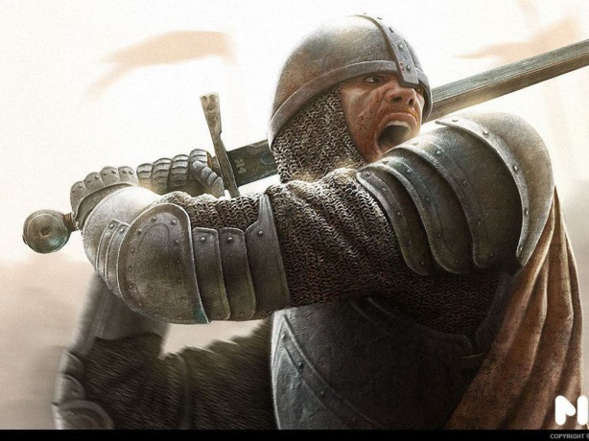
We Fight For The King
1 Timothy 6:11-16
We fight as faithful people of God.
“O man of God”
We fight without earthly desires.
1 Timothy 6:6-10; 2 Timothy 2:4
We live holy lives!
Righteousness; Godliness
Faith; Love, Patience
Gentleness

Slide 9
We Fight For The King
1 Timothy 6:11-16
We live up to our OATH
Romans 10:9-10
We live up to our CONFESSION
1 Timothy 6:12-14; John 14:15
Why do we serve the KING?
1 Timothy 6:15-16
We serve to HIS GLORY!

Slide 10
Our King Is Lord Of Lords
Revelation 17:14
We serve a KING who is greater than all kings.
Exodus 7:4-5 (Pharaoh)
Daniel 4:17, 32 (Nebuchadnezzar)
Daniel 5:23 (Belshazzar)
Acts 12:21-24 (Herod)

Slide 11
2 Chronicles 20:6
1 Chronicles 29:11-12

Slide 12
Our King Is Lord Of Lords
Revelation 19:11-16
Our KING has won the final victory
DEATH Revelation 20:14
HADES Revelation 20:14
SATAN Revelation 20:10
TEARS Revelation 21:4

Slide 13
Our King Is Lord Of Lords
Revelation 19:11-16
Our KING has won the final victory
DEATH 1 Thessalonians 4:13
PHYSICAL 2 Corinthians 5:1
COMPARISON Romans 8:18; 35-39

Slide 15
"Therefore let all the house of Israel know assuredly that God has made this Jesus, whom you crucified, both Lord and Christ … Repent, and let every one of you be baptized in the name of Jesus Christ for the remission of sins …
(Acts 2:36-40)

