Slide 2
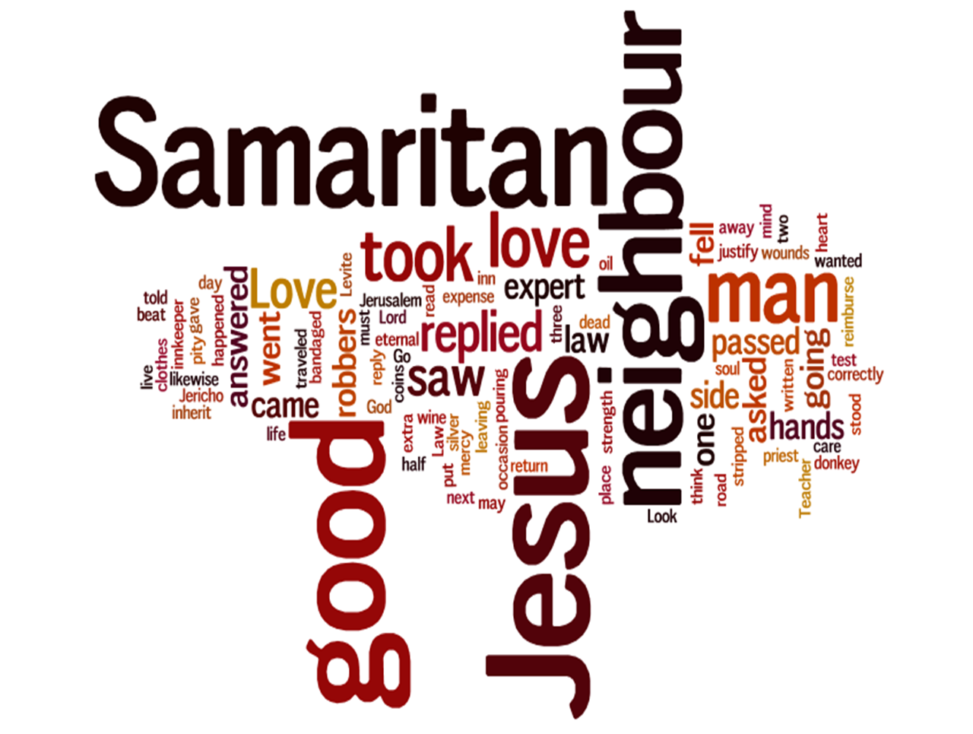

Slide 3
what
LOVE
is this?

Slide 4
what
LOVE
is this?
“When you reap the harvest of your land, you shall not reap your field right up to its edge, neither shall you gather the gleanings after your harvest. And you shall not strip your vineyard bare, neither shall you gather the fallen grapes of your vineyard. You shall leave them for the poor and for the sojourner: I am the LORD your God.”
—Leviticus 19:9-10

Slide 5
what
LOVE
is this?
“You shall not swear by my name falsely, and so profane the name of your God: I am the LORD.”
—Leviticus 19:12

Slide 6
what
LOVE
is this?
“You shall not oppress your neighbor or rob him.”
—Leviticus 19:13

Slide 7
what
LOVE
is this?
“The wages of a hired servant shall not remain with you all night until the morning.”
—Leviticus 19:13

Slide 8
what
LOVE
is this?
“You shall not curse the deaf or put a stumbling block before the blind, but you shall fear your God: I am the LORD.”
—Leviticus 19:14

Slide 9
what
LOVE
is this?
“You shall do no injustice in court. You shall not be partial to the poor or defer to the great, but in righteousness shall you judge your neighbor. You shall not go around as a slanderer among your people, and you shall not stand up against the life of your neighbor: I am the LORD.”
—Leviticus 19:15-16

Slide 10
what
LOVE
is this?
“You shall not take vengeance or bear a grudge against the sons of your own people, but you shall love your neighbor as yourself: I am the LORD.”
—Leviticus 19:18

Slide 11
what
LOVE
is this?
lawyers
good samaritans
Love from compassion and mercy
Love from obligation

Slide 12
what
LOVE
is this?
lawyers
good samaritans
Love as a means to gain blessing
Love because they have been blessed

Slide 13
what
LOVE
is this?
lawyers
good samaritans
Look for lines and limitations on their love
Take love to the next level

Slide 14
what
LOVE
is this?
lawyers
good samaritans
Seek to preserve their own goods
Love with sacrifice

Slide 15
what
LOVE
is this?
lawyers
good samaritans
See love as an event
See love as a process

Slide 16
what
LOVE
is this?
lawyers
good samaritans
Love by refraining from harm
Love by actively helping

Slide 17
what
LOVE
is this?
lawyers
good samaritans
Love in order to pay back
Love in order to give freely

Slide 18
what
LOVE
is this?
lawyers
good samaritans
Love those they judge worthy
Love those who need it

Slide 19
what
LOVE
is this?
lawyers
good samaritans
Love
friends
Love even enemies

Slide 20
what
LOVE
is this?
lawyers
good samaritans
Believe their love for God makes up for not loving their neighbors
Know they don’t really love God if they don’t love their neighbor

Slide 21
what
LOVE
is this?

