Slide 1
God’s Organization?
“And when they had appointed elders for them in every church, with prayer and fasting they committed them to the Lord in whom they had believed” (Acts 14:23).
“This is why I left you in Crete, so that you might put what remained into order, and appoint elders in every town as I directed you” (Tit. 1:5).
“Paul and Timothy, servants of Christ Jesus, to ¹all the saints in Christ Jesus who are ²at Philippi, with the ³overseers and ⁴deacons” (Phil. 1:1)
Notes:
While most people in the religious world are not concerned with what the Bible has to say about polity, i.e. how the church is governed; the Bible is quite clear on the subject:
Acts 14:23 – End of the first missionary trip which took about two years (AD 46-48) as recorded in Acts 13-15.
.

Slide 2
We are one one of these…
Scripturally Organized (Phil. 1:1)
Unscripturally Organized
Scripturally Disorganized
Unscripturally Disorganized

Slide 3
We are one one of these…
Scripturally Organized (Phil. 1:1)
Unscripturally Organized
Scripturally Disorganized
Unscripturally Disorganized

Slide 4
What the NT has to say about elders
“At the conclusion of the first missionary journey, Paul and Barnabas appointed elders in every church” (Acts 14:23).
The Jerusalem church had elders as Barnabas and Saul delivered to them “relief” that had been sent from the Antioch church to help relieve needy saints from a famine (Acts 11:26-30).
Direct statement regarding elders that they are to shepherd and oversee the flock (Acts 20:28; cf. 1 Pet. 5:2).
Elders given the charge to be soul watchers (Heb. 13:17)
The church at Philippi had overseers and deacons (Phil. 1:1)
Timothy and Titus were charged with appointing elders and given the characteristics (qualifications) of the men to be appointed (1 Ti. 3:1-7; Tit. 1:5-9).
Notes:
The Bible is silent about any other form of hierarchy or governing arrangement.= outside of the local church. Elders have responsibilities that are limited to the local church where they are a member – they have no right to oversee more than one church. Since the Bible specifies overseers within each congregation and is silent concerning any other arrangement we conclude that God has limited church government to be local in nature and scope.

Slide 5
WHAT TERMS ARE USED TO DESCRIBE ELDERS?
ELDERS – presbuteros – mean the same and differ only in that the later comes form the Greek, the elder from the Anglo-Saxon where it simply meant “old.” It designates maturity.
BISHOP – episcopos – means “overseer,” and the words, bishop, eposcopos, and overseer all mean the same differing only in their origin. Bishop (Latin) and overseer from the Anglo-Saxon. It designates oversight.
PASTOR or SHEPHERD – poimen – The word “pastor” is of Latin origin and “shepherd” is Anglo-Saxon. It designates leadership. and nurturing.
Notes:
Thus our elders should be mature overseers who shepherd the flock.
Occasionally, these words are used interchangeably:
Acts 20:17, 28: “Now from Miletus he sent to Ephesus and called the elders of the church to come to him” (20:17)
“Pay careful attention to yourselves and to all the flock, in which the Holy Spirit has made you overseers, to care for the church of God, which he obtained with his own blood” (20:28, ESV, KJV, NKJV, NASV). The ASV translates it bishop.
Tit. 1:5, 7: “This is why I left you in Crete, so that you might put what remained into order, and appoint elders in every town as I directed you…For an overseer, as God's steward, must be above reproach…”.

Slide 6
WHAT AUTHORITY MAY SCRIPTURALLY QUALIFIED ELDERS EXERCISE OVER A CONGREGATION?
They are to rule – hoi proistamenoi
“The ones having the rule” – hoi egoumenoi
They are to shepherd and teach – poimenas kai didakalous
“He that leads” (Ro. 12:8, ESV) KJV, ASV say “rules”
“Remember your leaders, those who spoke to you the word of God. Consider the outcome of their way of life, and imitate their faith” (Heb. 13:7)
“And he gave the apostles, the prophets, the evangelists, the shepherds and teachers, (Eph. 4:11; cf. 1 Cor. 12:28)
Notes:
What they are to do? Acts 20:28
“To care for the church” – ESV
“To feed the church” – KJV, ASV
“To shepherd the church” – NKJV, NASV, NIV

Slide 7
“The office of the presbyters was to watch over the particular church in which they were over…they were to instruct the ignorant, to exhort the faithful, to confute the gainsayers, to warn the unruly, to comfort the feebleminded, to support the week, to be patient toward all. They were to take heed to the flock over which the Holy Ghost had made them overseers, to feed the flock of God which He had purchased with His own blood. In one word, it was their duty to promote to the utmost of their abiltiy, and by every means within their reach, the spiritual good of all committed to their care.” -- Guy Woods

Slide 8
“The office of the presbyters was to watch over the particular church in which they were over…they were to instruct the ignorant, to exhort the faithful, to confute the gainsayers, to warn the unruly, to comfort the feebleminded, to support the week, to be patient toward all. They were to take heed to the flock over which the Holy Ghost had made them overseers, to feed the flock of God which He had purchased with His own blood. In one word, it was their duty to promote to the utmost of their abiltiy, and by every means within their reach, the spiritual good of all committed to their care.” -- Guy Woods

Slide 9
WHAT AUTHORITY MAY SCRIPTURALLY QUALIFIED ELDERS EXERCISE OVER A CONGREGATION?
Overseers – the ones having the rule over you
“Pay careful attention to yourselves and to all the flock, in which the Holy Spirit has made you overseers, to care for the church of God, which he obtained with his own blood” (Acts 20:28)
“To feed the church” – KJV, ASV
“To shepherd the church” – NKJV, NASV, NIV
Notes:
What they are to do? Acts 20:28
“To care for the church” – ESV
“To feed the church” – KJV, ASV
“To shepherd the church” – NKJV, NASV, NIV

Slide 10
WHAT AUTHORITY MAY SCRIPTURALLY QUALIFIED ELDERS EXERCISE OVER A CONGREGATION?
Pastors
The ones having the rule over you
“And he gave the apostles, the prophets, the evangelists, the shepherds and teachers” (Eph. 4:11)
“Remember your leaders, those who spoke to you the word of God. Consider the outcome of their way of life, and imitate their faith… Obey your leaders and submit to them, for they are keeping watch over your souls, as those who will have to give an account. Let them do this with joy and not with groaning, for that would be of no advantage to you.” (Heb. 13:7, 17).
Notes:
Yes, the elder is to oversee, shepherd, and to exercise rule over…to do it joyfully. But notice that the members of the church are to be ruled, be overseen, be shepherded, obey them that have the rule, and submit ot them.

Slide 11
What is the charge of the congregation toward its elders?
To appreciate and respect them (1 Thess. 5:12-13).
To esteem them (1 Thess. 5:12-13).
To obey them (Heb. 13:17).
To submit to them (Heb. 13:17).
To support them (1 Ti. 5:17-18)
To discipline or correct them (1 Ti. 5:19-20)
To remember them (Heb. 13:7)
To mimic them (Heb 13:7)
“We ask you, brothers, to respect (appreciate, NASV) those who labor among you and are over you in the Lord and admonish you,¹³ and to esteem them very highly in love because of their work. Be at peace among yourselves“ (1 Th. 5:12-13)
Notes:
How will we do when they make decisions we do not like? Will we follow them when disciplining is necessary?

Slide 12
What does it mean to “obey them that have the rule over you?” (Heb. 13:17)
The Greek is peitho – “to suffer one’s self to be persuaded. To listen to, to obey, to yield to, to obey, to follow,…” (Thayer).
The Greek for the above statement means literally, “the ones having the rule over you” (Heb. 13:17).
The term need not be minimized or ignored. Apart from erroneous teaching elders should simply be obeyed in matters of judgment. That is the force of the statement being made.

Slide 13
What the congregation can do to help… (Taken from elders/deacons class – June 6, 2016)
Submitting to elders should come naturally since we should be submitting to one another anyway.
Be joyfully supportive – even when disagreement occurs.
Do not try and isolate the elders (create division among them).
Become better listeners and support them with personal thankfulness – show appreciation.
Respect them…honor them. It’s like a parent telling you to go and wash the dishes – we might obey but not honor them. Elders need to be obeyed and honored.
Encourage/build one another up – 1 Th. 5:11. (Do not take for granted).
Never be quarrelsome with an elder - 2 Ti. 2:23-24.
Build them up. Be complimentary of them.
Acquiesce to their judgment...joyfully.

Slide 14
What the congregation can do to help… (Taken from elders/deacons class – June 6, 2016)
Esteem him (elder). Follow them. We cannot disconnect when things are not going our way.
Accept their discipline – follow their lead. (Heb. 12:5-6)
See them as a support system to help my family get to heaven.
If we respect them enough to help put them in as elders, it should weigh on us if we fail to give them that respect.
20% showed up for elders/deacon classes. That said, as a congregation, do we understand the gravity of not being supportive? Are we a drag on them? We need to help them to do their part and be more sensitive of their time.
Come to know and love them. Spend time with them. Be hospitable (open your house to them; it goes two ways).

Slide 15
What is the charge of the congregation toward its elders?
To appreciate and respect them (1 Thess. 5:12-13).
To esteem them (1 Thess. 5:12-13).
To obey them (Heb. 13:17).
To submit to them (Heb. 13:17).
To support them (1 Ti. 5:17-18)
To discipline or correct them (1 Ti. 5:19-20)
To remember them (Heb. 13:7)
To mimic them (Heb 13:7)
Let us make sure qualified men are serving – those we can appreciate, esteem, obey, submit to, support, discipline, remember, and imitate so that the glory of God may be manifest in our local church.
Notes:
How will we do when they make decisions we do not like? Will we follow them when disciplining is necessary?

Slide 16
What does it mean to “submit” (Heb. 13:17)?
It is from the Greek word upeikete which means to “yield, give way,; absol, to be submissive” (Thayer).
Elders, when functioning properly, are involved in a divine work authorized by God. To oppose them is to oppose God.
Their duty is to oversee; ours is to be overseen.
They are shepherds of the flock must give an account and the flock must recognize their rule to follow or be guilty of sin (Heb. 13:17).
Notes:
What does this mean?
It means in matters of judgment we will not whine about the decisions they make; i.e, class material, preacher choice, attendance times, gospel meetings

Slide 17
Please note Homer Hailey’s good words on the subject:
“Instead of talking about “leadership” and “leaders” so much…let’s put the emphasis on “following” for a while. No truly godly man wants to be “the leader of the church,” nor does he want to “rule” it; he realizes that true greatness according to Christ’s standard is to be realized in being a “servant of all.” The truly great and godly is content to follow Christ, and simply insist on others following Him. It seems to be that the work of elders and preachers is not so much that of being “leaders,” but it is that of instructing and guiding others to be followers of the Lord, as they themselves follow him (the elder).”

Slide 18
Scriptural Qualifications for Elders – 1 Ti. 3:1-7; Tit. 1:6-9, KJV
Positive Must be...
Negative Cannot be…
Desire
Above reproach
Husband of one wife
Vigilant
Sober
Given to hospitality
Apt to teach
Apt to teach
Patient
Have obedient children
A lover of good
Just
Holy
Self-controlled
Holding to the faithful word
Must be able to refute those who contradict
Must be orderly
Not given to wine
Not a striker
Not greedy
Not a brawler
Not a new convert
Not be self-willed
Not soon angry
Not contentious

Slide 19
Scriptural Qualifications for Deacons – 1 Ti. 3:8-12; cf. Acts 6:3, KJV
Grave
Not double-tongued
Not given to wine
Not greedy
Holds the mystery of faith in a pure conscience (faithful)
Proved (experienced)
Blameless
Husband of one wife
Rule their children well
Note: “Wives must also be grave; not slanderers, sober, faithful in all things” (3:11)

Slide 20
Timeline
Sunday 6/26 PM
Introduce the process
Hand out forms.
Study qualifications and visit with any you think worthy
Sunday 7/17
Elder selection forms are due back to Ross or David Tant.
Responses will be compiled, but your name will be held in confidence.
David and Ross will visit with those nominated
Sunday 7/31
Ross and David Tant will present names to congregation for final consideration
Or the process will cease
Sunday 8/14/16
Eldership installed

Slide 21
Front
Notes:
Front
Need your name
Who is ready to serve now?
This gives room for the fact that you are new or unsure of but to whom you would have no problem submitting.
Are there any that you think have the potential but are not yet ready? Are very close but stilltoo young, not believing children, not yet apt to teach, etc.)
As #C – this time list their names and the things in that individuals life that need to change before they could serve. Note: This is meant to be helpful to the individual so please do not hold back. David and I (or the future elders) will use this to help this individual improve.
Example – Not hospitable. Not approachable. Not good with discipline with children. Not consistent with attendance.

Slide 22
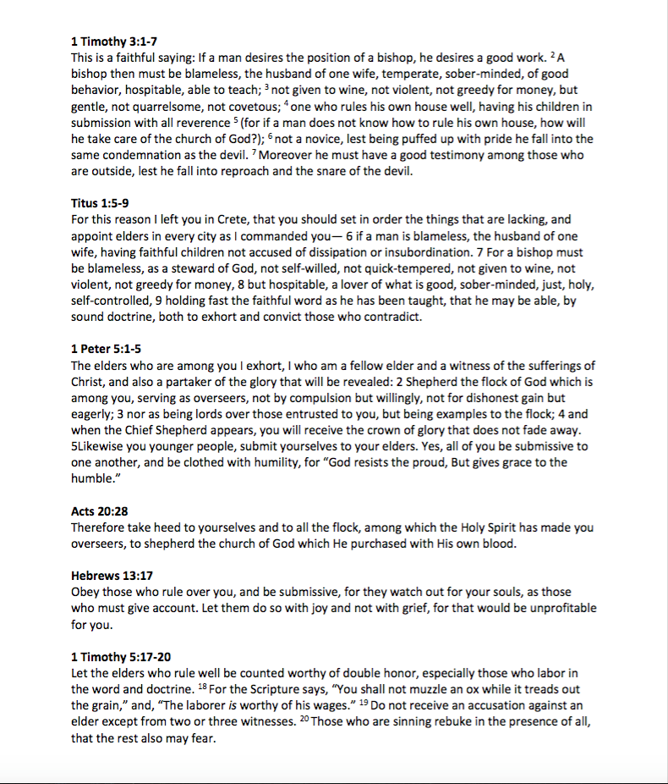
Back
Notes:
Read the passages. Go over the qualifications. Be reasonable but remember that these will be responsible for your souls – so be careful. Perfection can only be found in one place but the expectations should be high for these individuals.
In Paul’s closing admonition to the church at Thessalonica he reminds them to appreciate the elders there and includes this passage: “Pray without ceasing. Give thanks in all circumstances; for this is the will of God in Christ Jesus for you” (1 Th. 5:12, 17-18)
After we complete the process with the elders then they will lead us in the process of naming deacons.

Slide 23
Timeline
Sunday 6/26 PM
Introduce the process
Hand out forms.
Study qualifications and visit with any you think worthy
Sunday 7/17
Elder selection forms are due back to Ross or David Tant.
Responses will be compiled, but your name will be held in confidence.
David and Ross will visit with those nominated
Sunday 7/31
Ross and David Tant will present names to congregation for final consideration
Or the process will cease
Sunday 8/14/16
Eldership installed

