Slide 1
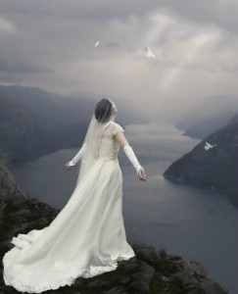
The Sanctified Church

Slide 2
Ephesians 5:25–27 (NKJV)
Husbands, love your wives, just as Christ also loved the church and gave Himself for her, 26 that He might sanctify and cleanse her with the washing of water by the word, 27 that He might present her to Himself a glorious church, not having spot or wrinkle or any such thing, but that she should be holy and without blemish.

Slide 3
What is Sanctification?
Sanctify: Set apart, honor as holy, make holy

Slide 4
Who or What is Sanctified or Holy?
Ultimately only God

Slide 5
Who or What is Sanctified or Holy?
Ultimately only God
But we can partake of His holiness

Slide 6
Partakers of His Holiness
Hebrews 12:10 — For they indeed for a few days chastened us as seemed best to them, but He for our profit, that we may be partakers of His holiness.
1 Peter 1:13–16 — Therefore gird up the loins of your mind, be sober, and rest your hope fully upon the grace that is to be brought to you at the revelation of Jesus Christ; 14 as obedient children, not conforming yourselves to the former lusts, as in your ignorance; 15 but as He who called you is holy, you also be holy in all your conduct, 16 because it is written, “Be holy, for I am holy.”

Slide 7
How was Jesus Sanctified?
By the Father before He came to earth – Jn. 10:36
On earth by maintaining His holiness – Jn. 17:19

Slide 8
Jesus’ Sanctification
John 10:36 —do you say of Him whom the Father sanctified and sent into the world, ‘You are blaspheming,’ because I said, ‘I am the Son of God’?
John 17:19 —And for their sakes I sanctify Myself, that they also may be sanctified by the truth.

Slide 9
How are We Sanctified?
Through Jesus’ atoning body and blood – Heb. 10:10, 14; 13:12; 1 Cor. 6:9-11

Slide 10
Sanctification by Christ’s Sacrifice
Hebrews 10:10–14 — By that will we have been sanctified through the offering of the body of Jesus Christ once for all. 11 And every priest stands ministering daily and offering repeatedly the same sacrifices, which can never take away sins. 12 But this Man, after He had offered one sacrifice for sins forever, sat down at the right hand of God, 13 from that time waiting till His enemies are made His footstool. 14 For by one offering He has perfected forever those who are being sanctified.
Hebrews 13:12—Therefore Jesus also, that He might sanctify the people with His own blood, suffered outside the gate.

Slide 11
1 Corinthians 6:9–11 (NKJV)
Do you not know that the unrighteous will not inherit the kingdom of God? Do not be deceived. Neither fornicators, nor idolaters, nor adulterers, nor homosexuals, nor sodomites, 10 nor thieves, nor covetous, nor drunkards, nor revilers, nor extortioners will inherit the kingdom of God. 11 And such were some of you. But you were washed, but you were sanctified, but you were justified in the name of the Lord Jesus and by the Spirit of our God.
Notes:
There is no uncleanness that Jesus cannot wash, there is no defilement he cannot sanctify, and there is no guilty soul he cannot justify

Slide 12
How are We Sanctified?
Through Jesus’ atoning body and blood – Heb. 10:10, 14; 13:12; 1 Cor. 6:9-11
By maintaining our holiness – 1 Jn 1:6-9

Slide 13
1 John 1:6–9 (NKJV)
If we say that we have fellowship with Him, and walk in darkness, we lie and do not practice the truth. 7 But if we walk in the light as He is in the light, we have fellowship with one another, and the blood of Jesus Christ His Son cleanses us from all sin. 8 If we say that we have no sin, we deceive ourselves, and the truth is not in us. 9 If we confess our sins, He is faithful and just to forgive us our sins and to cleanse us from all unrighteousness.

Slide 14
Why should we Pursue Holiness?
Without it we cannot see God – Heb. 12:14

Slide 15
Hebrews 12:14 (NKJV)
Pursue peace with all people, and holiness, without which no one will see the Lord:

Slide 16
Why should we Pursue Holiness?
Without it we cannot see God – Heb. 12:14
That is why Jesus gave Himself for us – John 17:19; Eph. 5:25-27

Slide 17
John 17:19
And for their sakes I sanctify Myself, that they also may be sanctified by the truth.

Slide 18
Ephesians 5:25–27 (NKJV)
Husbands, love your wives, just as Christ also loved the church and gave Himself for her, 26 that He might sanctify and cleanse her with the washing of water by the word, 27 that He might present her to Himself a glorious church, not having spot or wrinkle or any such thing, but that she should be holy and without blemish.

Slide 19
Why should we Pursue Holiness?
Without it we cannot see God – Heb. 12:14
That is why Jesus gave Himself for us – John 17:19; Eph. 5:25-27
It is a source of joy – Is. 61:10

Slide 20
Isaiah 61:10 (NKJV)
I will greatly rejoice in the Lord, My soul shall be joyful in my God; For He has clothed me with the garments of salvation, He has covered me with the robe of righteousness, As a bridegroom decks himself with ornaments, And as a bride adorns herself with her jewels.

Slide 21
Why should we Pursue Holiness?
Without it we cannot see God – Heb. 12:14
That is why Jesus gave Himself for us – John 17:19; Eph. 5:25-27
It is a source of joy – Is. 61:10
Because of what comes next for the saints – Rev. 19-22

Slide 22
Revelation 19:4–9 (NKJV)
7 Let us be glad and rejoice and give Him glory, for the marriage of the Lamb has come, and His wife has made herself ready.” 8 And to her it was granted to be arrayed in fine linen, clean and bright, for the fine linen is the righteous acts of the saints. 9 Then he said to me, “Write: ‘Blessed are those who are called to the marriage supper of the Lamb!’ ” And he said to me, “These are the true sayings of God.”

Slide 23
Revelation 7:13–17 (NKJV)
Then one of the elders answered, saying to me, “Who are these arrayed in white robes, and where did they come from?” 14 And I said to him, “Sir, you know.” So he said to me, “These are the ones who come out of the great tribulation, and washed their robes and made them white in the blood of the Lamb. 15 Therefore they are before the throne of God, and serve Him day and night in His temple. And He who sits on the throne will dwell among them. 16 They shall neither hunger anymore nor thirst anymore; the sun shall not strike them, nor any heat; 17 for the Lamb who is in the midst of the throne will shepherd them and lead them to living fountains of waters. And God will wipe away every tear from their eyes.”

Slide 24
Revelation 21:1–4 (NKJV)
Now I saw a new heaven and a new earth, for the first heaven and the first earth had passed away. Also there was no more sea. 2 Then I, John, saw the holy city, New Jerusalem, coming down out of heaven from God, prepared as a bride adorned for her husband. 3 And I heard a loud voice from heaven saying, “Behold, the tabernacle of God is with men, and He will dwell with them, and they shall be His people. God Himself will be with them and be their God. 4 And God will wipe away every tear from their eyes; there shall be no more death, nor sorrow, nor crying. There shall be no more pain, for the former things have passed away.”

Slide 25
What if a Christian stops pursuing Sanctification?
God sees every sin, even if we don’t – Jer. 2:32-35

Slide 26
Jeremiah 2:32–35 (NKJV)
Can a virgin forget her ornaments, Or a bride her attire? Yet My people have forgotten Me days without number. 33 “Why do you beautify your way to seek love? Therefore you have also taught The wicked women your ways. 34 Also on your skirts is found The blood of the lives of the poor innocents. I have not found it by secret search, But plainly on all these things. 35 Yet you say, ‘Because I am innocent, Surely His anger shall turn from me.’ Behold, I will plead My case against you, Because you say, ‘I have not sinned.’

Slide 27
What if a Christian stops pursuing Sanctification?
God sees every sin, even if we don’t – Jer. 2:32-35
Jesus Christ is trampled underfoot – Heb. 10:28-29

Slide 28
Hebrews 10:28–29 (NKJV)
Anyone who has rejected Moses’ law dies without mercy on the testimony of two or three witnesses. 29 Of how much worse punishment, do you suppose, will he be thought worthy who has trampled the Son of God underfoot, counted the blood of the covenant by which he was sanctified a common thing, and insulted the Spirit of grace?

Slide 29
What if a Christian stops pursuing Sanctification?
God sees every sin, even if we don’t – Jer. 2:32-35
Jesus Christ is trampled underfoot – Heb. 10:28-29
The example of Judah – Ezek. 16:1-43

Slide 30
What if a Christian stops pursuing Sanctification?
God sees every sin, even if we don’t – Jer. 2:32-35
Jesus Christ is trampled underfoot– Heb. 10:28-29
The example of Judah – Ezek. 16:1-43
The church is defiled – Rev. 3:1-6

Slide 31
Revelation 3:1–6 (NKJV)
“And to the angel of the church in Sardis write, … “I know your works, that you have a name that you are alive, but you are dead. 2 Be watchful, and strengthen the things which remain, that are ready to die, for I have not found your works perfect before God. 3 Remember therefore how you have received and heard; hold fast and repent. Therefore if you will not watch, I will come upon you as a thief, and you will not know what hour I will come upon you. 4 You have a few names even in Sardis who have not defiled their garments; and they shall walk with Me in white, for they are worthy. 5 He who overcomes shall be clothed in white garments, and I will not blot out his name from the Book of Life; but I will confess his name before My Father and before His angels

Slide 32
Ephesians 5:25–27 (NKJV)
Husbands, love your wives, just as Christ also loved the church and gave Himself for her, 26 that He might sanctify and cleanse her with the washing of water by the word, 27 that He might present her to Himself a glorious church, not having spot or wrinkle or any such thing, but that she should be holy and without blemish.

Slide 33
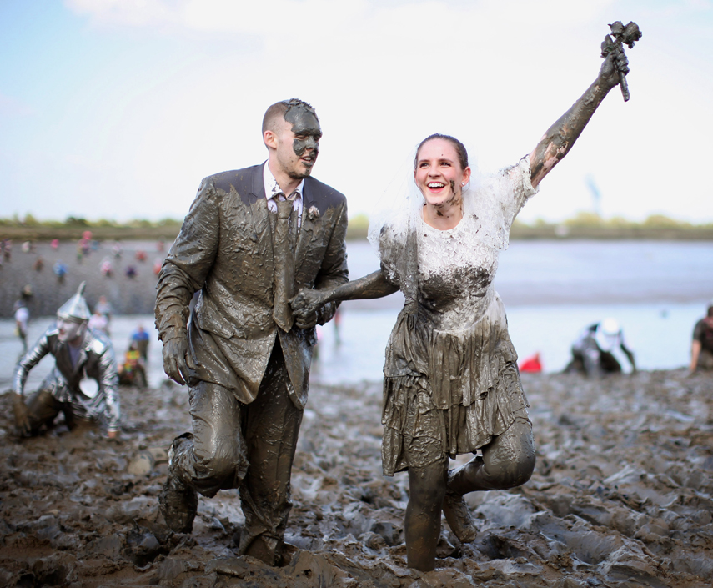
Notes:
http://www.mnn.com/health/fitness-well-being/stories/dressing-up-to-play-in-the-mud-photos

Slide 35
Revelation 22:16–17 (NKJV)
“I, Jesus, have sent My angel to testify to you these things in the churches. I am the Root and the Offspring of David, the Bright and Morning Star.” 17 And the Spirit and the bride say, “Come!” And let him who hears say, “Come!” And let him who thirsts come. Whoever desires, let him take the water of life freely.

