Slide 1
Why Professing to be a Christian is not Enough

Slide 2
“For no good tree bears bad fruit, nor again does a bad tree bear good fruit, 44 for each tree is known by its own fruit. For figs are not gathered from thornbushes, nor are grapes picked from a bramble bush. 45 The good person out of the good treasure of his heart produces good, and the evil person out of his evil treasure produces evil, for out of the abundance of the heart his mouth speaks. 46 “Why do you call me ‘Lord, Lord,’ and not do what I tell you? 47 Everyone who comes to me and hears my words and does them, I will show you what he is like: 48 he is like a man building a house, who dug deep and laid the foundation on the rock. And when a flood arose, the stream broke against that house and could not shake it, because it had been well built. 49 But the one who hears and does not do them is like a man who built a house on the ground without a foundation. When the stream broke against it, immediately it fell, and the ruin of that house was great” (Lk. 6:43-49)

Slide 3
“Enter by the narrow gate. For the gate is wide and the way is easy that leads to destruction, and those who enter by it are many. 14 For the gate is narrow and the way is hard that leads to life, and those who find it are few. 15 “Beware of false prophets, who come to you in sheep's clothing but inwardly are ravenous wolves. 16 You will recognize them by their fruits. Are grapes gathered from thornbushes, or figs from thistles? 17 So, every healthy tree bears good fruit, but the diseased tree bears bad fruit. 18 A healthy tree cannot bear bad fruit, nor can a diseased tree bear good fruit. 19 Every tree that does not bear good fruit is cut down and thrown into the fire. 20 Thus you will recognize them by their fruits. I Never Knew You 21 “Not everyone who says to me, ‘Lord, Lord,’ will enter the kingdom of heaven, but the one who does the will of my Father who is in heaven. 22 On that day many will say to me, ‘Lord, Lord, did we not prophesy in your name, and cast out demons in your name, and do many mighty works in your name?’ 23 And then will I declare to them, ‘I never knew you; depart from me, you workers of lawlessness.’ 24 “Everyone then who hears these words of mine and does them will be like a wise man who built his house on the rock. 25 And the rain fell, and the floods came, and the winds blew and beat on that house, but it did not fall, because it had been founded on the rock. 26 And everyone who hears these words of mine and does not do them will be like a foolish man who built his house on the sand. 27 And the rain fell, and the floods came, and the winds blew and beat against that house, and it fell, and great was the fall of it.” (Mt. 7:21-27)

Slide 4
Two Ways (Mt. 7:13-27; Lk. 6:43-49)
Broad way (Mt. 7:13-14)
Good Fruit (Mt. 7:15; Lk. 6:43)
Good Disciple – says and does (Mt. 7:21-23)
Wise builder - rock (Mt. 7:24-27; Lk. 6:46-49)
Narrow way
Bad Fruit
Bad Disciple – says and does not
Foolish builder - sand

Slide 5
Confession - Meaning
Confession comes from the Greek word homologeo [3670] which means to assent, that is, covenant, acknowledge, to profess (Occurs 24x in NT KJV).
“To confess means to declare, acknowledge, profess, admit. One confesses when he openly declares that he is convinced a thing is true. Confession is the opposite of denial and of silence.” --- Grimm-Wilke-Thayer, Random House College Dictionary.

Slide 6
Three Elements in Proper Confession
Belief in the heart that a certain thing is true.
A decision that one is willing to stand up for what he believes, to make an open commitment about it, and let others know (implies conviction)
A statement acknowledging, professing, declaring the conviction.

Slide 7
Confession
Peter did it it Matthew 16:16-17, "Simon Peter answered and said, You are the Christ, the Son of the living God. Jesus answered and said to him, Blessed are you, Simon Barjona, for flesh and blood has not revealed this to you, but My Father who is in heaven."
Belief, willing decision, statement acknowledging, professing, declaring the conviction

Slide 8
Confession
The Eunuch did it in Acts 8:36-37, The Eunuch asks, "See here is water. What hinders me from being baptized?"
Then in verse 37, "Then Philip said, "If you believe with all your heart you may. And he answered and said, I believe that Jesus Christ is the Son of God” (NASV)
Belief, willing decision, statement acknowledging, professing, declaring the conviction

Slide 9
Confession
Paul puts believing and confessing in chronological order that results in righteousness/justification/salvation: “Because, if you confess with your mouth that Jesus is Lord and believe in your heart that God raised him from the dead, you will be saved. For with the heart one believes and is justified, and with the mouth one confesses and is saved” (Ro. 10:9-10)
Belief, willing decision, statement acknowledging, professing, declaring the conviction

Slide 10
Would you be willing to confess to others that you believe that Jesus is the Christ the Son of the living God?
“So everyone who acknowledges me before men, I also will acknowledge before my Father who is in heaven” (Mt. 10:32)
In Luke’s account, Jesus said, “And I tell you, everyone who acknowledges me before men, the Son of Man also will acknowledge before the angels of God,” (Lk. 12:8)
“Because, if you confess with your mouth that Jesus is Lord and believe in your heart that God raised him from the dead, you will be saved. 10 For with the heart one believes and is justified, and with the mouth one confesses and is saved” (Ro. 12:9-10; ESV)
“And every tongue confess that Jesus Christ is Lord, to the glory of God the Father” (Phil. 2:1, ESV)

Slide 11
Is confession enough?
Why do you call me ‘Lord, Lord,’ and not do what I tell you?” (Lk. 6:46)
“Not everyone who says unto me, ‘Lord, Lord,’ will enter the kingdom of heaven…” (Mt. 7:21).

Slide 12
What is the Application?
Profession without practice is insufficient
Jesus said, “If you love me, keep my commandments” (Jhn. 14:15)
John later tells us, “For this is the love of God, that we keep His commandments” (1 Jhn. 5:3).

Slide 13
Was there confession “wholly admirable?” --- John Stott
They were polite or courteous in their confession – in calling Jesus, “Lord, Lord”
The profession was orthodox or respectful in that they acknowledged His divinity verbally
Their confession was apparently fervent or enthusiastic – not cold or informal
They confessed publically – not afraid to go public – even prophesying in His name, casting out demons and doing mighty works in His name.

Slide 14
Was there confession “wholly admirable?” --- John Stott
They were polite or courteous in their confession – in calling Jesus, “Lord, Lord”
The profession was orthodox in that they acknowledged His divinity verbally
Their confession was fervent or enthusiastic – not cold or informal
They confessed publically – not afraid to go public – even prophesying in His name, casting out demons and doing mighty works in His name.
What’s wrong with this confession if it is polite, respectful, enthusiastic and public (without shame)?

Slide 15
Was there confession “wholly admirable?” --- John Stott
They were polite or courteous in their confession – in calling Jesus, “Lord, Lord”
The profession was orthodox in that they acknowledged His divinity verbally
Their confession was fervent or enthusiastic – not cold or informal
They confessed publically – not afraid to go public – even prophesying in His name, casting out demons and doing mighty works in His name.
What’s wrong with this confession? Jesus says, there is everything wrong with it if our actions do not jive with the confession (Mt. 15:8; Isa. 29:13)

Slide 16
Was there confession “wholly admirable?” --- John Stott
They were polite or courteous in their confession – in calling Jesus, “Lord, Lord”
The profession was orthodox in that they acknowledged His divinity verbally
Their confession was fervent or enthusiastic – not cold or informal
They confessed publically – not afraid to go public – even prophesying in His name, casting out demons and doing mighty works in His name.
Nothing new with confessing and not doing:
“My people come to you, as they usually do, and sit before you to listen to your words, but they do not put them into practice. With their mouths they express devotion, but their hearts are greedy for unjust gain" (Ezek. 33:31).

Slide 17
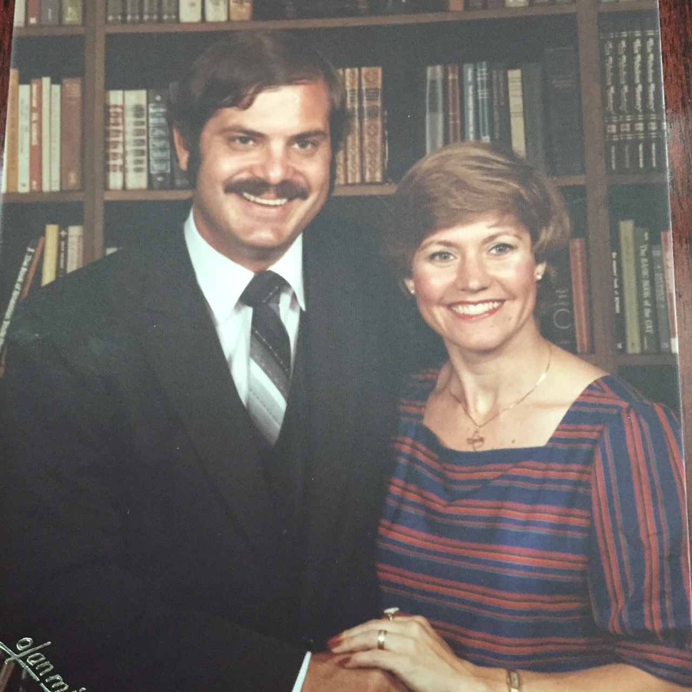
Profession without practice is insufficient

Slide 18
The point made…
Profession without practice is insufficient
Jesus said, “If you love me, keep my commandments” (Jhn. 14:15)
John later tells us, “For this is the love of God, that we keep His commandments” (1 Jhn. 5:3)

Slide 19
The point made…
Profession without practice is insufficient
One who professes and DOES is like a wise man who builds his house on the rock
47 Everyone who comes to me and hears my words and does them, I will show you what he is like: 48 he is like a man building a house, who dug deep and laid the foundation on the rock” (Lk. 16:47-48)

Slide 20
The point made…
Profession without practice is insufficient
One who professes and DOES is like a wise man who builds his house on the rock
One who professes and DOES NOT is like a foolish man who builds on sand
“And when a flood arose, the stream broke against that house and could not shake it, because it had been well built. 49 But the one who hears and does not do them is like a man who built a house on the ground without a foundation. When the stream broke against it, immediately it fell, and the ruin of that house was great” (Lk. 6:48-49)

Slide 21
God has made it plain that people really have only two options:
Will we walk on the narrow way or the broad way? (Mt. 7:13-14)
Will we produce good fruit or bad fruit? (Mt. 7:15-20)
Will be confess and obey or confess and sit on the sidelines? (Mt. 7:21-23)
Will we build on a rock or on the sand? (Mt. 7:24-27)
“Not everyone who says unto me, ‘Lord, Lord,’ will enter the kingdom of heaven…” (Mt. 7:21).

Slide 22
Why Professing to be a Christian is not Enough

