Slide 1
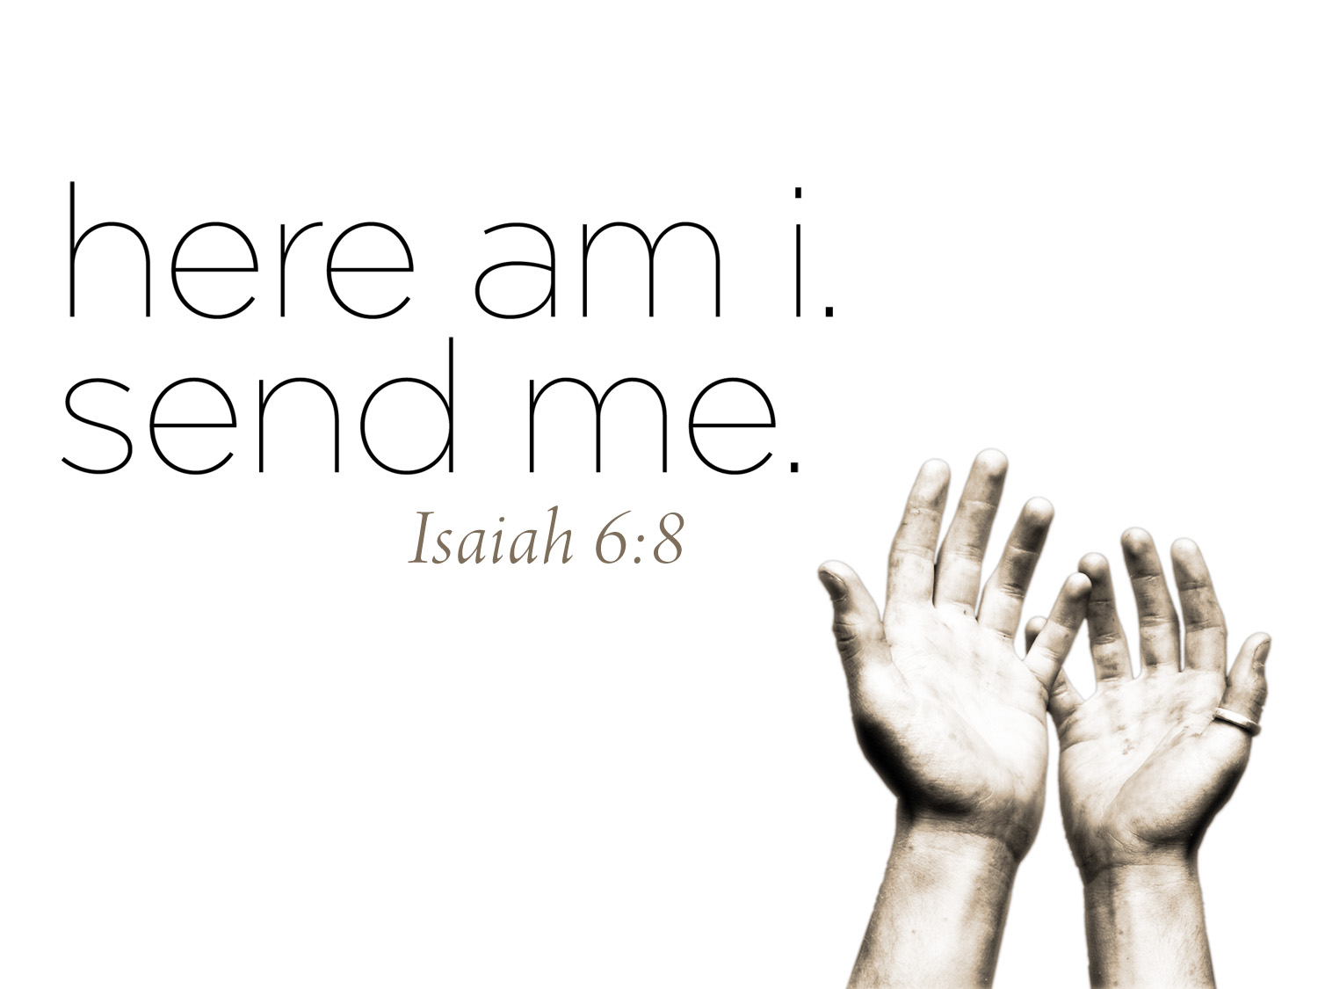

Slide 2
here am i, send
someone else!
Exodus 4:13

Slide 3
Excuse #1: Who am I?
Excuse #2: I wouldn’t know what to say.
Excuse #3: Who’s going to listen to me?
Excuse #4: I don’t feel comfortable talking to people.
Excuse #5: Please, just send someone else.

Slide 4
What changed Moses?
Moses ceased to believe he was alone and began to believe God was with him

Slide 5
If I really believe God is with me, what will I do?

