Slide 1
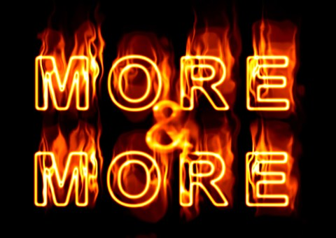
Getting What We Deserve

Slide 3
Those Who Knew What They Deserved:
Eve was convinced that she deserved the knowledge God was withholding from her…
Balaam knew that he deserved the riches that were being offered him…
Ahab was enraged that he could not have the vineyard he deserved…
Gehazi couldn’t stand the thought of not receiving their deserved pay from this pagan foreigner…

Slide 4
How Entitlement Ruins Everything
Even the good I do is wasted when I think that I deserve to be recognized and honored…
What God has given me to enjoy seems like nothing when I think I deserve more…
Those I should be encouraging become a source of embitterment when they take my time…

Slide 5
What DO We Deserve?
Paul paints a clear picture that what we’ve earned and deserve is nothing more than death.
Anything we do is to be seen through the lens of responsibility and indebtedness…
And anything we have should be seen as more than we truly deserve.

