Slide 1
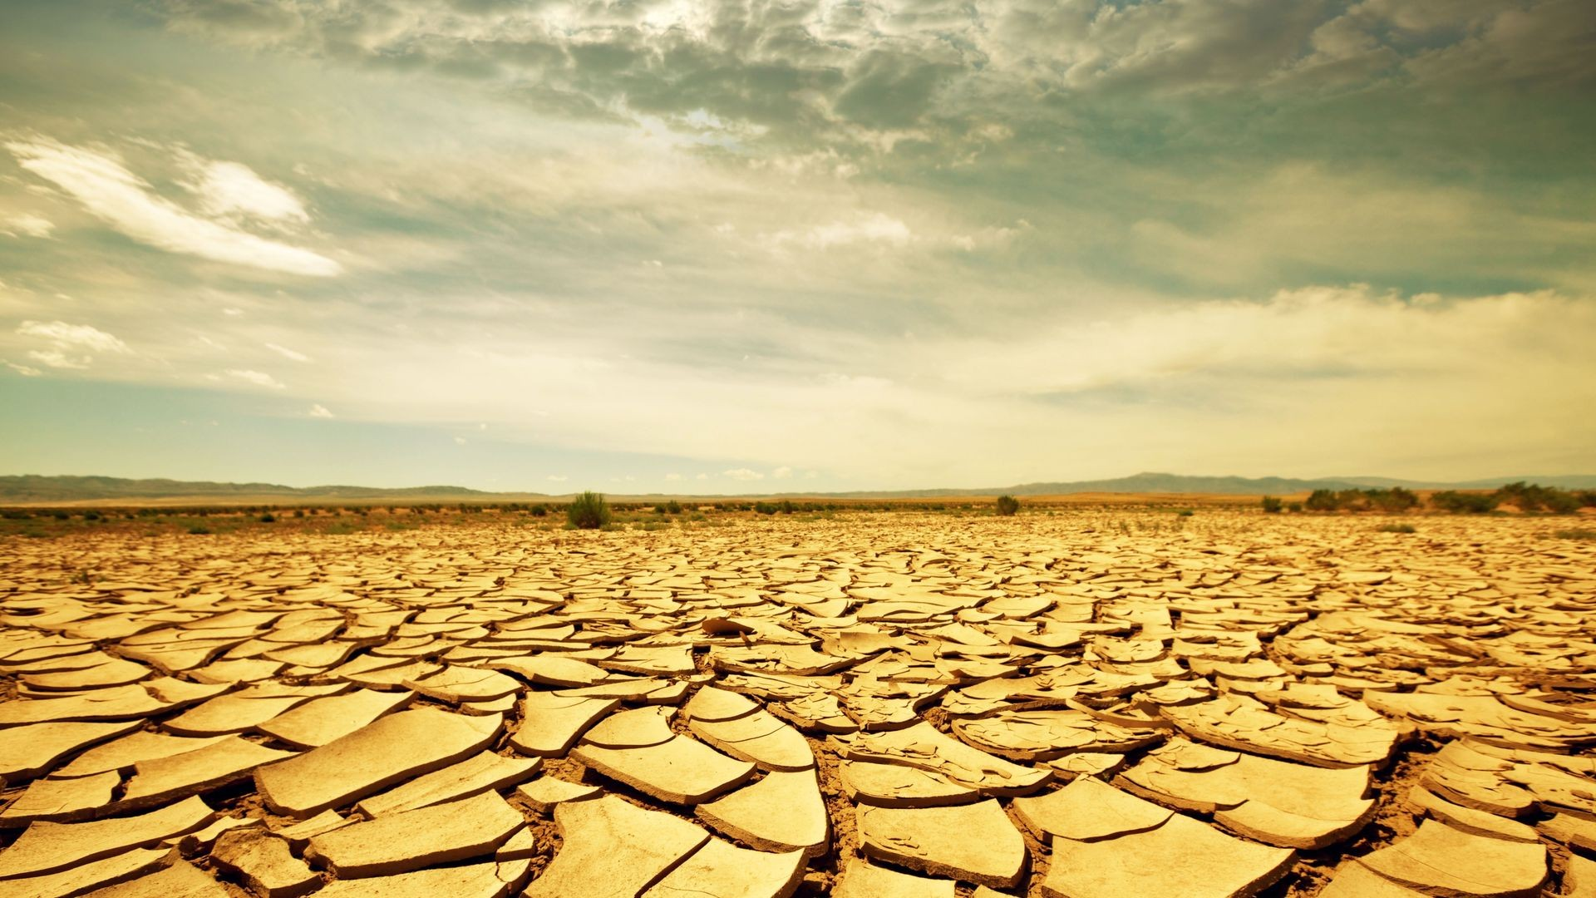
PREPARING FOR CHAPTER 19 DAYS

Slide 2
JAMES 5:17
ELIJAH WAS A MAN WITH A NATURE LIKE OURS

Slide 3
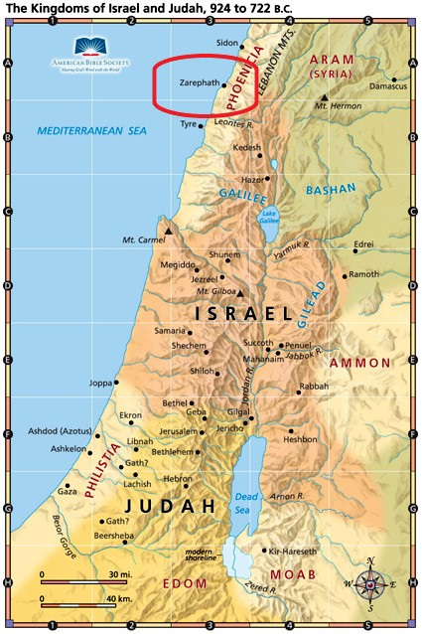

Slide 4
JAMES 5:17
ELIJAH WAS A MAN WITH A NATURE LIKE OURS

Slide 5
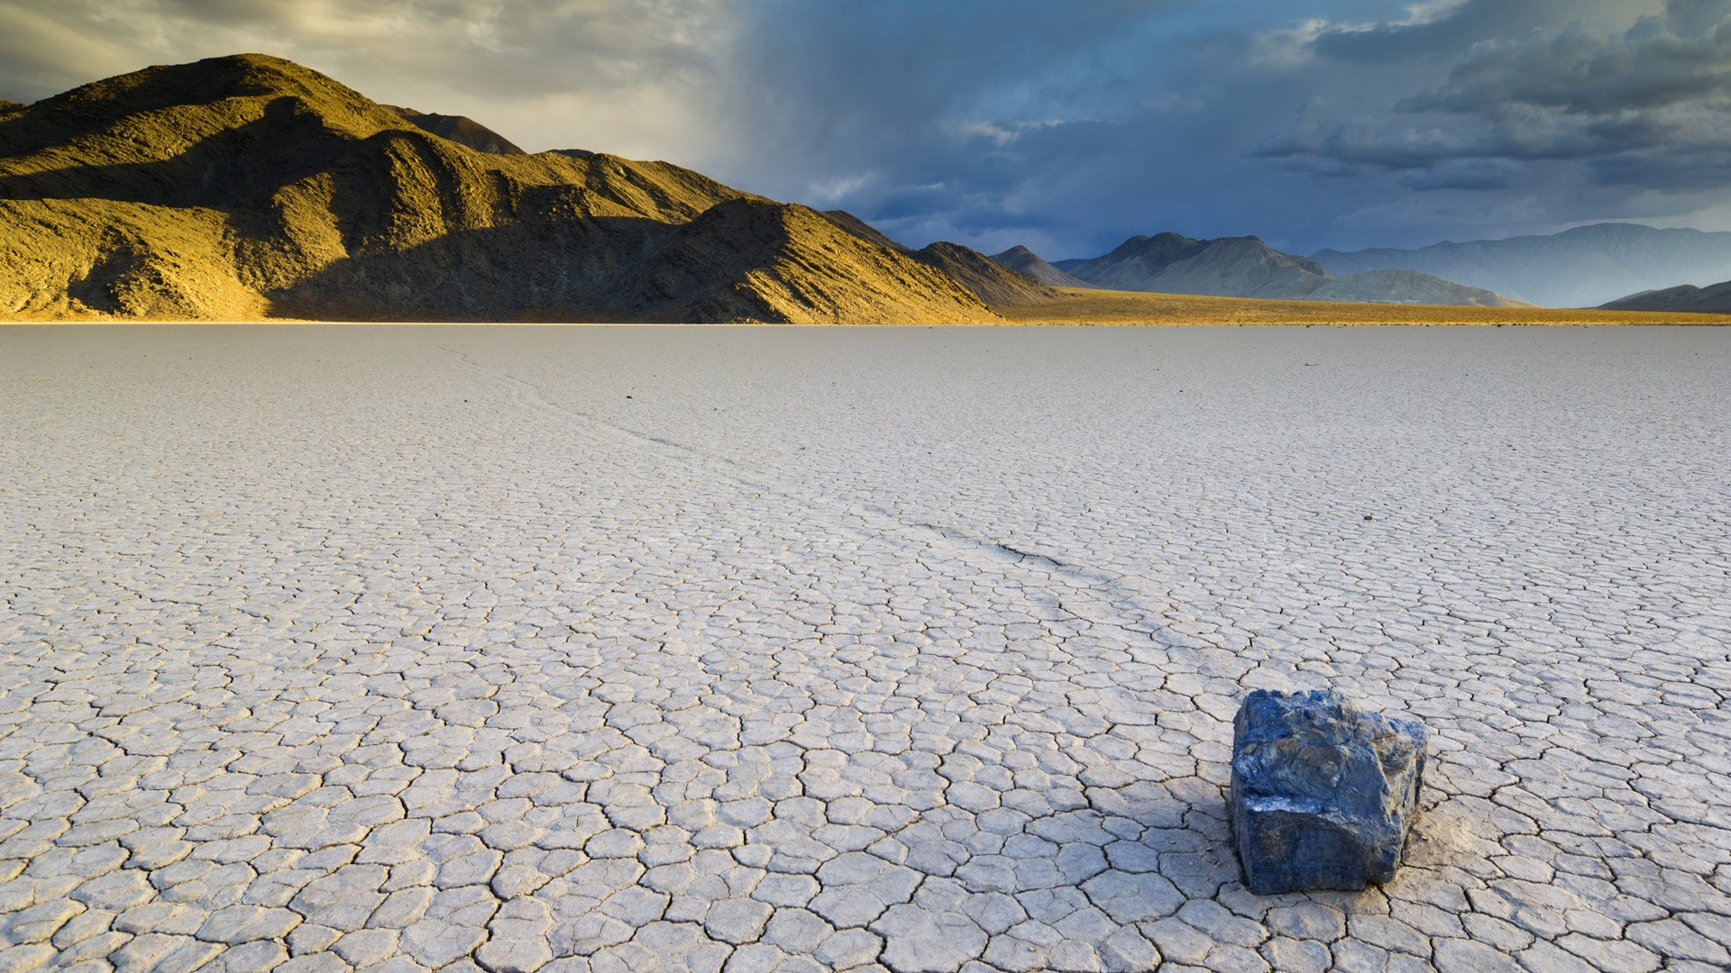
Have you ever had a Chapter 18 Day?

Slide 6
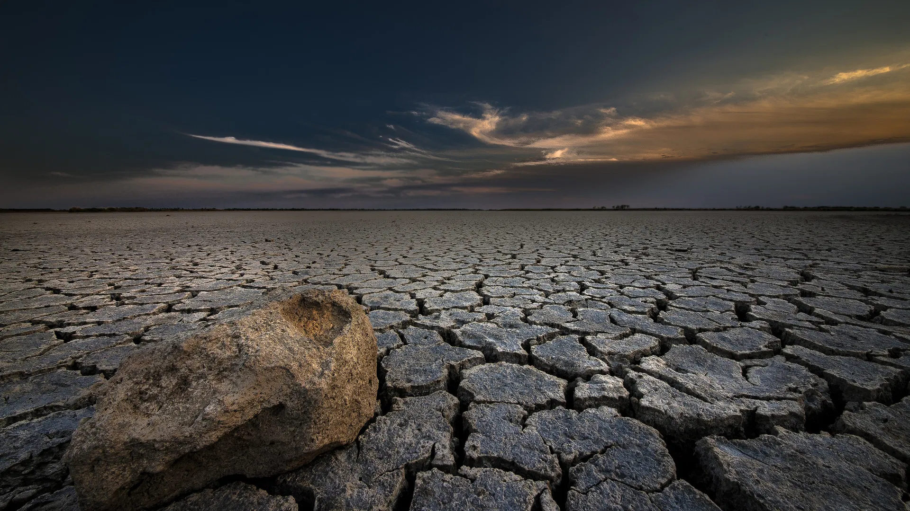
So may the gods do to me and more also, if I do not make your life as the life of one of them by this time tomorrow.
Then he was afraid, and he arose and ran for his life.

Slide 7
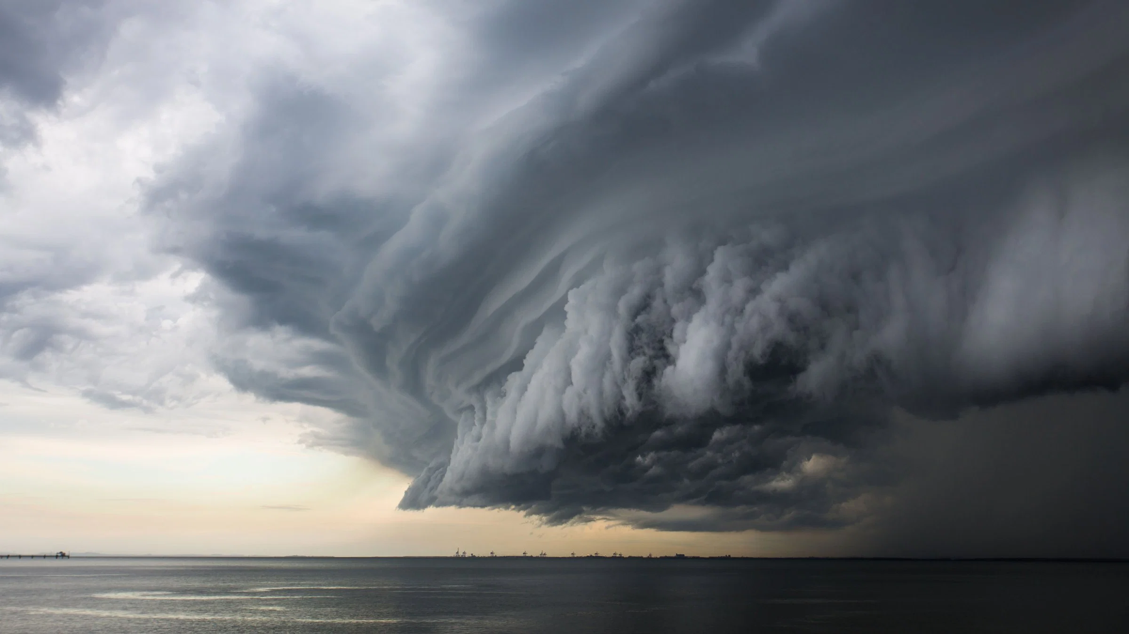
What are you doing here, Elijah?
Why are you HERE in THIS place?

Slide 8
PREPARING FOR CHAPTER 19 DAYS
DON’T ISOLATE YOURSELF
DON’T LET PRIDE OR DESPARATION FOOL YOU
GO BACK TO WHERE THE WORK IS AND DO IT
GUARD AGAINST FEAR

