Slide 1
The Story Within the Story In The Book of Ruth

Slide 2
The Story Within The Story:
God’s Faithfulness To His People

Slide 3
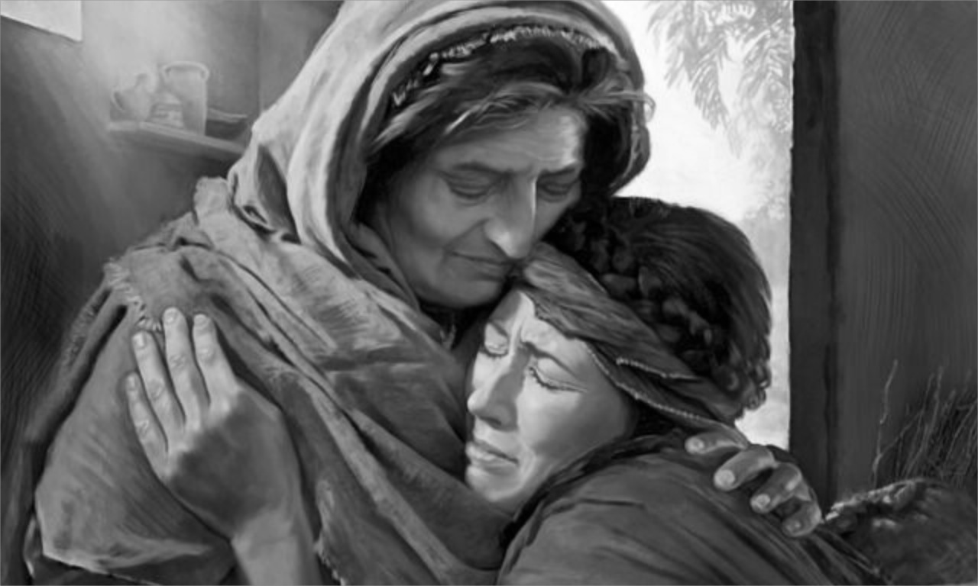
Tragedy Strikes (Chapter 1)
The Story of the Book of Ruth

Slide 4
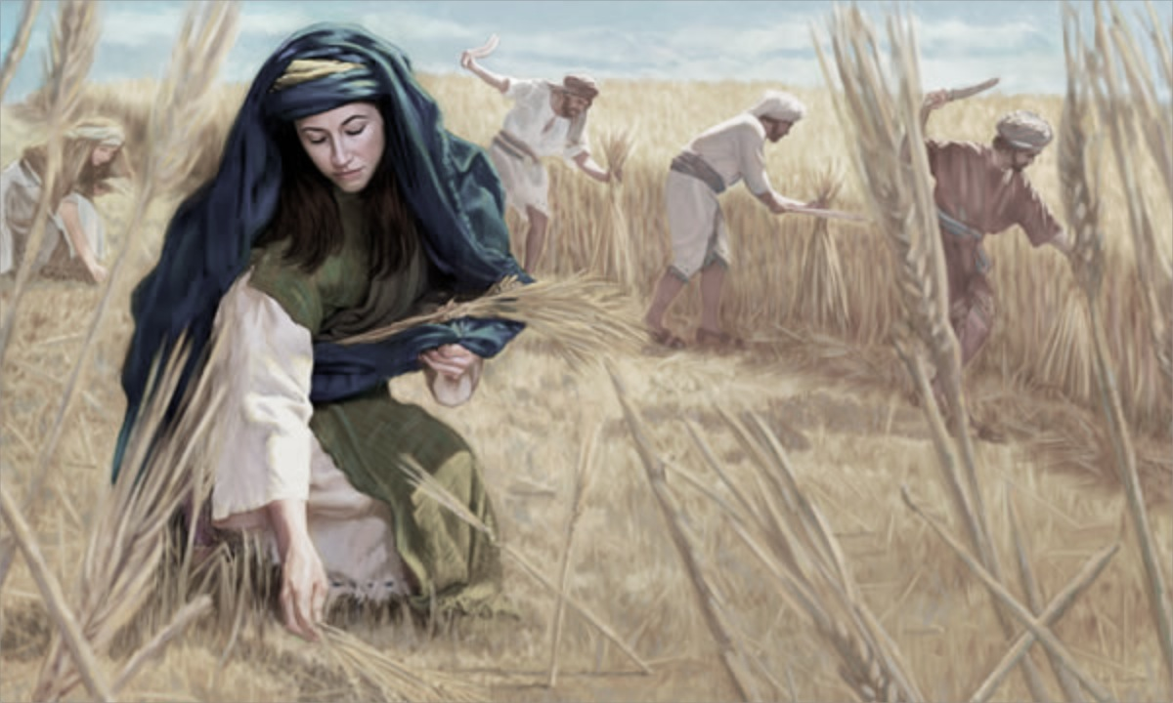
Life Is Sustained (Chapter 2)
The Story of the Book of Ruth

Slide 5
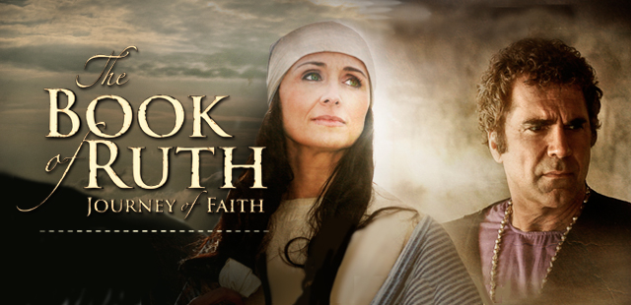
A Redeemer Is Revealed (Chapter 3)
The Story of the Book of Ruth

Slide 6
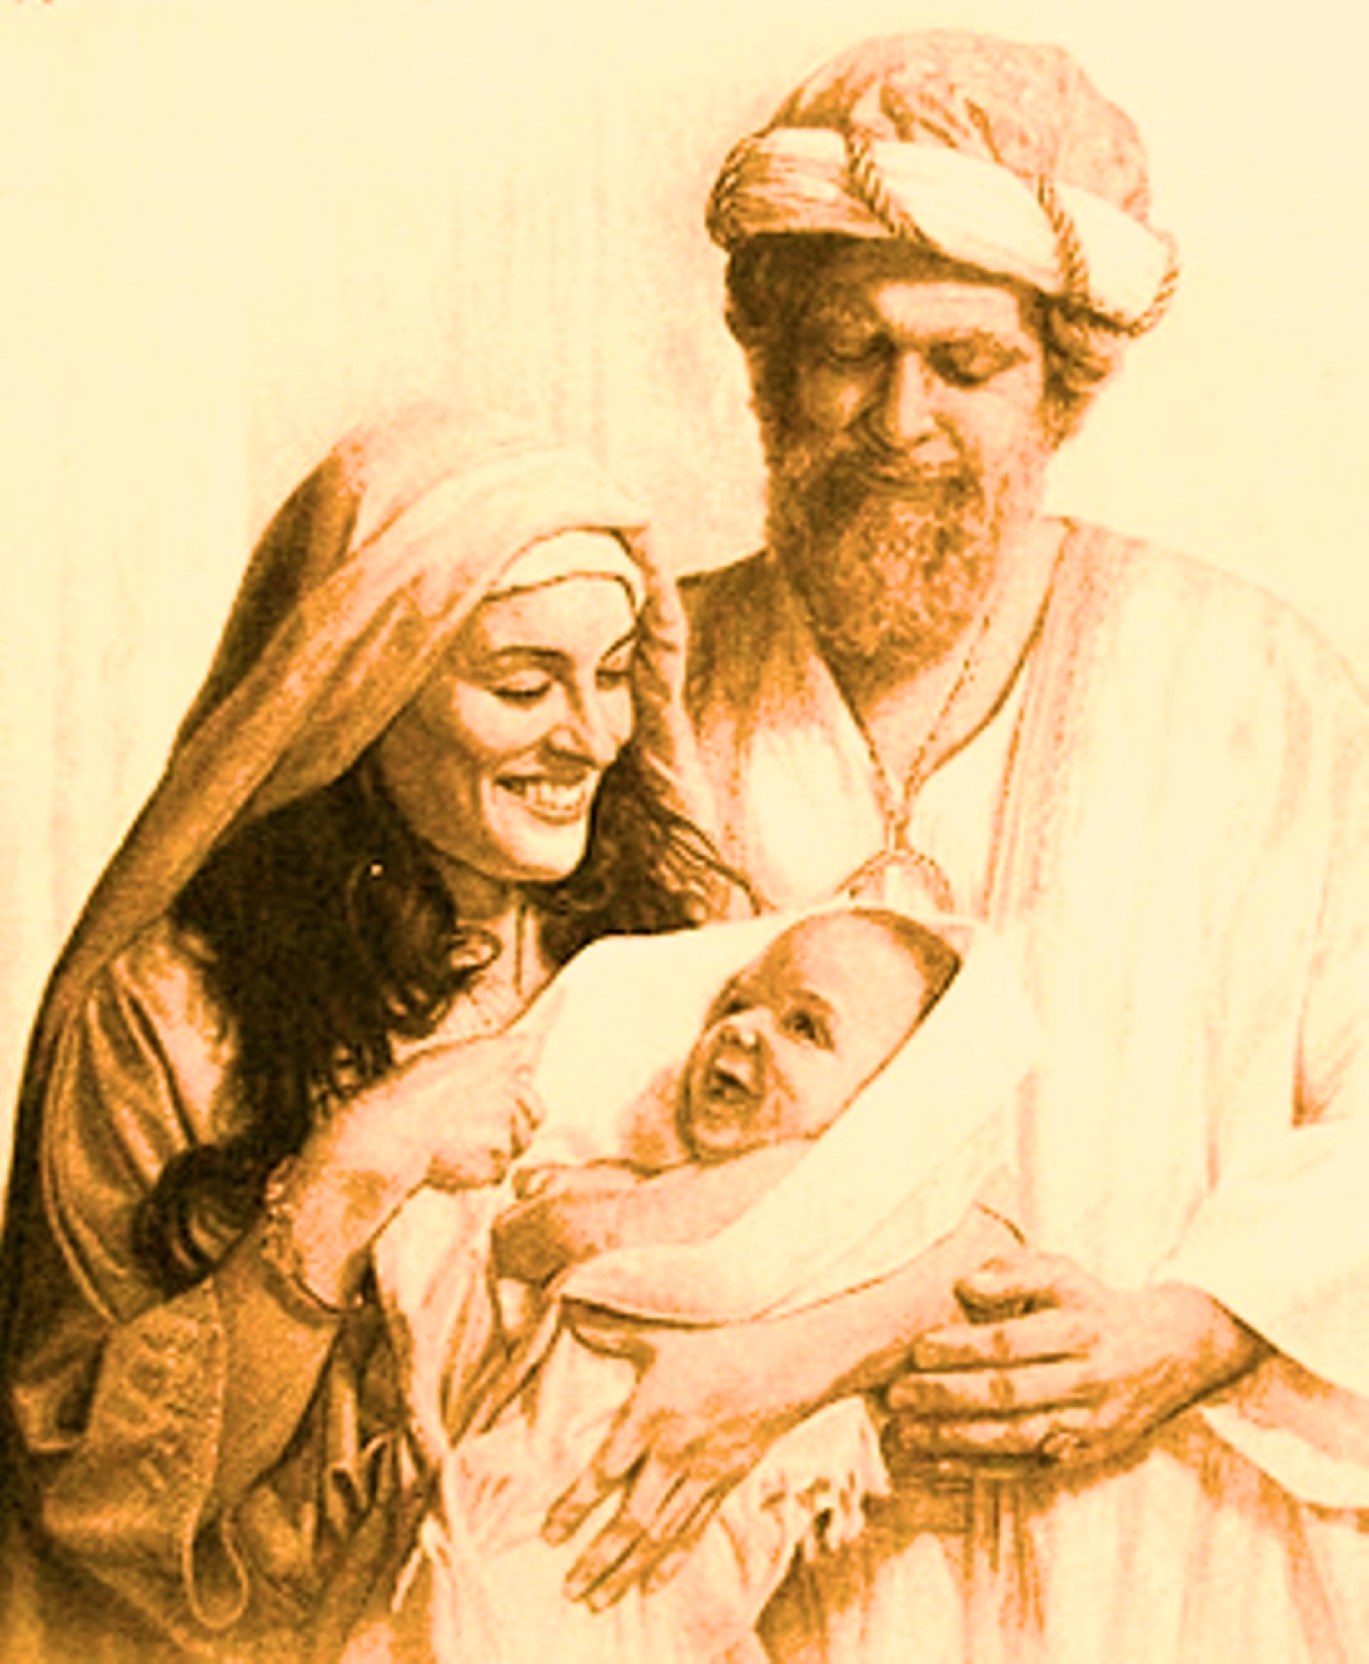
Healing Restoration (Chapter 4)
The Story of the Book of Ruth

Slide 7
The Story Within
The Story:
God’s Faithfulness To His People

Slide 8
The Lord’s Covenant Faithfulness.
Redemptive Restoration Through God’s People.
Divine Reversal and Transformation.

