Slide 1
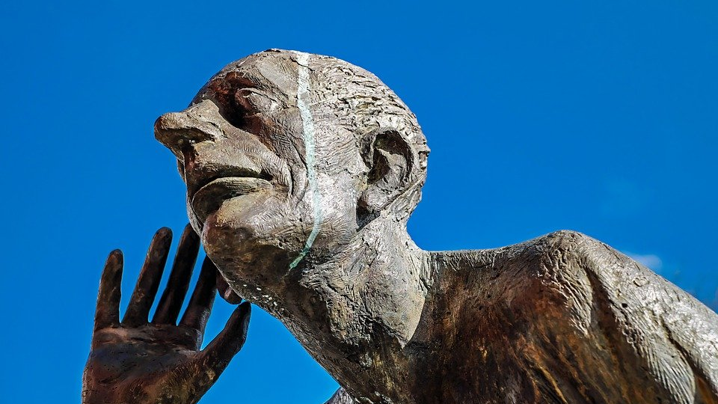
Praying to Be Heard

Slide 2
A Failure to Ask for Help
The foolishness of failing to seek help when it’s needed is no safeguard against committing this error…
Especially when we often are guilty of willfully refusing.

Slide 3
A Failure in Purity of Motive
Selfish prayers are a tainted and unhealthy offering that God will reject.
Their prayers were focused entirely on the benefits for self; brethren were left out of the picture, and ultimately driven further away.

Slide 4
A Failure to Address Personal Sin
Continuing in willful sin makes us enemies to be opposed instead of children to be heard
We cannot hope for healing when we have not yet approached God with a recognition of our worldly behavior

Slide 5
Challenges
Are You Living as a Dwelling of the Spirit?
Are You Seeking Reconciliation with Brethren?

Slide 6
Praying to Be Heard

