Slide 2
Bridget Moynahan
Bridget Moynahan

Slide 3
Bridget Moynahan

Slide 4
Donnie Wahlberg

Slide 5
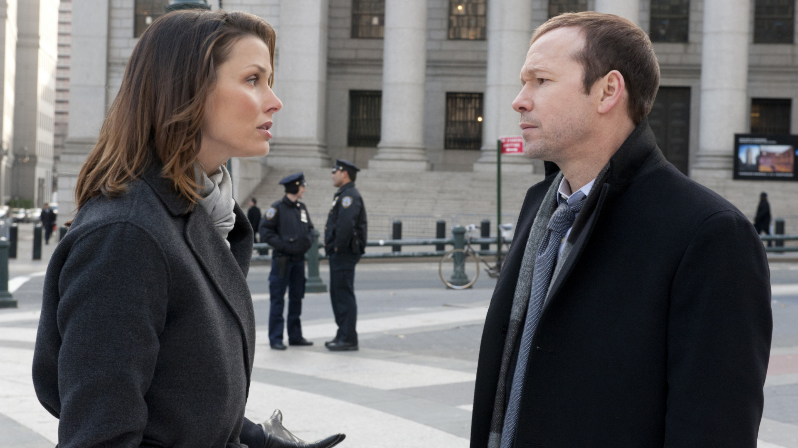

Slide 6
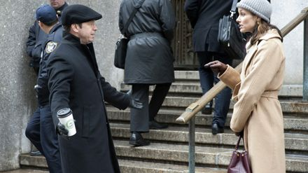

Slide 7
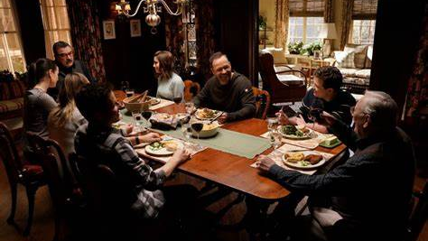

Slide 8
WHO DOES THIS SORT OF THING IN REAL LIFE?

Slide 9
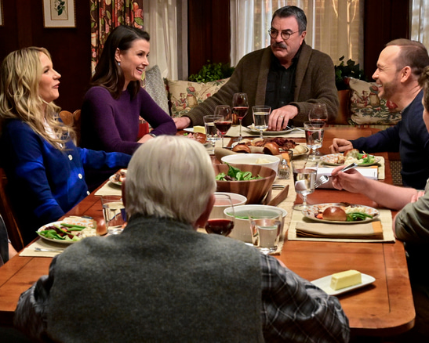
WHY CAN’T IT BE THIS EASY IN REAL LIFE?
MAYBE IT IS

Slide 10
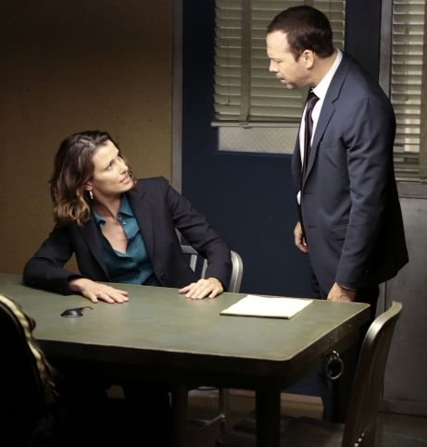
RELATIONSHIPS CAN BE DIFFICULT

Slide 11
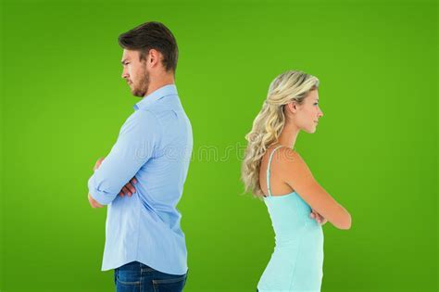
BECAUSE OF HARSH DISAGREEMENTS AND HURT FEELINGS

Slide 12
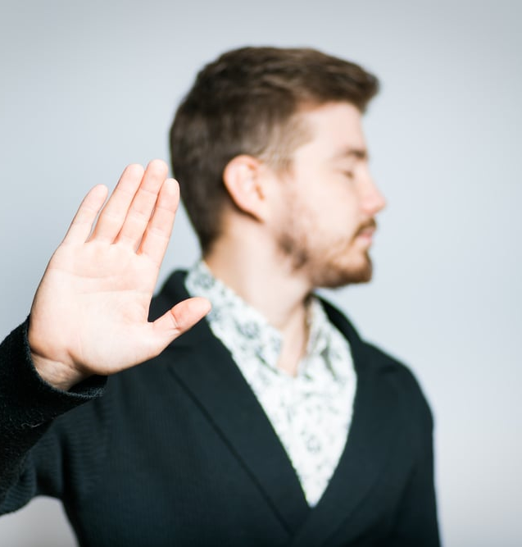
IT’S IMPOSSIBLE THAT NO OFFENCES SHOULD COME
LUKE 17.1

Slide 13
THIS IS WHY WE MUST RESPOND IN THE WAY THAT IS PLEASING TO THE LORD

Slide 14
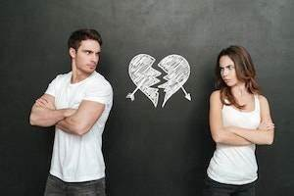
WORSE THINGS WILL HAPPEN IF THINGS ARE NOT QUICKLY RESOLVED

Slide 15
LACK OF COMMUNICATION

Slide 16
WE MUST COMMUNICATE IN SUCH A WAY THAT WE CAN PUT THINGS IN THE PAST AND MOVE FORWARD IIN A POSITIVE WAY

Slide 17
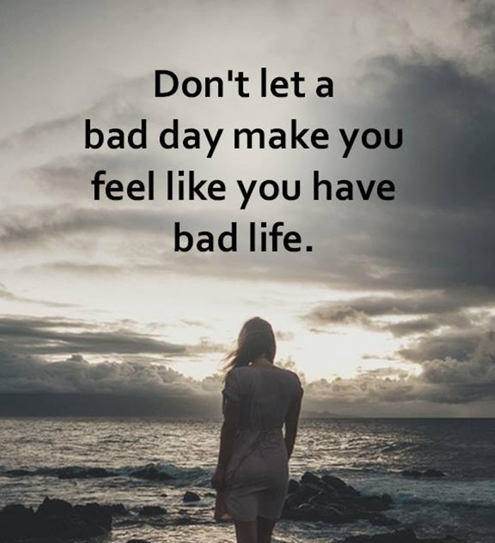
I’M SORRY – PLEASE ACCEPT MY APOLOGY

Slide 18
IT’S IMPOSSIBLE THAT NO OFFENCES SHOULD COME
LUKE 17.1

Slide 19
Therefore, as God’s chosen people, holy and dearly loved, clothe yourselves with compassion, kindness, humility, gentleness and patience.
COLOSSIANS 3.12 - NIV

Slide 20
Make allowance for each other’s faults, and forgive anyone who offends you. Remember, the Lord forgave you, so you must forgive others. NLT
COLOSSIANS 3.13 – NEW LIVING TRANSLATION

Slide 21
In addition to all these things put on love, which is the perfect bond of unity.
COLOSSIANS 3.14 - NASB

Slide 22
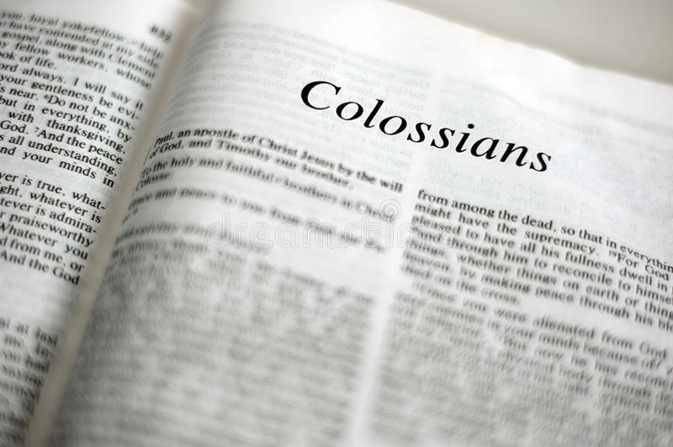
forbearing one another, and forgiving each other, if any one with any- one may have a quarrel, as also the Christ did forgive you -- so also ye
COLOSSIANS 3.13 – YLT – YOUNG’S LITERAL TRANS.LATION

Slide 23
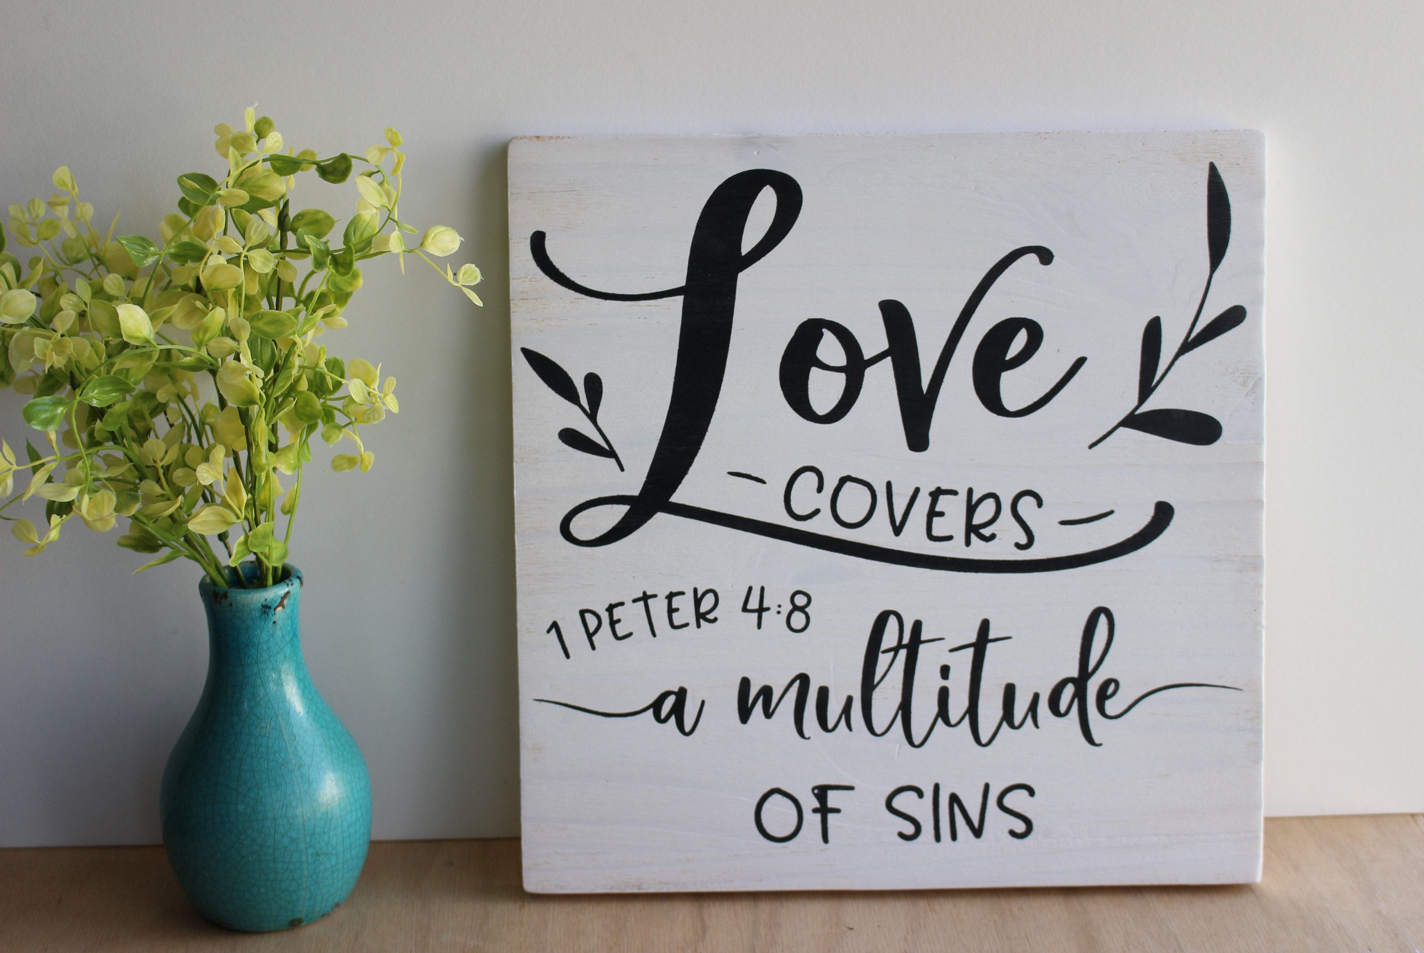
Above all, keep fervent in your love for one another, because love covers a multitude of sins. NASB
1 PETER 4.8

Slide 24
forbearing one another, and forgiving each other, if any one with any- one may have a quarrel, as also the Christ did forgive you -- so also ye
COLOSSIANS 3.13 – YLT – YOUNG’S LITERAL TRANS.

Slide 25
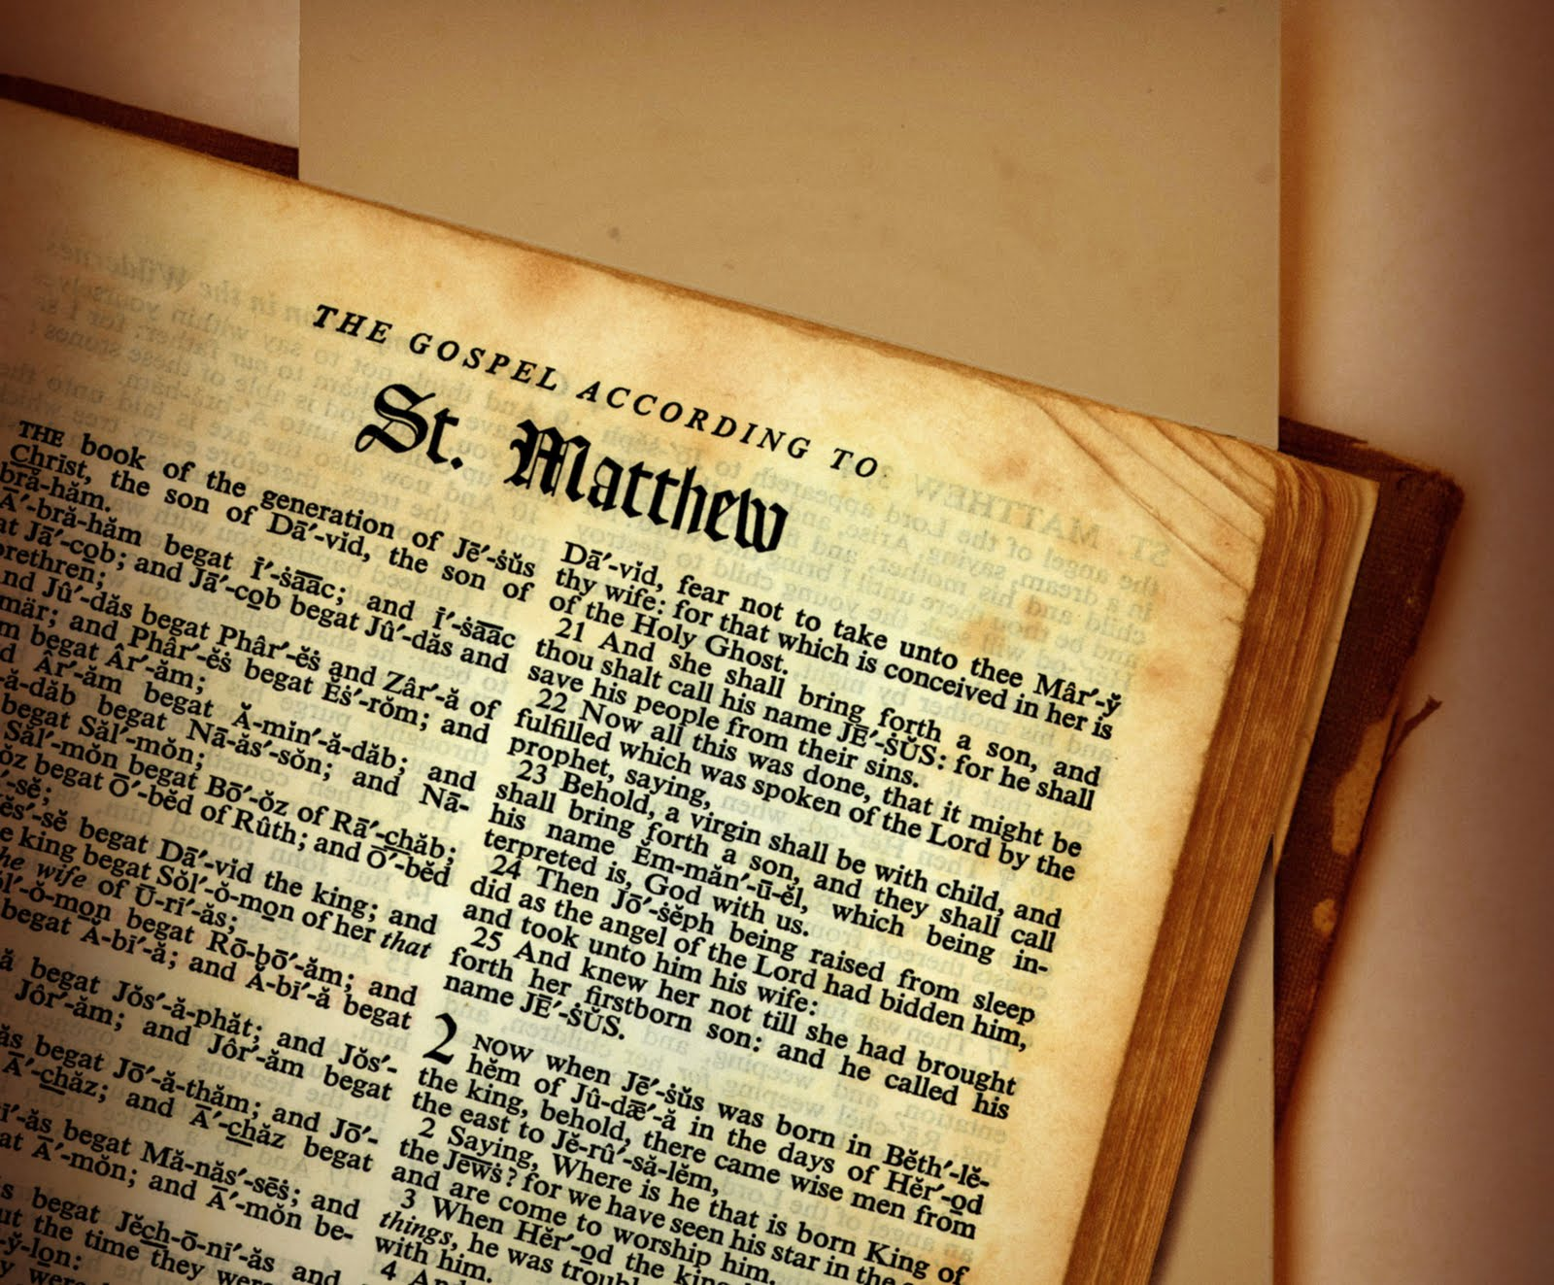
For if you forgive men their trespasses, your heavenly Father will also forgive you. ¹⁵ But if you do not forgive men their trespasses, neither will your Father forgive your trespasses.
MATTHEW 6.14-15 NJKV

Slide 26
And forgive us our debts, as we also have forgiven our debtors.
post·script
[ˈpōs(t)ˌskript]
NOUN
an additional remark at the end of a letter, after the signature and introduced by “P.S.”:
"he added a postscript: “Leaving tomorrow.”"
SIMILAR:afterthought
PS
MATTHEW 6.12 NASB

Slide 28
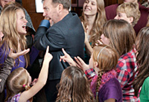
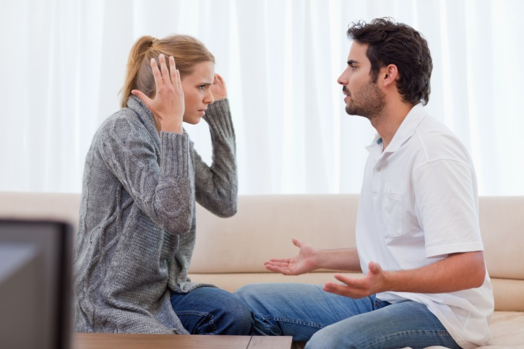
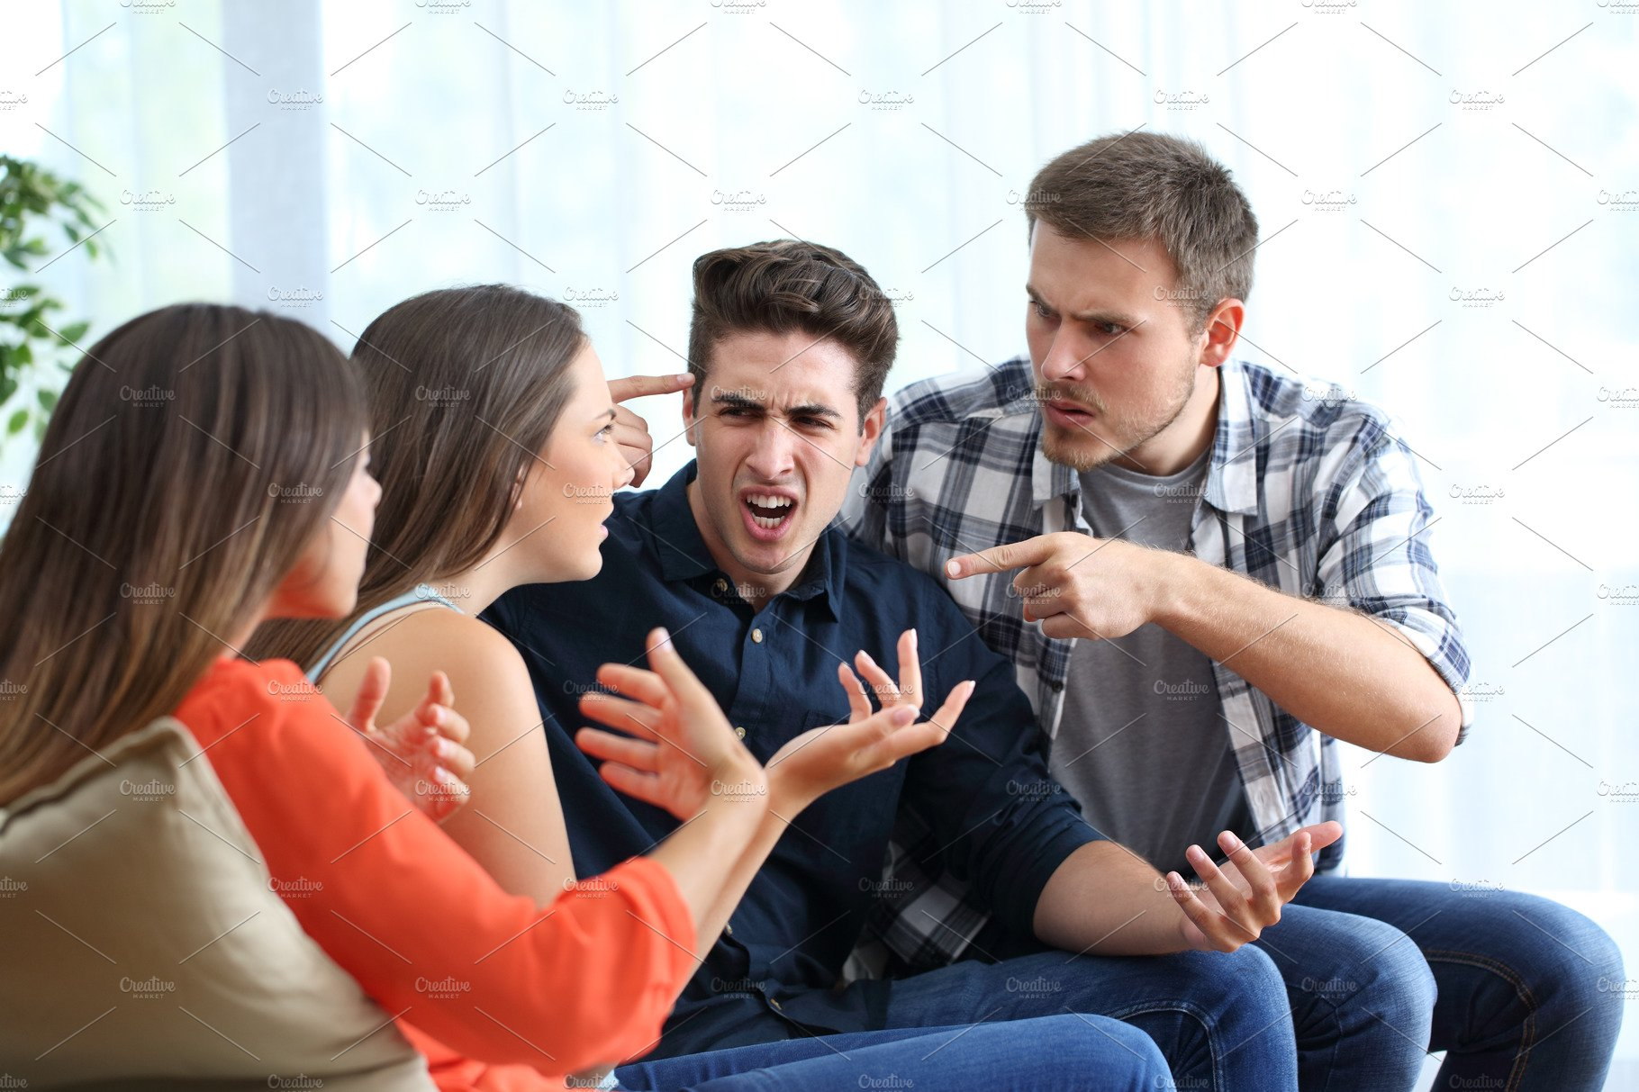
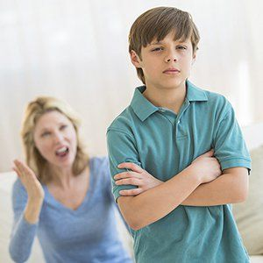
INSULTS AND DISAGREEMENTS HAVE THE POWER TO END RELATIONSHIPS

Slide 29
BECAUSE OF HURTS – INSULTS AND DISAGREEMENTS
TENSION - OCCASIONALLY MAY EVEN MAKE ITS WAY TO THE DINNER TABLE

Slide 30
Lack of communication

Slide 31
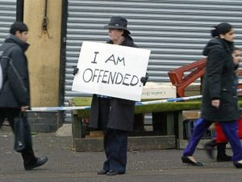
I’M SORRY – PLEASE ACCEPT MY APOLOGY

Slide 32
IT’S IMPOSSIBLE THAT NO OFFENCES SHOULD COME
LUKE 17.1

Slide 33
Make allowance for each other’s faults, and forgive anyone who offends you. Remember, the Lord forgave you, so you must forgive others. NLT
COLOSSIANS 3.13 – NEW LIVING TRANSLATION

