Slide 1
His name was Joses/Joseph
The book of Acts is where we learn most of what we know about a man we know as Barnabas.

Slide 2
His name was Joses/Joseph
I want to use Barnabas – and some of what we know about him to “encourage” you.

Slide 3
His name was Joses/Joseph
Barnabas is what we call his nickname. Given to him by the apostles.

Slide 4
His name was Joses/Joseph
ACTS 4.33-37
We learn about the generosity of Barnabas.

Slide 5
His name was Joses/Joseph
ACTS 9.20-27
We learn about that Barnabas had to vouch for the apostle Paul.

Slide 6
His name was Joses/Joseph
ACTS 11.19-24
Barnabas hears of the spread of the Gospel – and he wants to go help teach and encourage.

Slide 7
His name was Joses/Joseph
ACTS 11.24
“for he was a good man, and full of the Holy Spirit and of faith.”

Slide 8
His name was Joses/Joseph
ACTS 11.24
“for he was a good man, and full of the Holy Spirit and of faith.”

Slide 9
His name was Joses/Joseph
ACTS 11.24
“for he was a good man, and full of the Holy Spirit and of faith.”

Slide 10
His name was Joses/Joseph
LOVE – JOY – PEACE – PATIENCE – KINDNESS – GOODNESS – FAITHFULNESS – GENTLENESS – SELF-CONTROL
GALATIANS 5.22-24

Slide 11
His name was Joses/Joseph
LOVE – JOY – PEACE – PATIENCE – KINDNESS – GOODNESS – FAITHFULNESS – GENTLENESS – SELF-CONTROL
GALATIANS 5.22-24

Slide 12
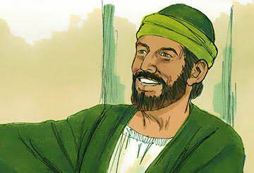
His name was Joses/Joseph
A good man –
An encourager of many –
A giver – i.e., benevolent –
A worker in the Lord’s Kingdom -
BARNBAS WAS -

Slide 13
His name was Joses/Joseph
I. All of us need to be encouraged.

Slide 14
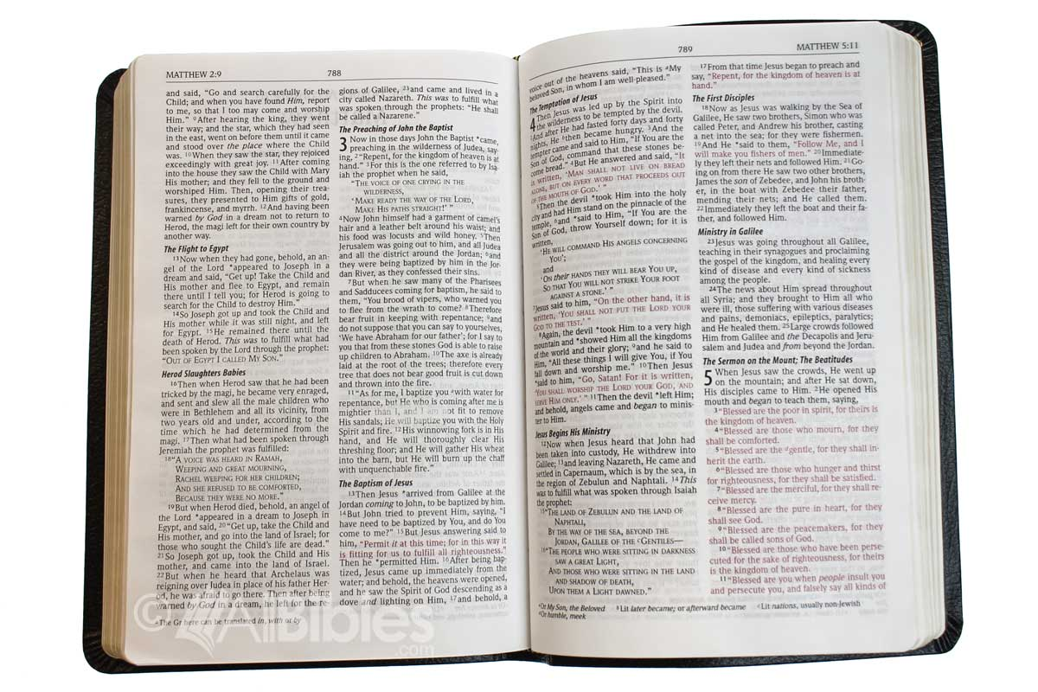
His name was Joses/Joseph
¹ Man born of woman is short of days and full of trouble. Man, that is born of a woman, Is of few days, and full of trouble. For a mortal born of a woman is short lived, and full of wrath. Life is short and sorrowful for every living soul.
JOB 14.1

Slide 15
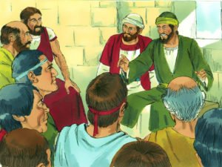
His name was Joses/Joseph
- Sometimes we may need help financially- but – all-of-the time-we need people to help build us up in the most Holy Faith.

Slide 16
- We also need encouragers and encouragement when things are going well for us. Times of prosperity can challenger our dependence on the Lord.

Slide 17
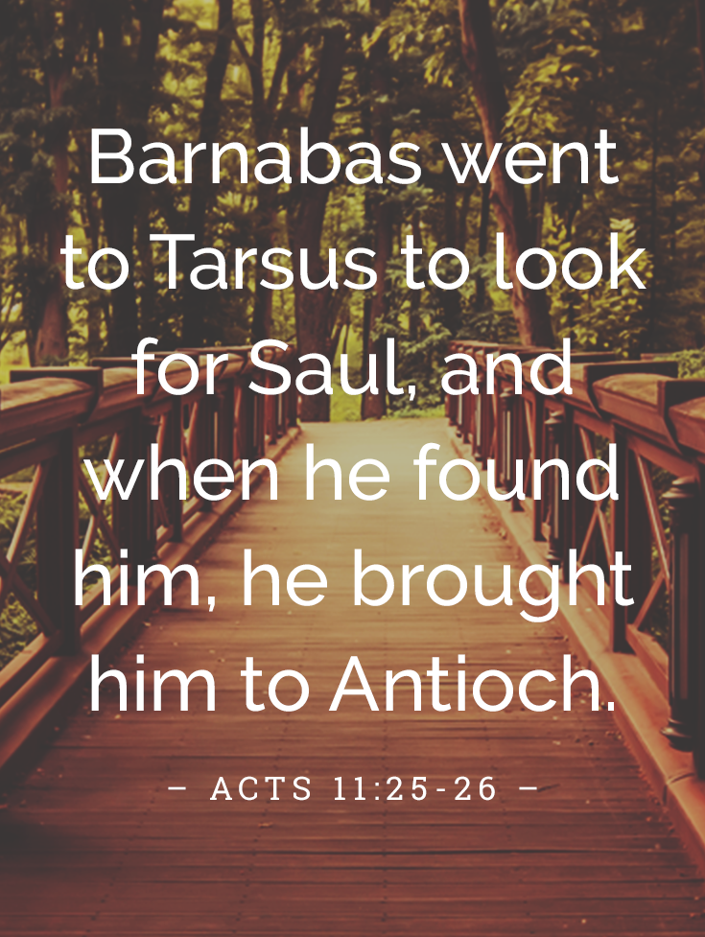
His name was Joses/Joseph
Barnabas was also willing to risk his good name and reputation for Saul of Tarsus. [it was the right thing to do]
ACTS 11.25-26

Slide 18
His name was Joses/Joseph
When you begin to think that your work in the Lord’s Kingdom isn’t valuable – go back and read about Barnabas.

Slide 19
His name was Joses/Joseph
A good man –
An encourager of many –
A giver – i.e., benevolent –
A worker in the Lord’s Kingdom -
YOU CAN FOR CERTAIN BE AN ENCOURAGER OF OTHERS-

Slide 20
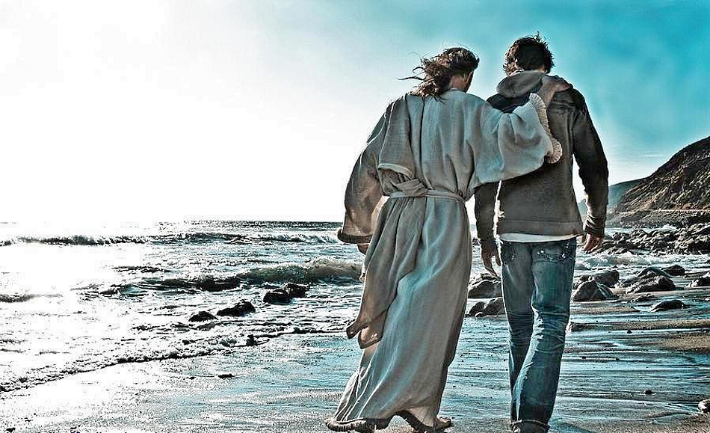
His name was Joses/Joseph
II. How Barnabas lived his life.

Slide 21
His name was Joses/Joseph
^{I} In the same way, you wives, be subject to your own husbands so that even if any of them are disobedient to the word, they may be won over without a word by the behavior of their wives, ² as they observe your pure and respectful behavior.
1 PETER 3.1-2

Slide 22
His name was Joses/Joseph
^{I} In the same way, you wives, be subject to your own husbands so that even if any of them are disobedient to the word, they may be won over without a word by the behavior of their wives, ² as they observe your pure and respectful behavior.
1 PETER 3.1-2

Slide 23
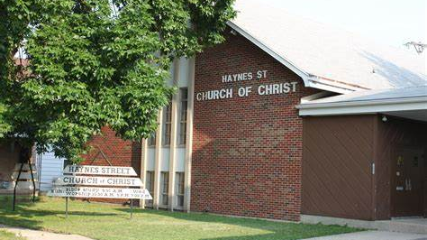
Sister ANNIE’S example.

Slide 24
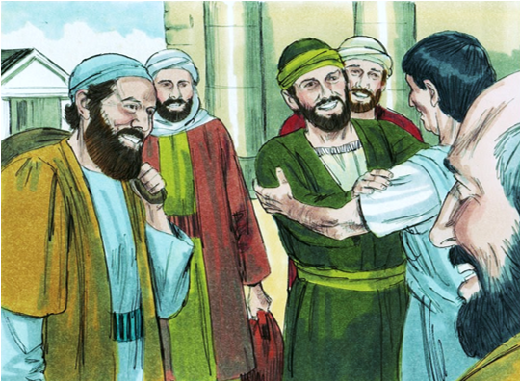
His name was Barnabas
III. What can we/you do?

Slide 25
You can be an encourager.

