Slide 3
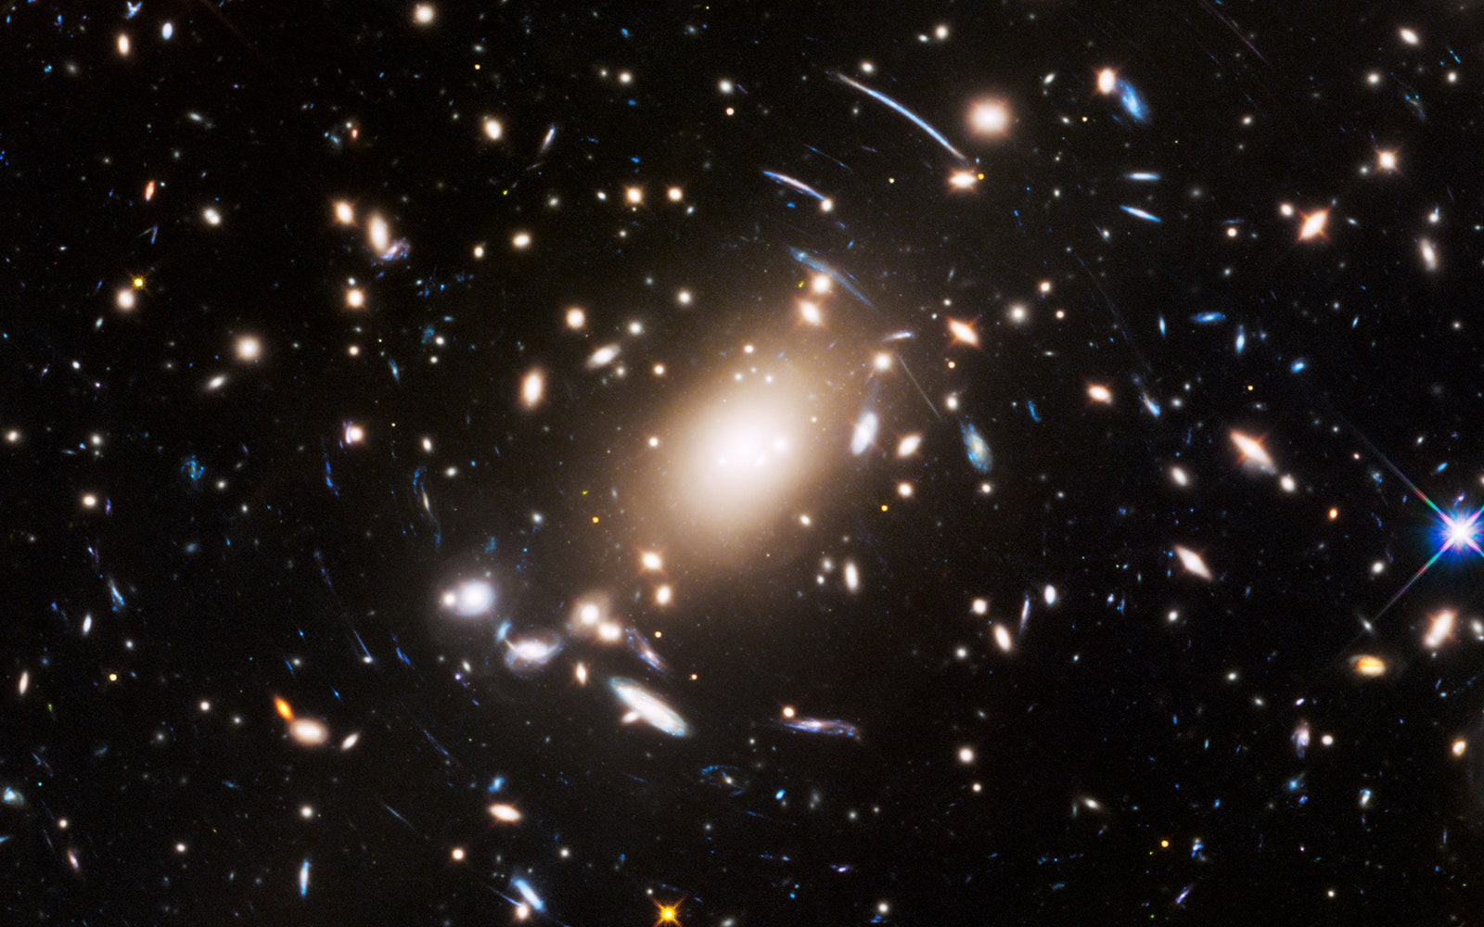

Slide 4
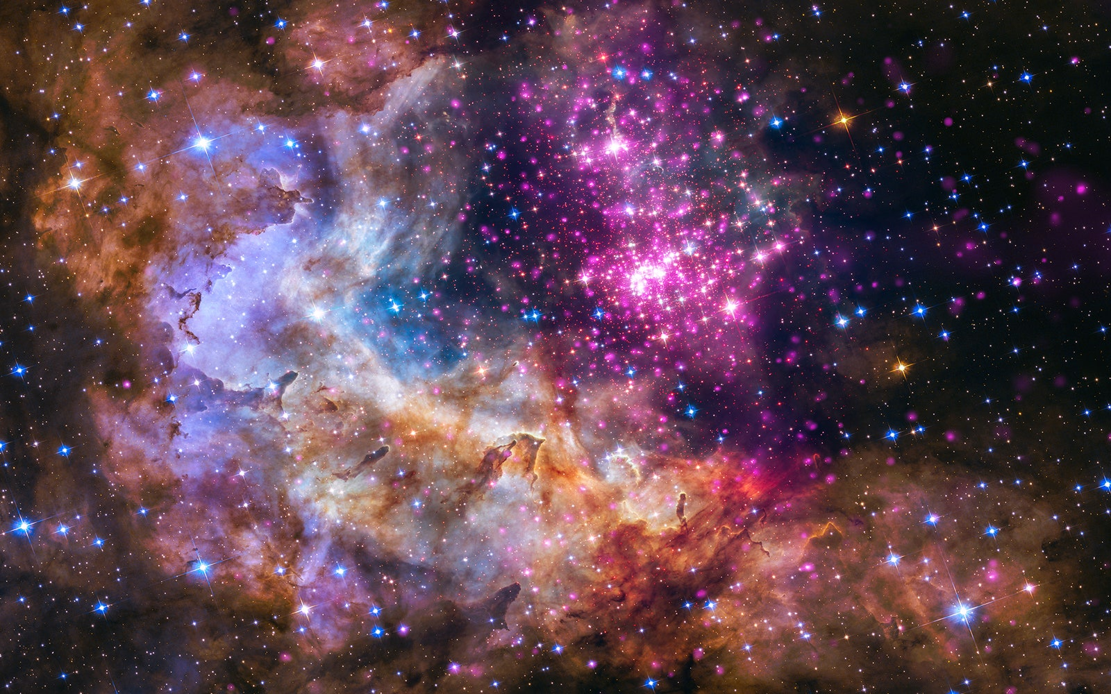

Slide 5
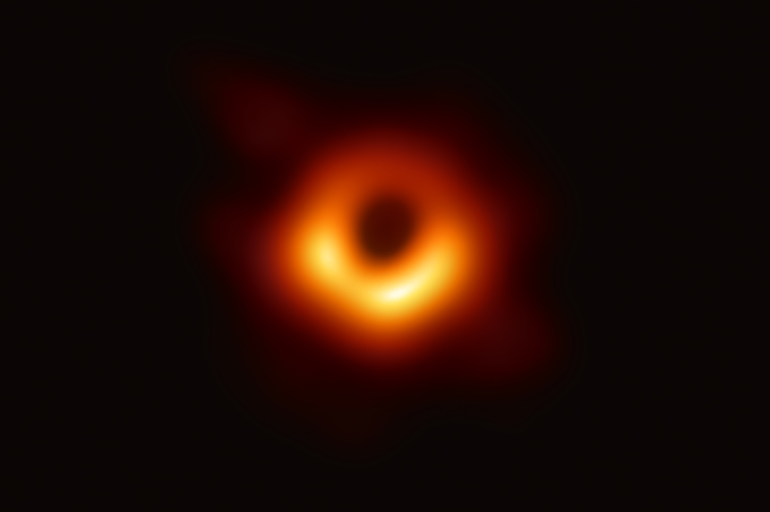

Slide 6
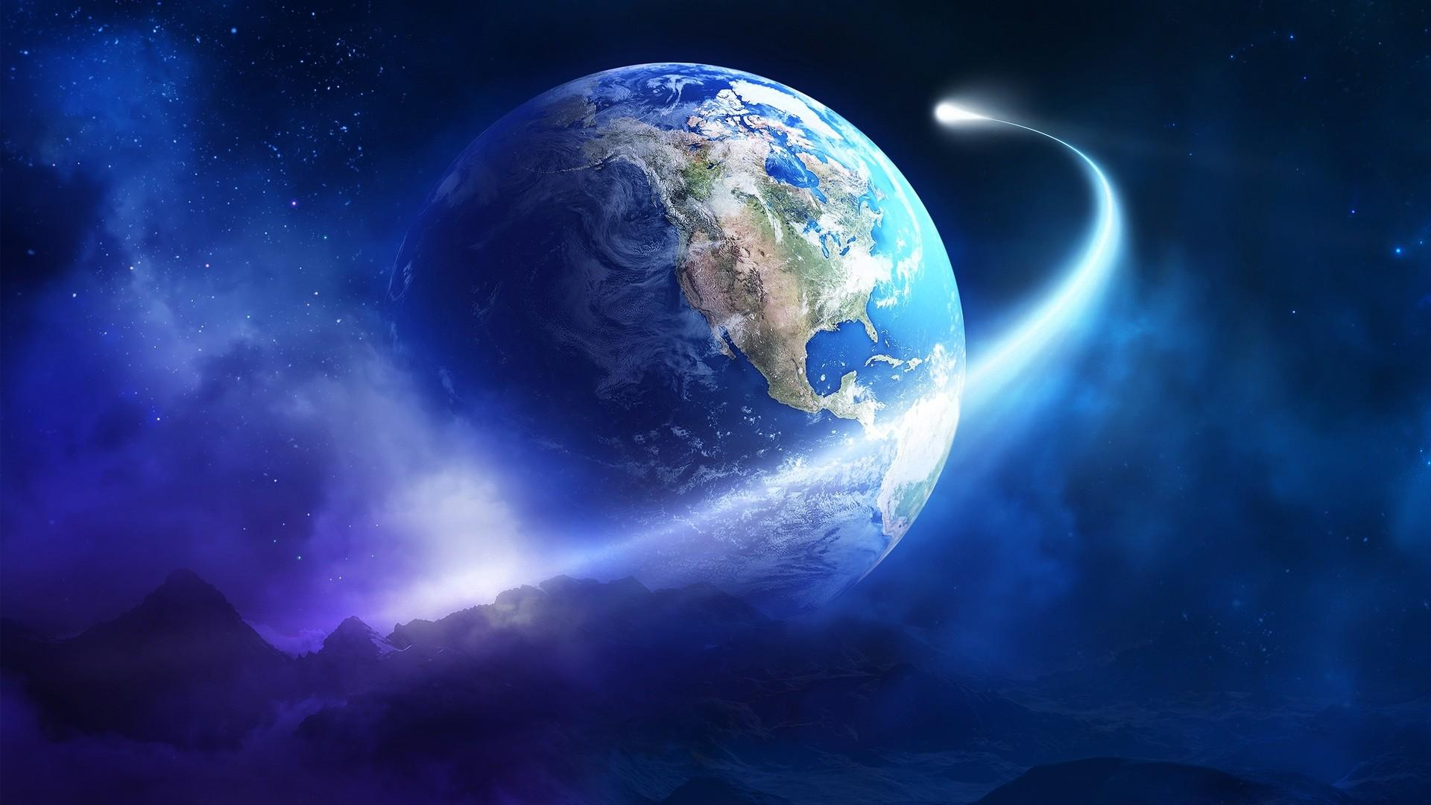
OUR GOD HE IS ALIVE

Slide 8
ACTS 17 – The Sermon on Mars Hill
Our God is Creator (v. 24)
Our God is the Lord of heaven and earth (v. 24)
Our God is the Giver of all things (v. 25)
Our God made mankind (v. 26)
Our God is near (v. 27)
Our God sustains life (v. 28)
Our God shapes and is not shaped (v. 29)
Our God judges (v. 31)

Slide 9
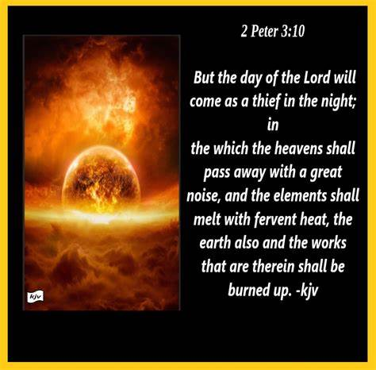

Slide 10
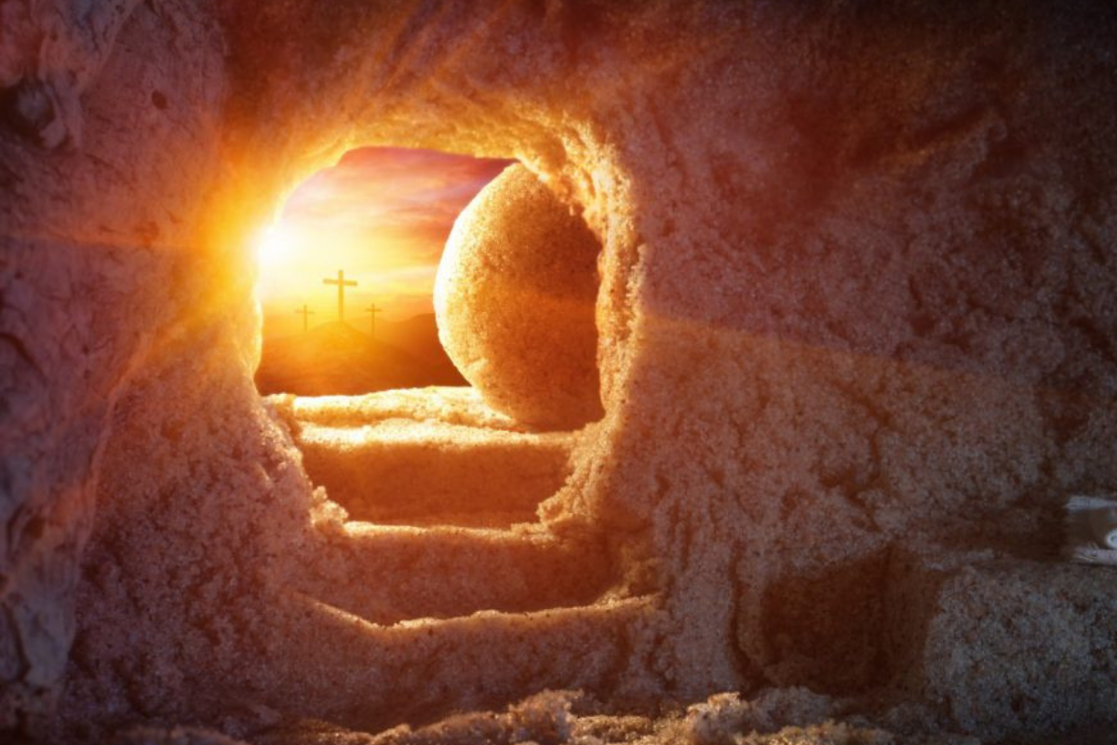
OUR GOD RAISES THE DEAD! (Acts 17: 31)

